Slide 1
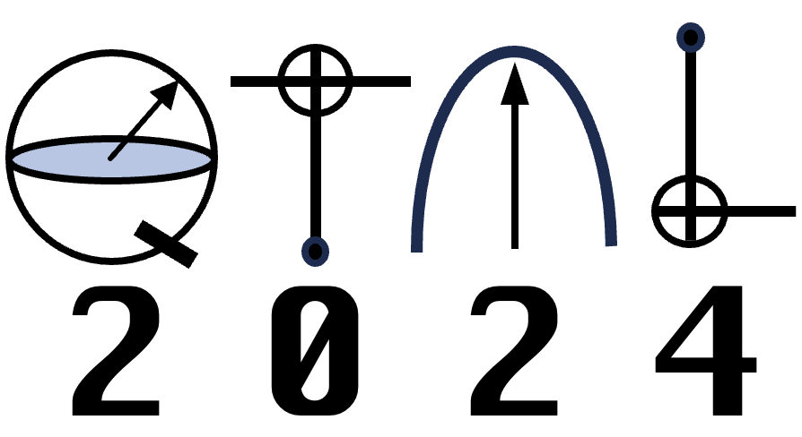
Welcome to the
8th International Conference on
Quantum Techniques in Machine Learning

Slide 2
Acknowledgement of Country
I would like to acknowledge the Traditional Owners of the land on which this conference is being held: the Wurundjeri Woi-wurrung and Bunurong peoples.
We recognise the unique place held by Aboriginal and Torres Strait Islander peoples as the original owners and custodians of the lands and waterways across the Australian continent, with histories of continuous connection dating back more than 60,000 years. We pay respect to their Elders past, present and future.

Slide 3
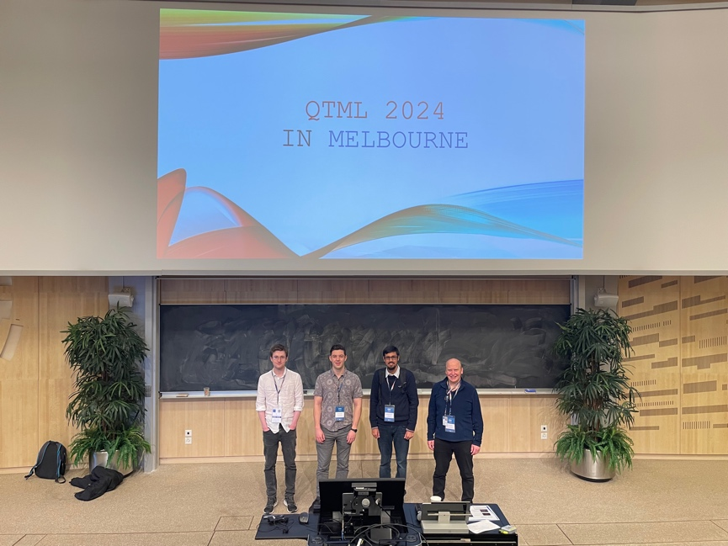
QTML 2024 in Melbourne
Quantum for High School
Australian QTML2024 presence: 80
Over 130 high school students!

Slide 4
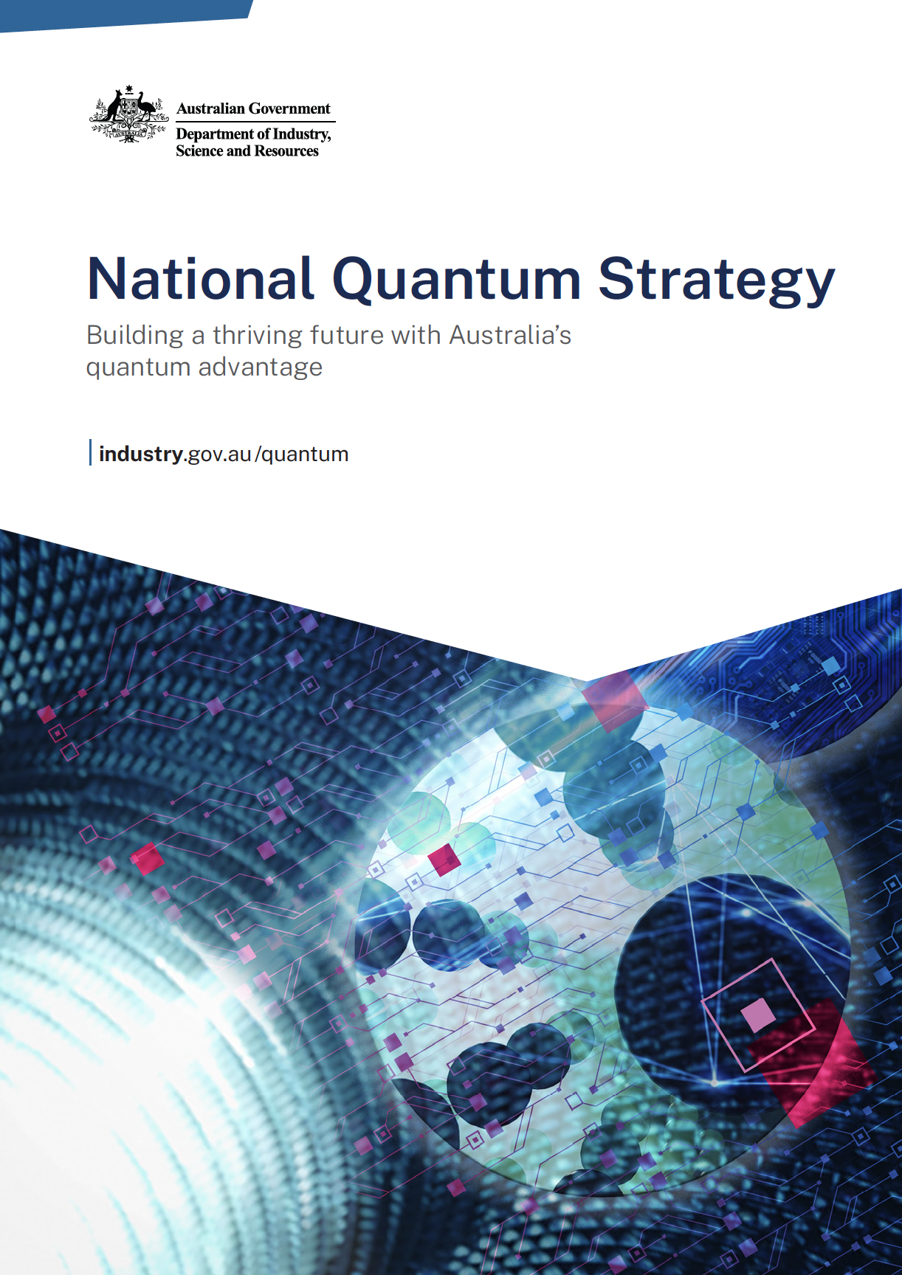
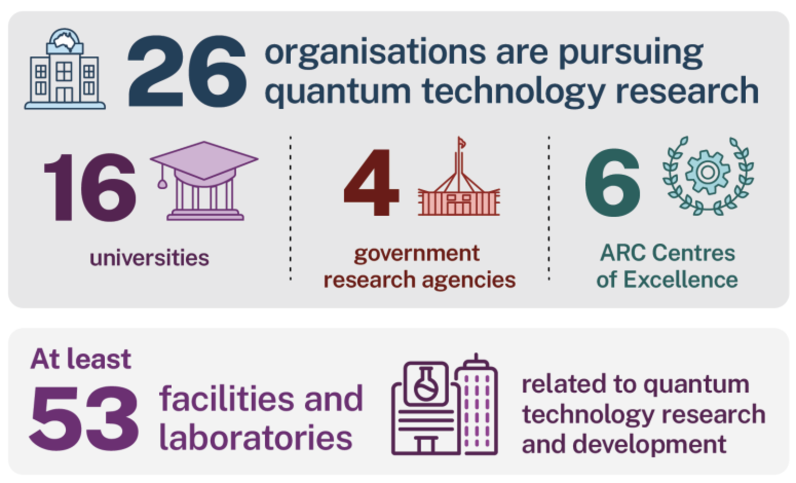
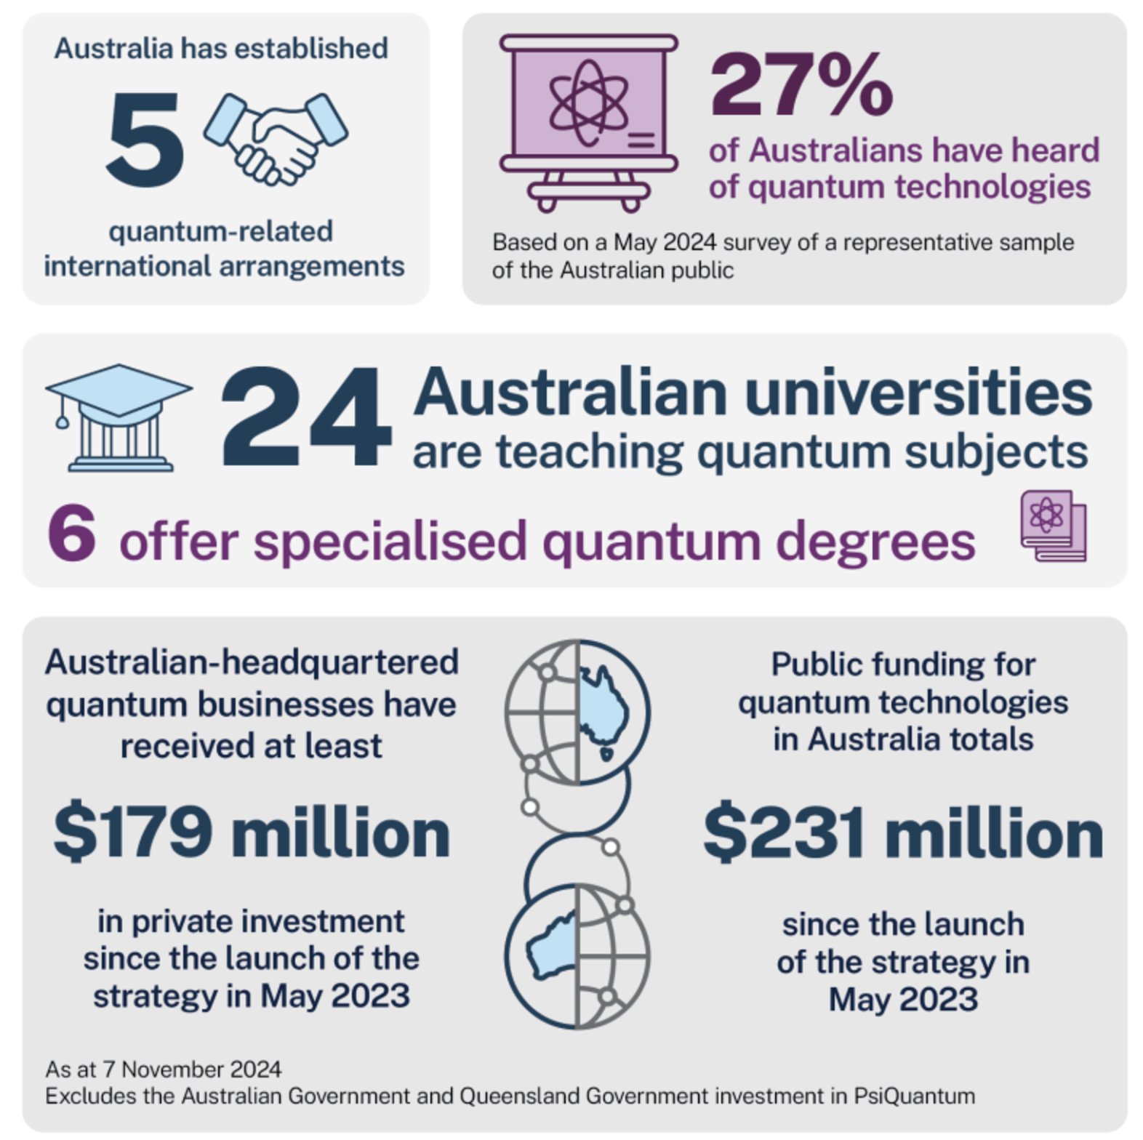
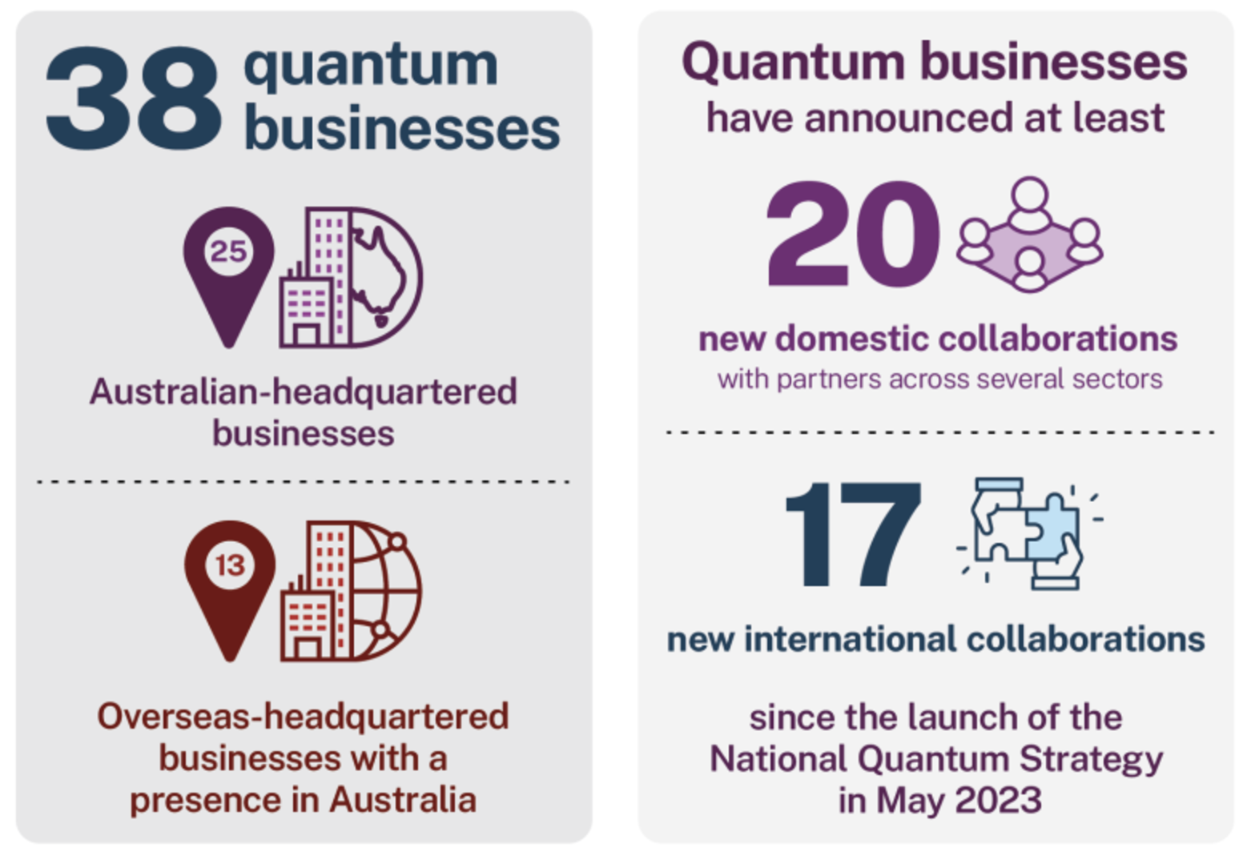
At a glance: Australia’s quantum ecosystem
https://www.industry.gov.au/publications/state-australian-quantum-report-2024/glance-australias-quantum-ecosystem

Slide 5
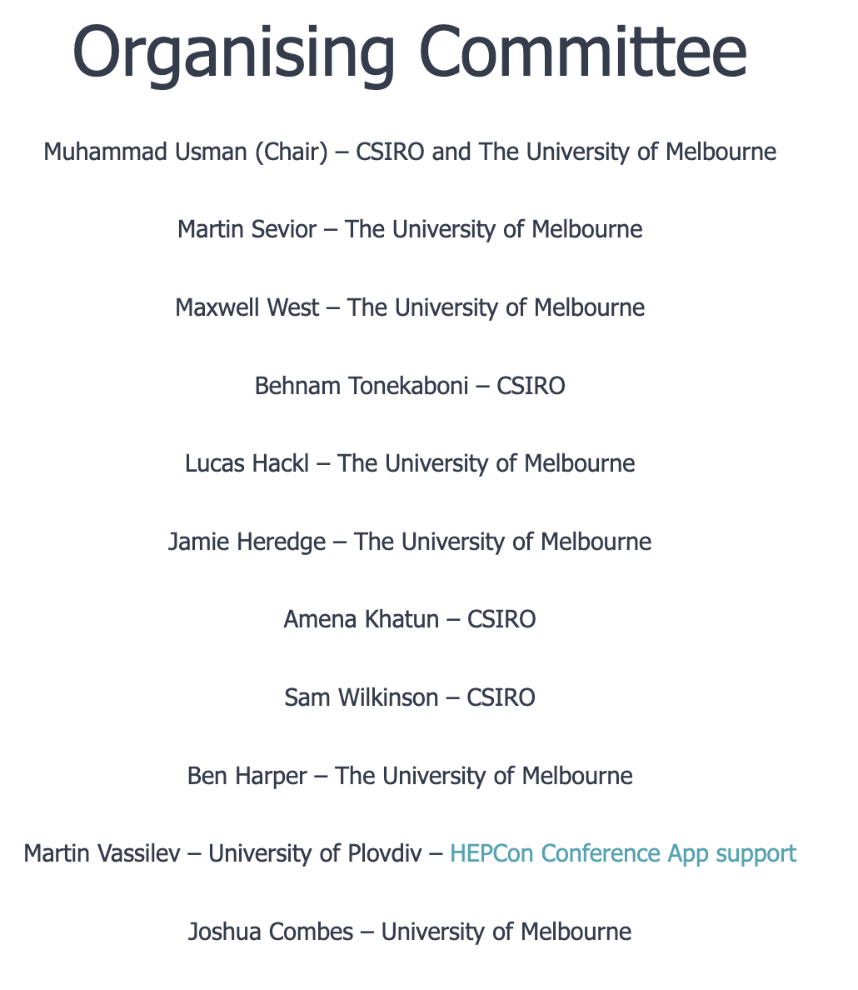
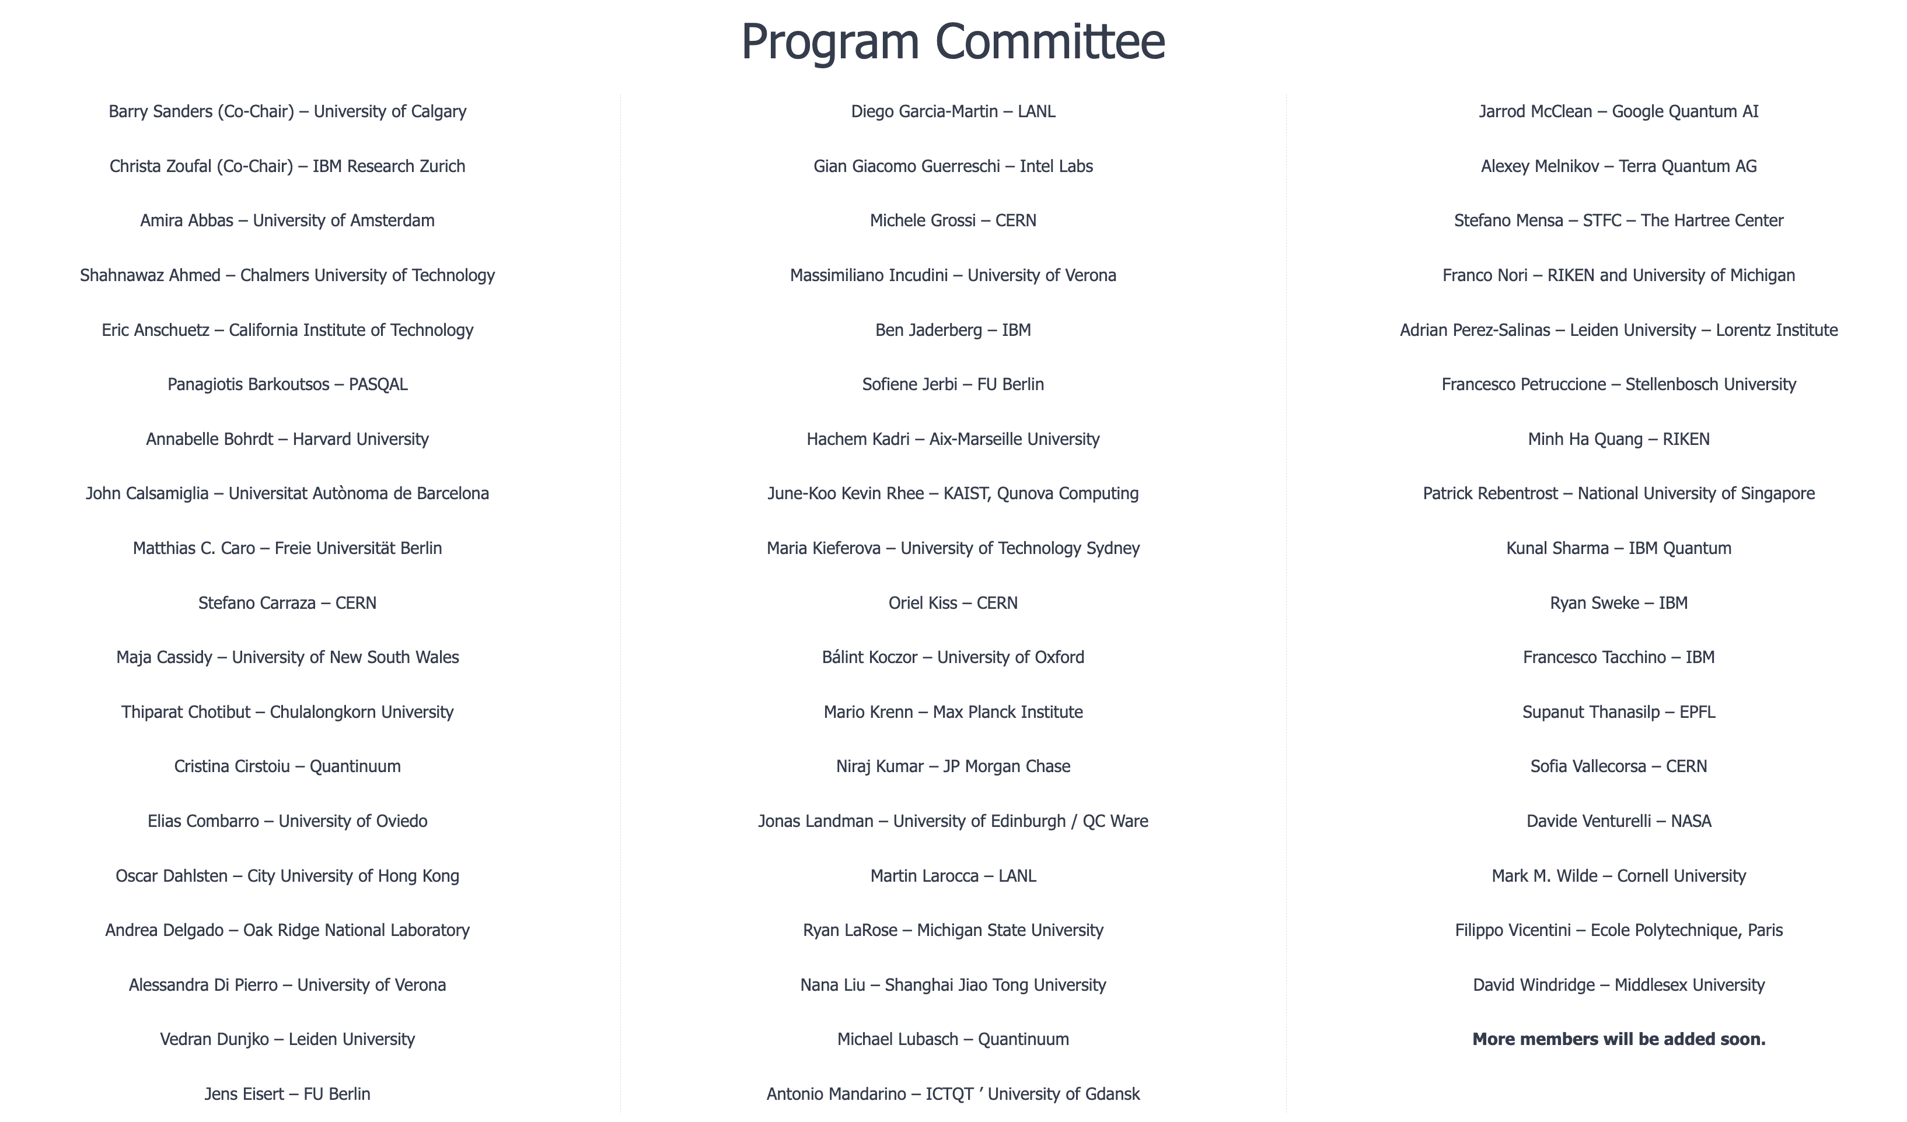
Conference Committees
Tutorial Speakers
Lloyd Hollenberg
Kristan Temme
Sergii Strelchuk
Martin Larocca
Francesco Tacchino

Slide 6
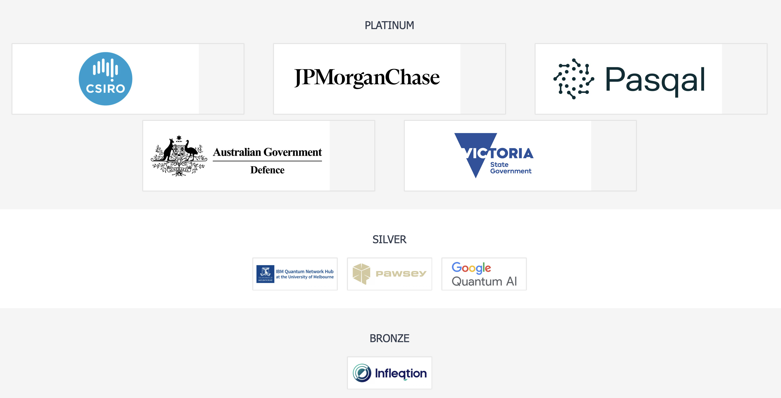
QTML 2024 Sponsors

Slide 7
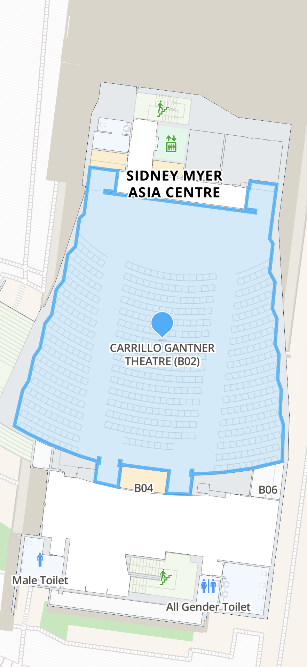
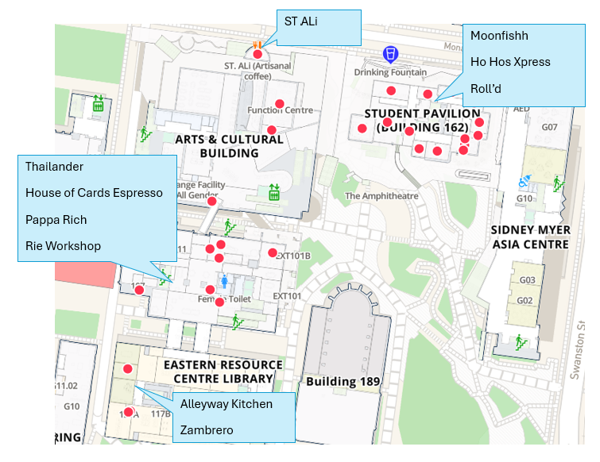
Some House Keeping Stuff…
Building plan
Fire exists
Access via lifts if stairs are problem.
Welcome Reception at Science Gallery this evening at 7 PM
HEPCON App for conference program
Lunch vouchers – everyone must have received vouchers for 5 days
Dinner tickets

Slide 8
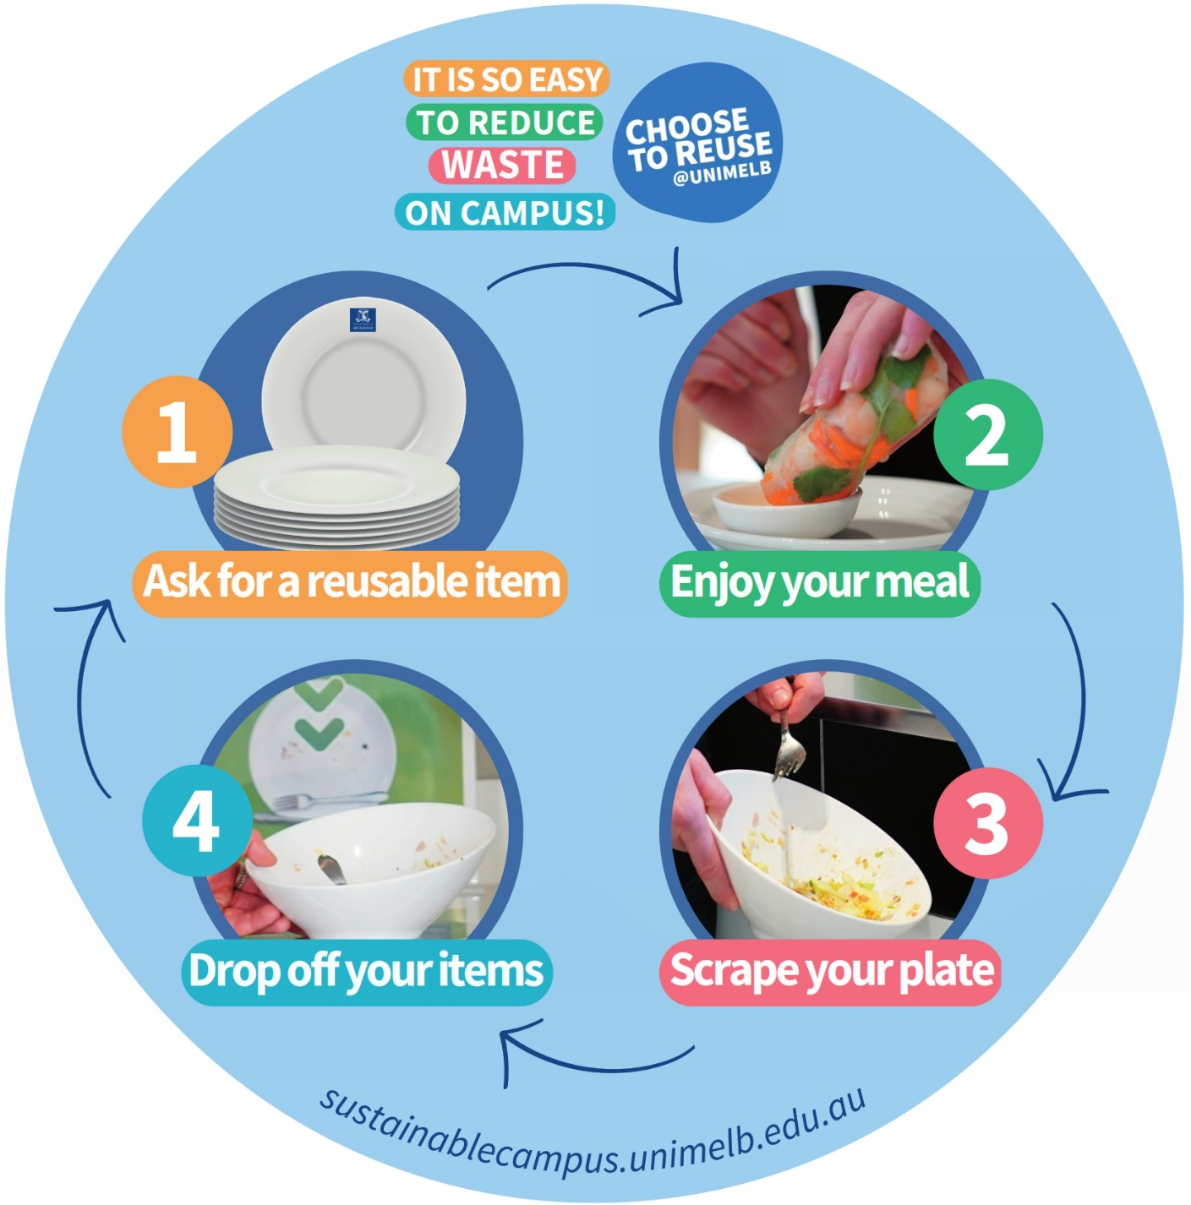
Choose to Reuse!
The Choose to Reuse (C2R) Plate Program is a free reusable dish service offered at the University of Melbourne.
The service allows staff, students and visitors to purchase enjoy food and drinks from retailers using reusable tableware.
Working towards zero waste.
As part of the University’s Sustainability Plan 2030.
Find out more at sustainablecampus.unimelb.edu.au

