Slide 1

Quantum Technologies at CSIRO (ψρ)
November 2024
Chris Vale (QT FSP Director)
chris.vale@csiro.au
https://research.csiro.au/qt/
https://www.csiro.au/quantum

Slide 2
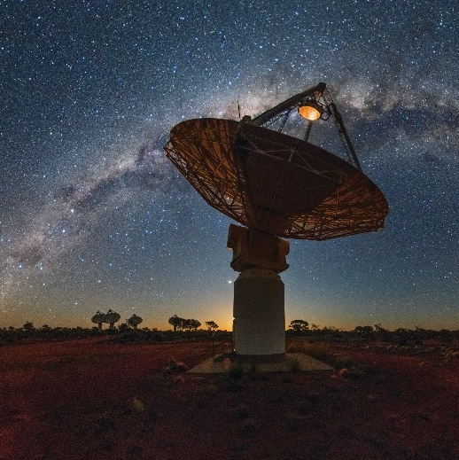
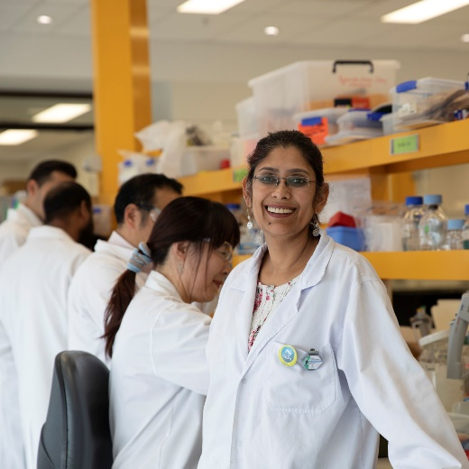
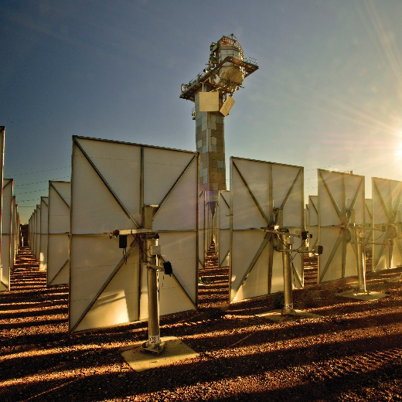
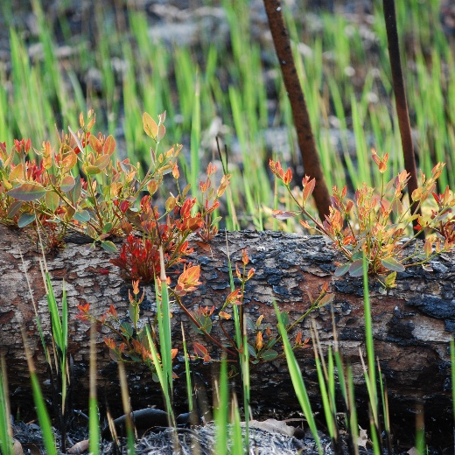
CSIRO: Who we are
Australia’s national science agency
One of the world’s largest multidisciplinary science and technology organisations
~6000 dedicated people working across ~50 sites globally
State-of-the-art national research infrastructure
We delivered
$10.2 billion of annual benefit to the nation
Notes:
Source: yearinrevew_web (2022)
Understand you will be coming to CSIRO on Weds and Dr Marcus Zipper will give some more detail and background on the organisation but… a few words for context…

Slide 3
Our purpose
We solve the greatest challenges through innovative science and technology
Notes:
Source: Pages 8 and 9 of CSIRO’s Annual Report 2020-21
Some example of CSIRO achievements are …
More broadly, we have identified 6 challenges as the areas of greatest importance to Australians. We solve these challenges through our portfolio of missions. Together, the challenges and missions drive Australia’s recovery and resilience following recent national crises.

Slide 4

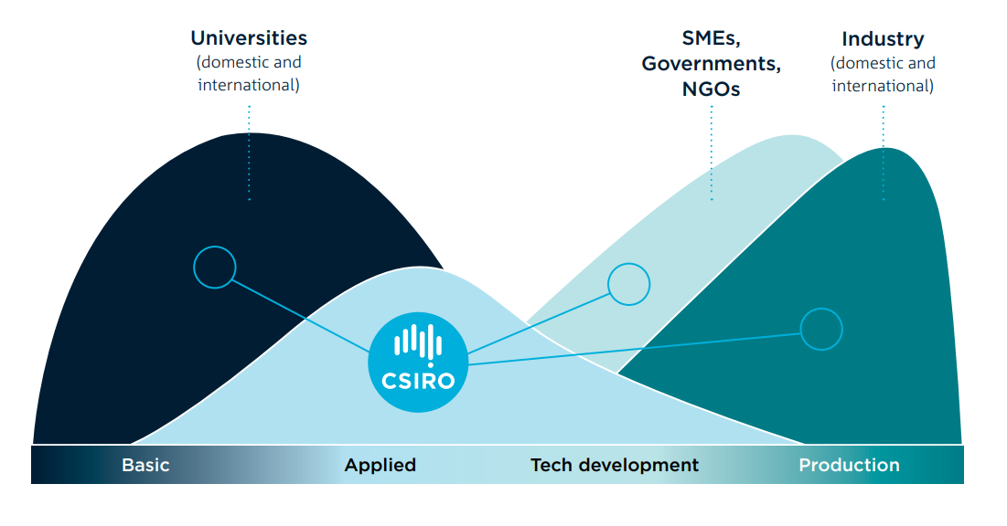

Our place in the Innovation Ecosystem

Slide 5



CSIRO Quantum Technologies Future Science Platform
Around 150 people working in quantum tech and adjacent areas! ​
Engagement
Help to establish an Australian quantum technology industry with government, academia and commercial organizations
Connect with universities, industry and government to inform policy that supports quantum capability development
Identify roles and opportunities for CSIRO based on our unique position in the quantum technology ecosystem
Education and Awareness
Foster a new generation of cross-disciplinary quantum experts and capability
Build awareness and identify opportunities for new quantum technology research
Educate and inform internally and externally on quantum technology end use and understand domain challenges
Science
Deliver cutting-edge quantum technology research for long-term practical outcomes
Support focussed quantum research areas that are aligned with existing and emerging capabilities
Establish collaborations to enhance our research potential

Slide 6
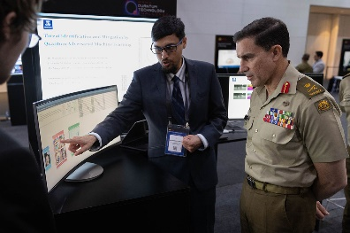
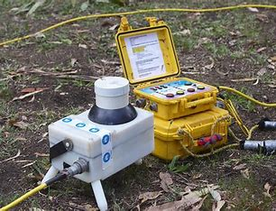
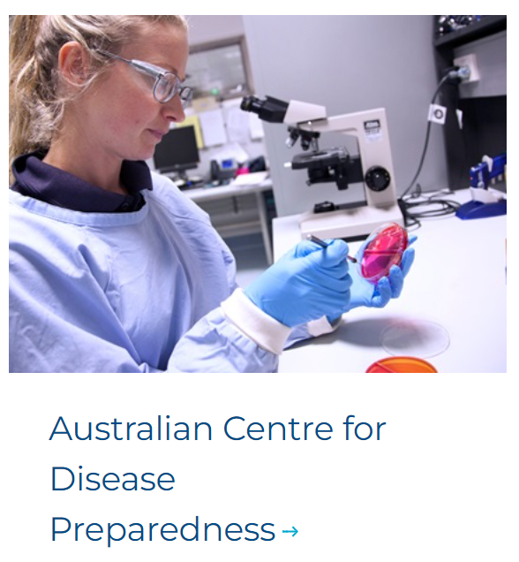
Quantum Research @ CSIRO
Sensing and Devices
Algorithms and Security
Emerging Research
Quantum sensors and system integration
Superconducting quantum devices
(magnetometry, RF/THz)
Quantum biotech, NV- diamond sensors (NMR / magnetometry)
PNT - Quantum assured positioning (optics)
Quantum algorithms and applications
Quantum machine learning
Full-stack quantum software platform
Post-Quantum Cryptography, QKD responsible use
Quantum readiness
Quantum testbeds (computing / comms)
Quantum batteries
Quantum communications hardware
Quantum supply chain solutions
    https://www.csiro.au/en/research/technology-space/quantum-technology
    https://research.csiro.au/ri/understanding-quantum-readiness-across-australian-industry-sectors/

Slide 7
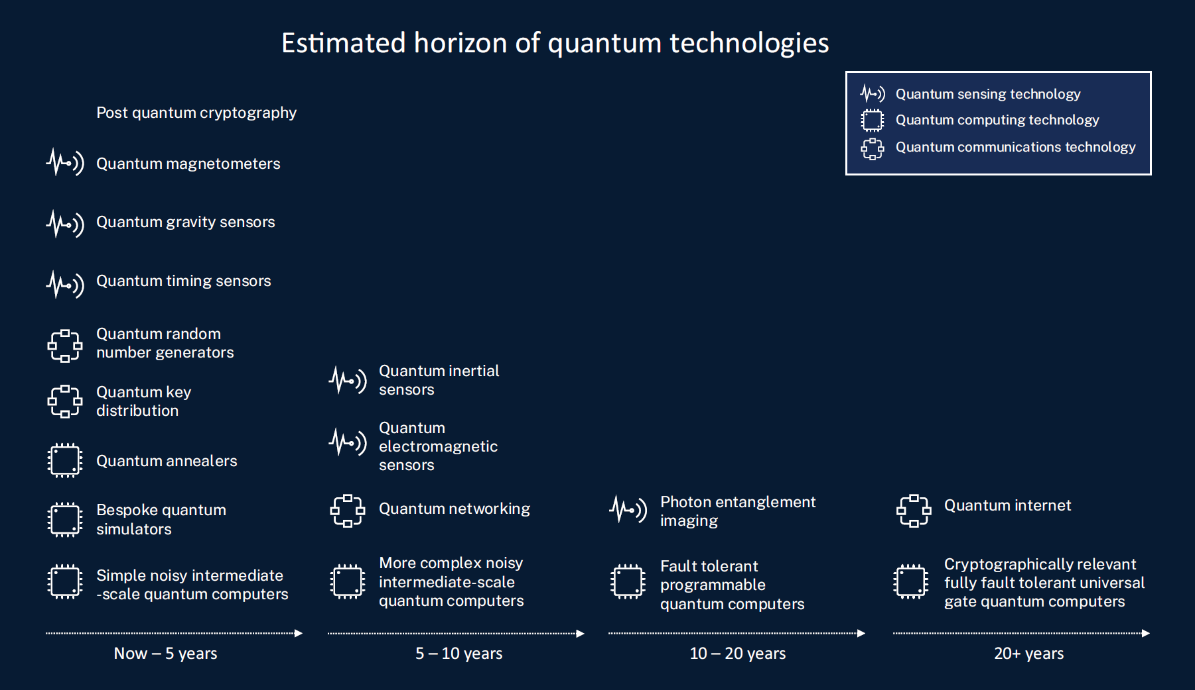


The Quantum FSP today...
Seeded projects across a range of areas
Established significant capability, complemented by other CSIRO activities
CSIRO directed research
CSIRO using/enhancing

Slide 8
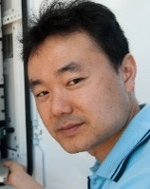
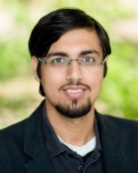

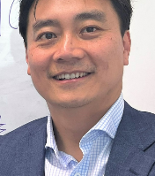

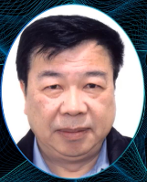
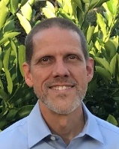
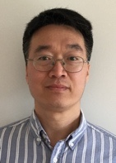
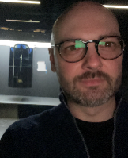

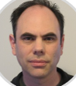
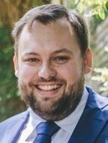
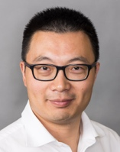

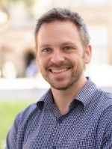
Our project leaders
Application of QT
New algorithms and software
Materials and devices
Hajime Suzuki
Quantum ML for cybersecurity
Usman Muhammad
QC software stack
Wendy Purches
Single photon sources
James Quach
Quantum ML for
robotics
Andrew Squires
2D Q materials
Dongxi Liu
Q cryptography
Sam Yang
Q annealing for microstructure
modelling
Manolo Per
QC for
materials
chemistry
Stephen Gensemer
Q-assured time transfer
Mark Tizard
Quantum Sensing in Bio
Marcus Thatcher
Q climate analaysis
Tim van der Laan
Q light emitting materials
Zhaojun Han
Q modelling catalysis
Liam Hall
Quantum Sensing in Bio
Justine Lacey
Responsible Innovation

Slide 9
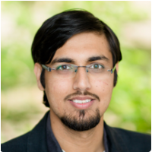

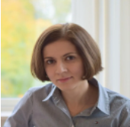

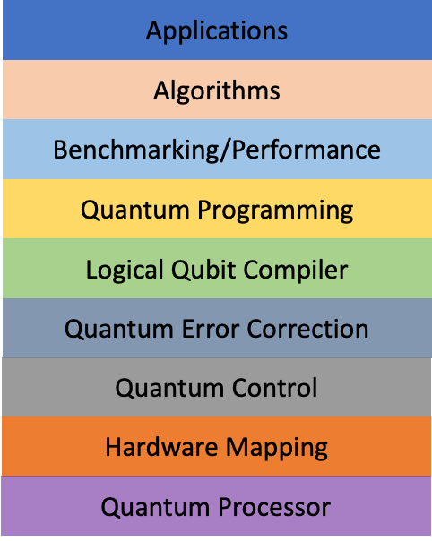
Quantum Software Platform
A highly versatile quantum compiler with built-in:
Error mitigation/correction
Security
Algorithm library
Quantum control optimisation
Optimal hardware mapping
Leveraging our existing strength in software engineering, Data61 will develop state-of-the-art quantum software engineering methods, tools, and platforms to tackle these challenges.
This will lower the barrier for quantum application developers by allowing them to co-design and co-develop quantum applications in a high-level abstraction next to traditional compute and software.
Notes:
Add notes here for Chris to use when presenting your work (optional):

Slide 10
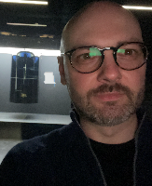
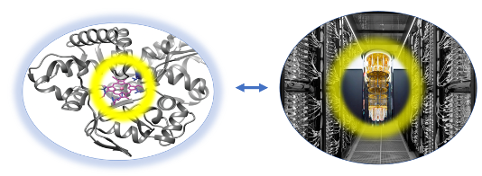
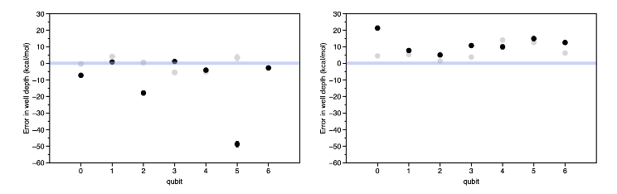
Quantum Computed Materials Chemistry
Embedding Quantum Computing approaches within traditional computational chemistry workflows
Benchmarking NISQ hardware, advancing practical methods towards high-precision agreement with experiment
Many technologically & biologically important molecules & materials exhibit strongly correlated electronic structure (e.g. Transitional metal centres)
Traditional methods using classical HPC are either too expensive or inaccurate to address real-world problems
Notes:
Add notes here for Chris to use when presenting your work (optional):
The broad point here is to develop practical approaches to use Quantum Computing as a tool for computational chemistry & materials science in the near-term, i.e. not developing methods that will only be practical in the far future, but focusing on what needs to be done now to make progress. Our approach is to focus on the calculation of physically relevant quantities that can be compared to experiment, and to grow with the advances in quantum computing hardware.
The figure on the left is a depiction of our approach to calculate the properties of strongly correlated systems in different environments (left), by embedding quantum computing within traditional HPC calculations (right).
The figure on the right shows results obtained on two different IBM Quantum Computers, which demonstrate that when calculating physically relevant quantities (in this case molecular well-depth), the use of energy differences can significantly reduce the errors from noisy quantum devices

Slide 11
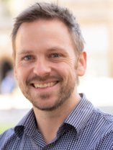

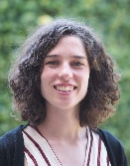



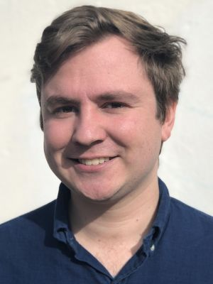


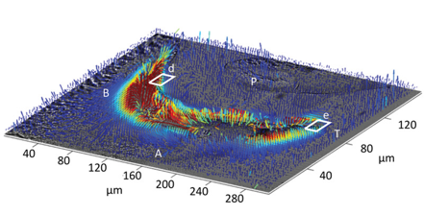
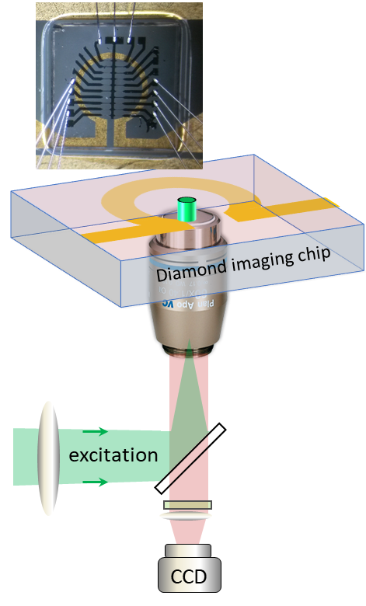
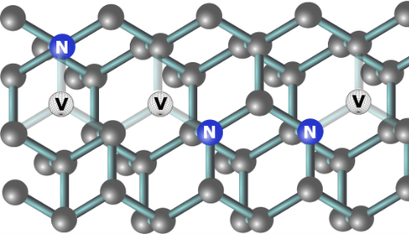
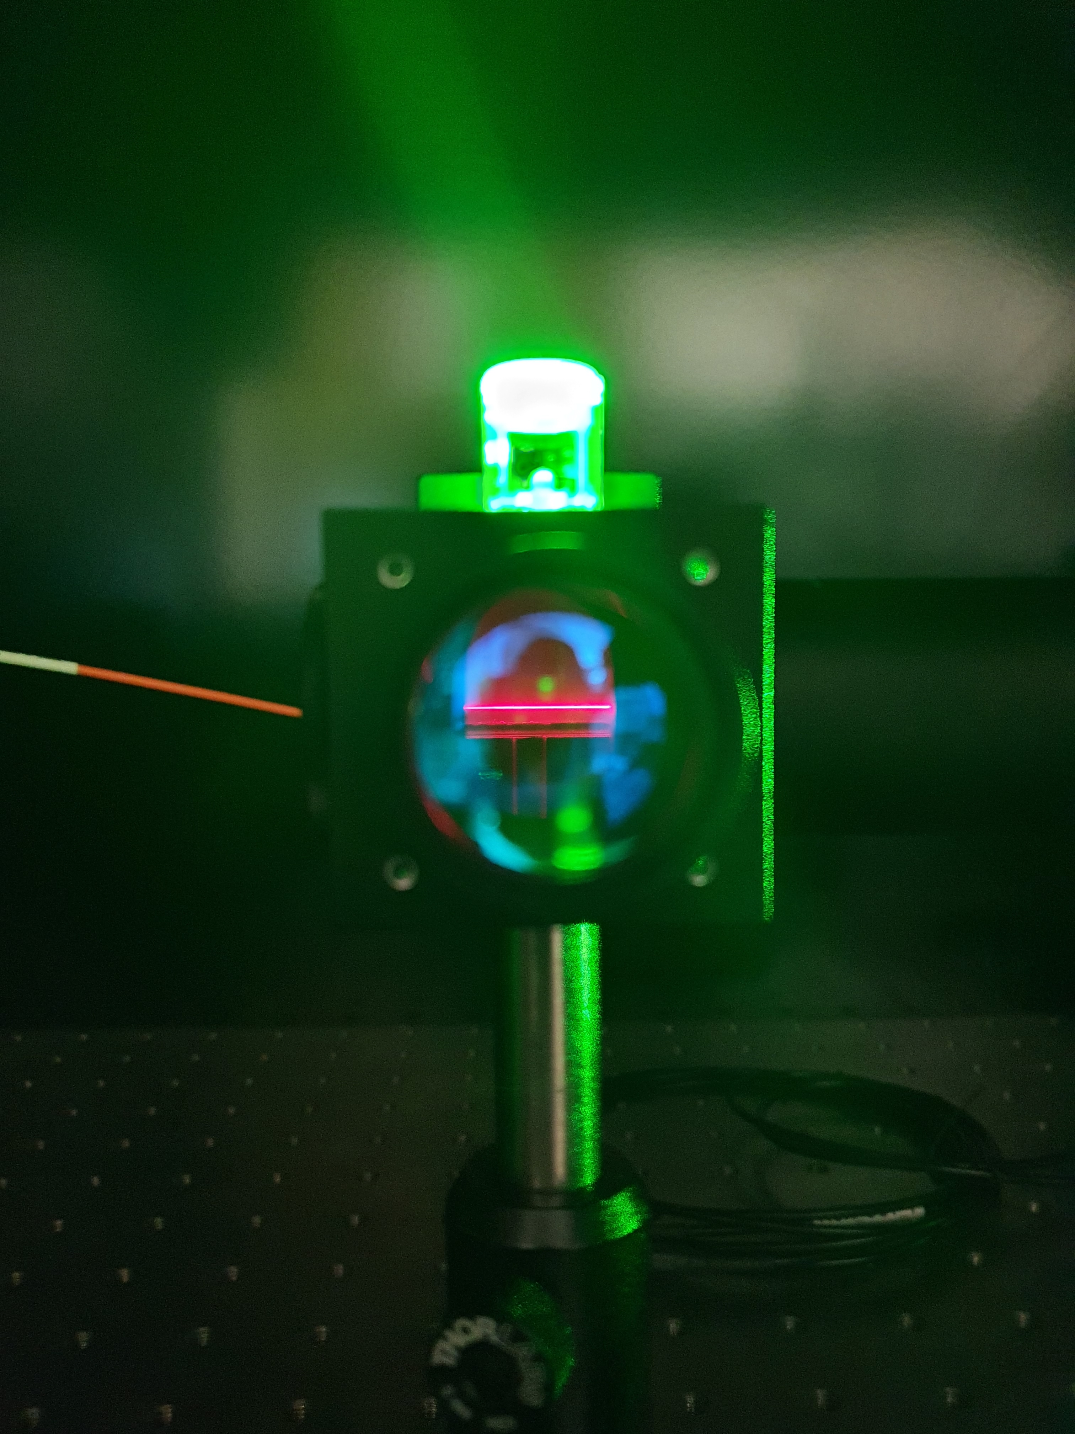
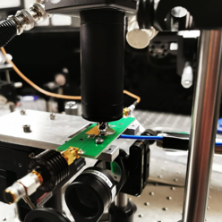
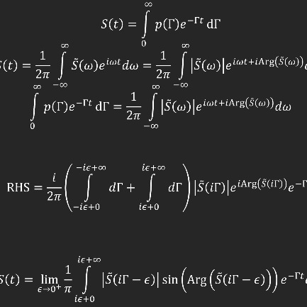
Quantum Biotechnology
Biosensing with quantum precision
532nm
637-800nm
Reconstruction of biogenic iron vector field
Diamond is ‘cold’ at room temperature
Stable quantum states at temperatures ranging from mK up to 800ºC
Biologically and chemically inert matrix
Increased sample compatibility
2mm
Quantum enhanced biomedical diagnostics
Quantum
microscopy
and spectroscopy
Theory and modelling of quantum dynamics
Nitrogen-vacancy defects in diamond fluoresce red under green light
Fluorescence intensity is proportional to target field strength
Fluorescence modulation rate
is proportional to target field frequency
Notes:
Add notes here for Chris to use when presenting your work (optional): xwf
Chris, note this one has animations! K.

Slide 12

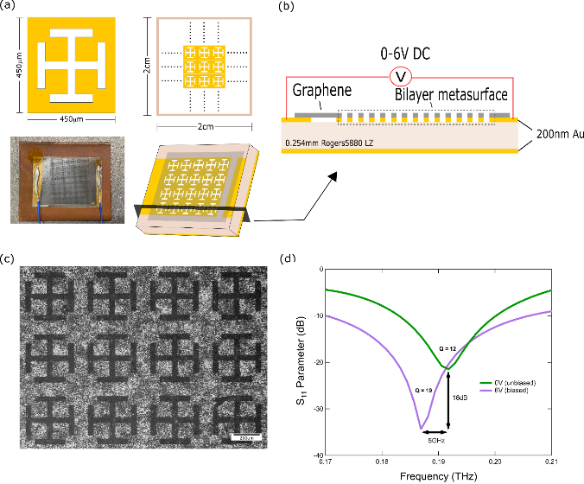
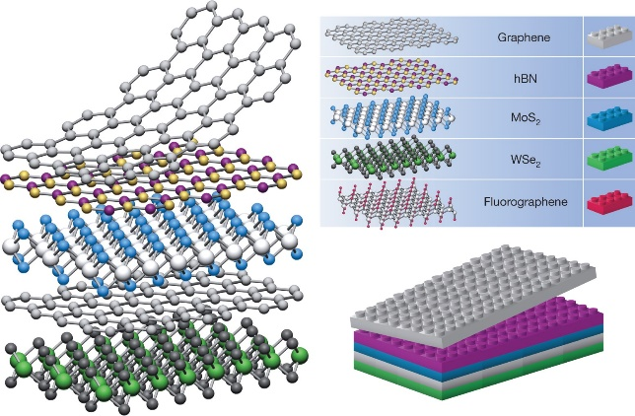
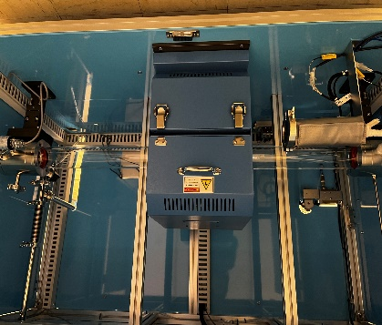
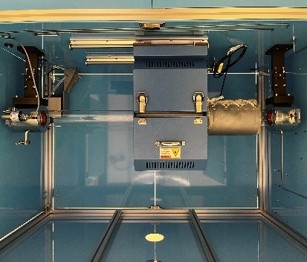
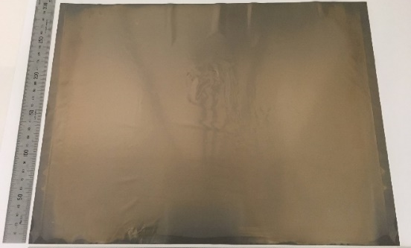
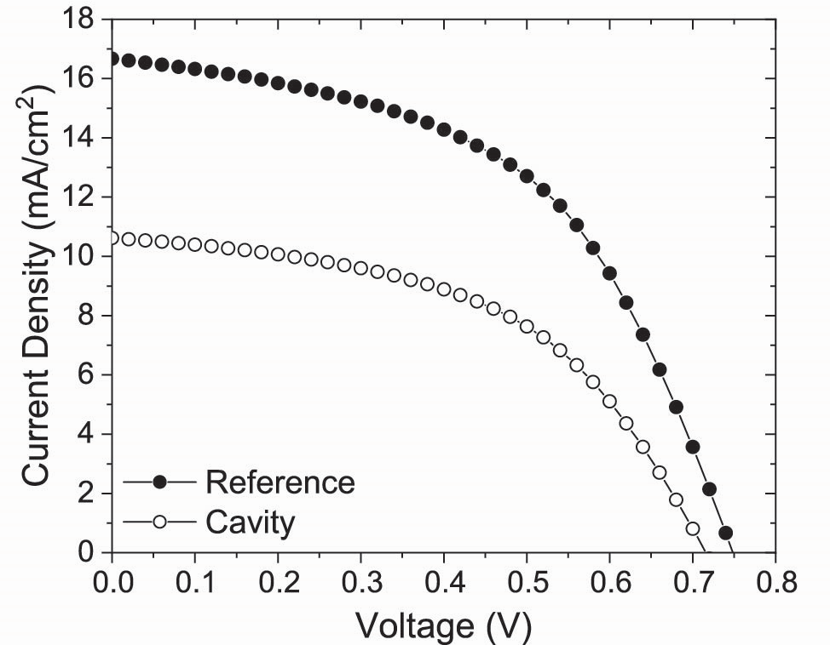
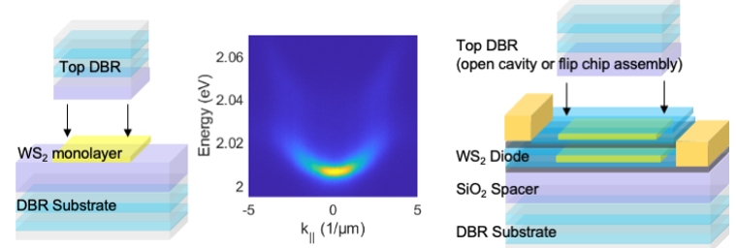
Polariton Light Emitting Devices
Capability development leveraging existing investments.
Using 2D materials like Lego!
TMDCs
Graphene/hBN
Produce a useful device, controlling a quantum state.
Already useful elsewhere
Notes:
Add notes here for Chris to use when presenting your work (optional):
Speaking notes:
New reactors are being installed that are specifically designed for the production of high quality transition metal dichalcogenides, hexa-boronitride and graphene. Between these systems we will have the building blocks of optically active materials/semiconductors, insulators and conductors all within 2D systems. (top left)
We already have extensive experience with production of graphene at scale, these materials are useful for membranes, transparent conductors and electronics devices, we are seeking to push these 2D/quantum materials to produce new novel devices in the quantum regime (bottom left)
The electronic devices we have made with graphene are already showing themselves to be useful for producing communication devices, we have produced electrically tunable terahertz frequency devices. Silicon doesn’t work at this frequencies we are taking advantage of the unique properties of graphene to make these devices function, namely linear dispersion of dirac fermions thanks to a unique band structure – this also allows for ultrafast carrier mobilities and thus responsivity to teraherz radiation and an electrically tunable fermi level and conductivity. (middle)
We have commence assembling our TMDCS, hBN and graphene into stacked heteroestructures, aiming to replicate the effects seen in thin film systems but with enhanced non-linearties due to more quantum confinement. This gives us a plethora of opportunities to assemble functional devices and start exploring quantum effects (top right)
Finally the embodiment of this which we are most excited about at the moment is the production of polariton systems in condensed matter systems. Here we are aiming to couple an exciton in the TMDC system to a microcavity to produce polaritons. Because we are in a 2D system we can then add in conductors to tune the excitons as well as more confinement through nanofabrication with the eventual goal of producing similar results to atomic systems but in a more practical physical system where control is through electronics rather than laser systems and can be done with bigger systems and not in vacuum environments. (bottom right)
The images have been supplied by collaborators at ANU in FLEET!
These polaritronic systems are already proving to be useful for other areas we just recently put work up on the arxiv showing we can use these polariton systems to enhance the amount of energy extracted from solar cells (bottom middle)

Slide 13

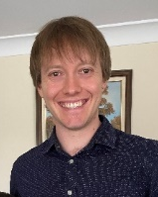
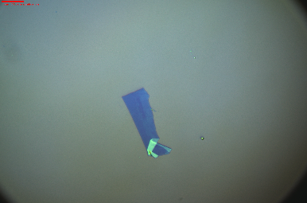
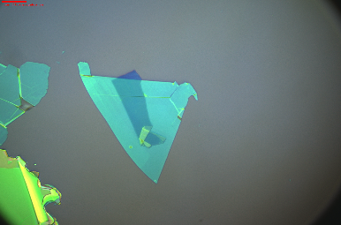
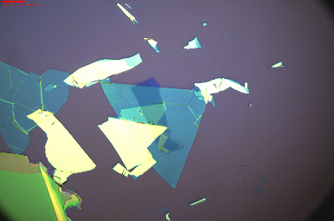
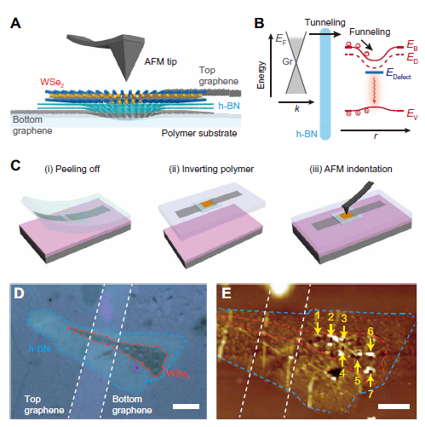
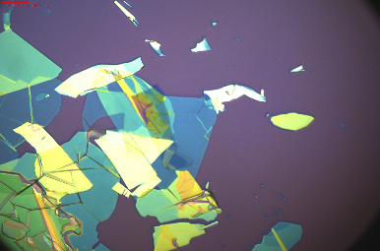
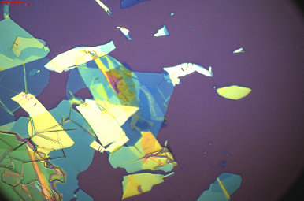
2D Materials for Single Photon Emission
CSIRO Van der Waals Heterostructures
Stacked 2D materials and defect centres are good candidates for single photon emission
1.
Graphene
2.
Graphene
hBN
3.
Graphene
hBN
BP
4.
Graphene
hBN
BP
hBN
5.
Graphene
hBN
BP
hBN
Graphene
Dotted traces are top layers
CSIRO has strong capability in stacking various 2D materials
So et. al. Science Advances, 2021
Notes:
Add notes here for Chris to use when presenting your work (optional):
The main talking points are that 2D materials are good candidate materials for single photon emitters -> Even more so when they are stacked (van der Waals Heterostructures) -> CSIRO has current capability in building and characterising these 2D material stacks, Therefore well situated to leverage this to produce Single Photon Emitters.
If you could mention that we now have a good suite of 2D material/nanofabrication capability that would be fantastic ! We have the NanoFrazor lithography tool (nm resolution), nano etch, CVD system and 2D material transfer station as well as a metal evaporator coming. These tools would provide great collaboration opportunities for PhDs etc in FLEET making nano- 2D material (quantum) devices.

Slide 14
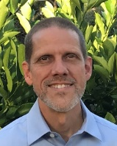

Quantum Comms Satellite Demo
Goal:
build a prototype instrument for a mobile quantum optical communications network
Collaborators:
RMIT, UWA, UniSA
Progress to date:
Design phase is finished
Entangled photon source in the lab producing over 2M entangled photon pairs/sec
Conducting for first outdoor test to determine atmospheric disturbances at UniSA
Applications include:
quantum time transfer, positioning and navigation where GNSS is not available
quantum key distribution and real-time sensor signals where spoofing could create disruptions
Notes:
Add notes here for Chris to use when presenting your work (optional):

