Slide 1
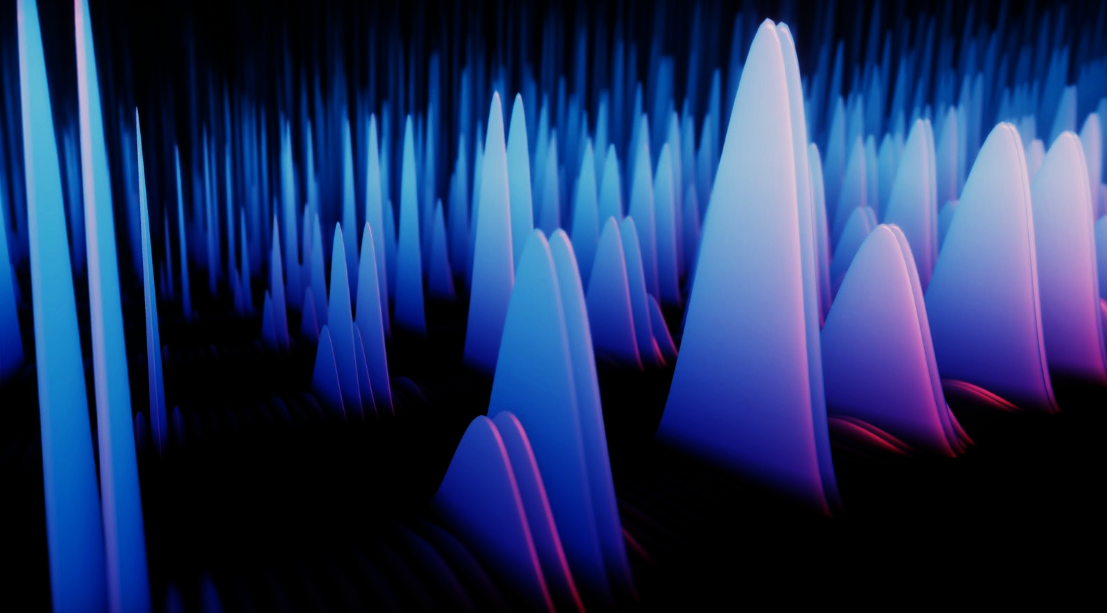
Quantum at the
University of Melbourne
  Prof. Harry Quiney
  Head, School of Physics
QTML, Melbourne 2024

Slide 2





Quantum at UoM – Historical Snapshot
Longest running Centre of Excellence 2003-2025
Significant UoM contribution to Silicon Quantum Computing
(experiment and theory)
Established 2018: Science, FEIT, FBE
Quantum computing at the leading edge
13 academics + over 20 RHDs
(>10B quantum program shots)
Centre of Excellence in Quantum Biotechnology (QUBIC, 2023)
Quantum sensing, computing (QHUB), imaging, bioinformatics
+ many academics in and around fundamental quantum research
and enabling technology (Science and Engineering)
Early Quantum Start-up (2005-2008)
Significant basis for UoM establishment of diamond-based quantum technology
(experiment and theory)

Slide 3
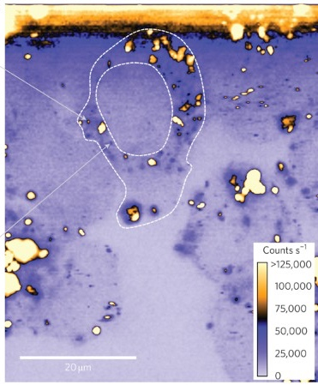
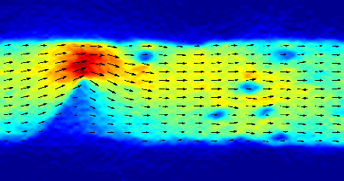
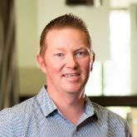
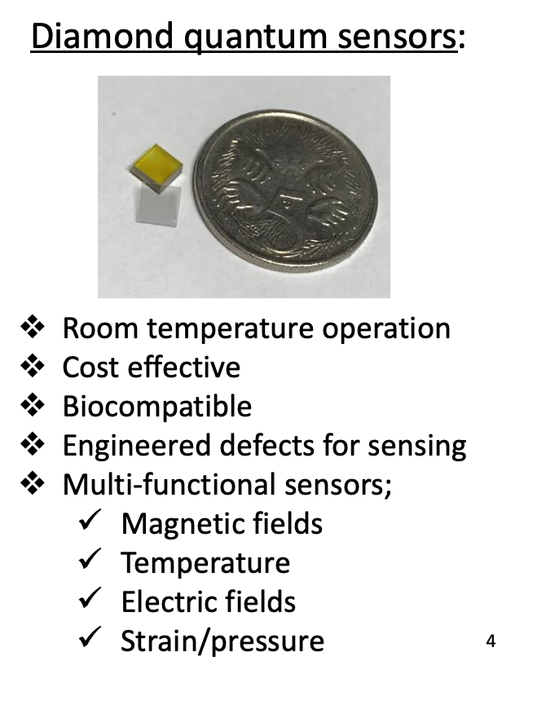

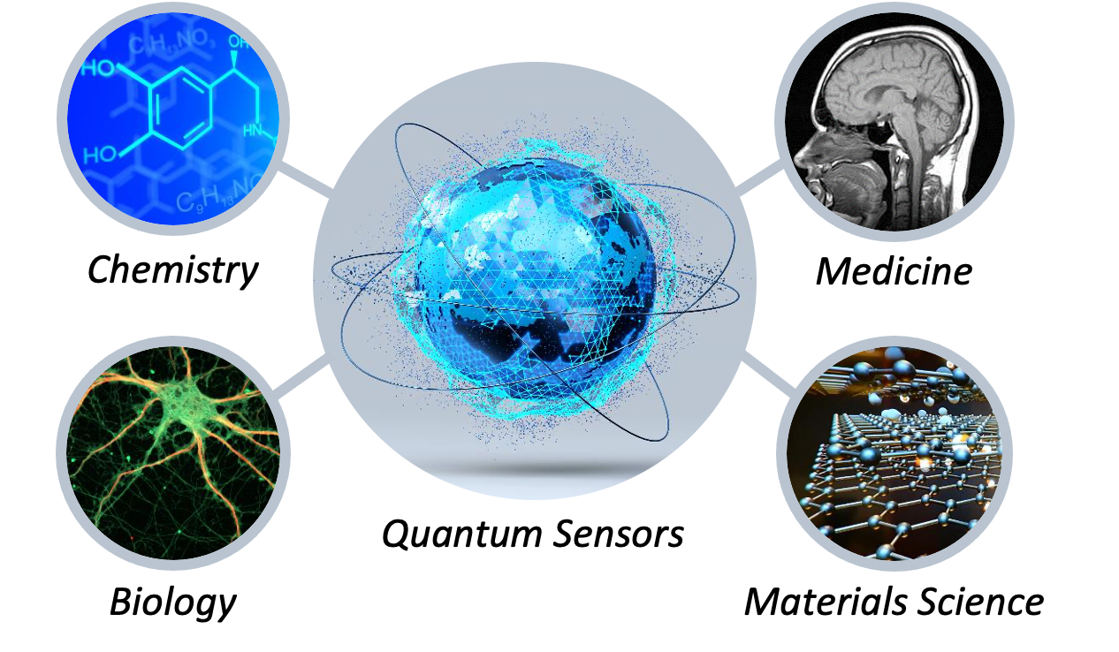
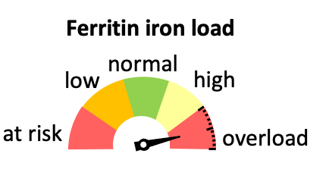





Quantum sensing @ UoM
2011-2022: Quantum diamond labs established (Hollenberg, ALF)
-> first quantum probe in a living cell (Eureka Prize ID Research 2013)
-> imaging current flow in graphene/2D materials/devices (Tetienne et al)
Science Advances 2017
Nature Nano 2011
2022: New management -> A/Prof. David Simpson
-> biology, defence (PNT), translational/commercialisation
Quantum assisted
clinical iron assay
Electrophysiology
microscope
FeBi Technologies
Chromos Laboratories

Slide 4
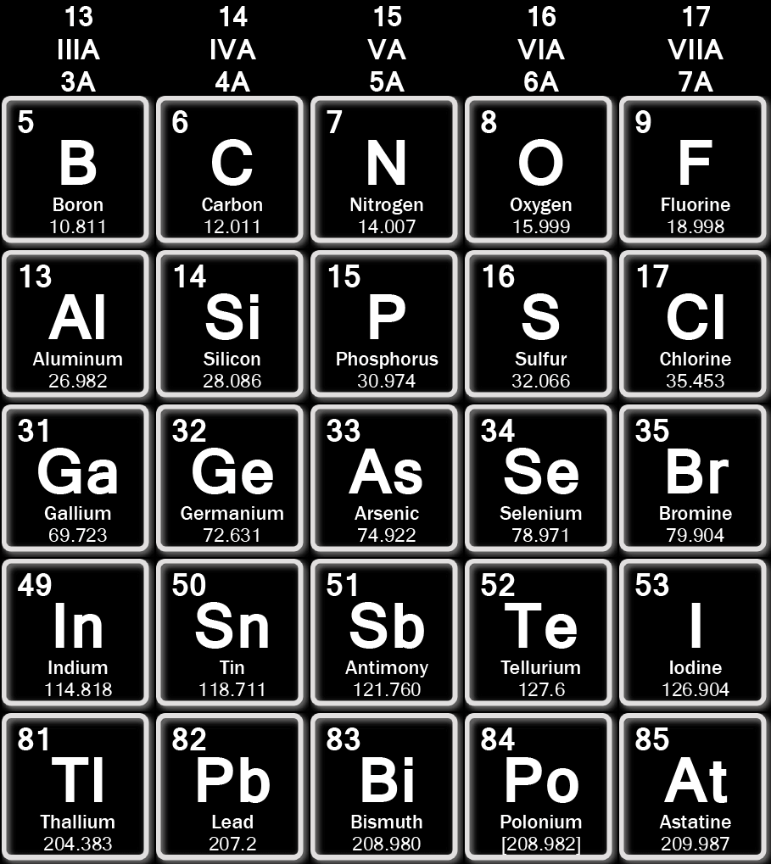
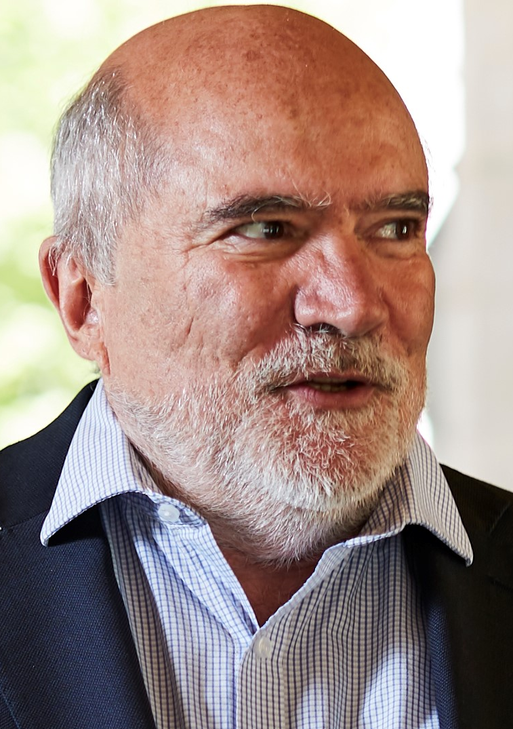
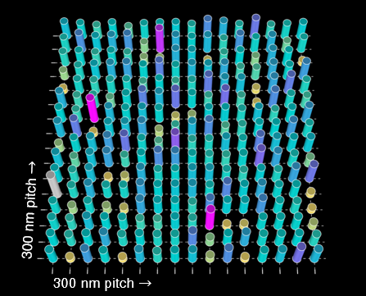
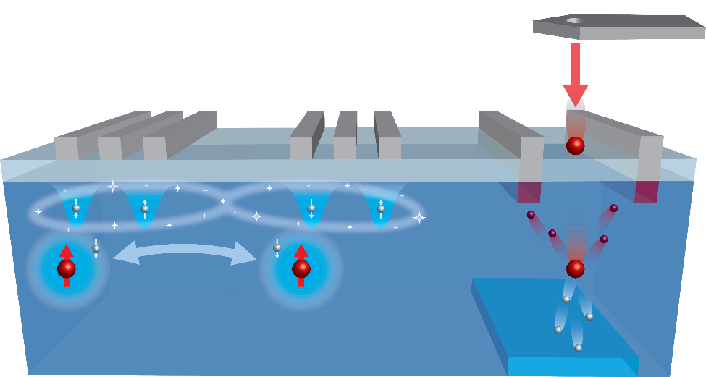
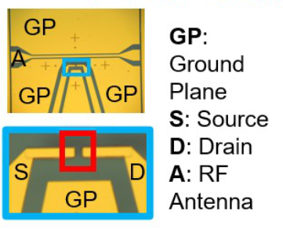
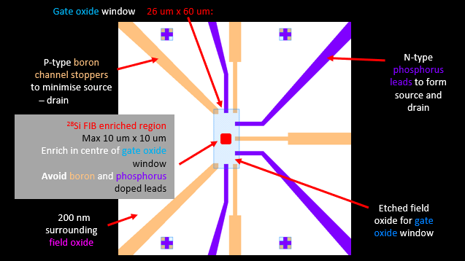
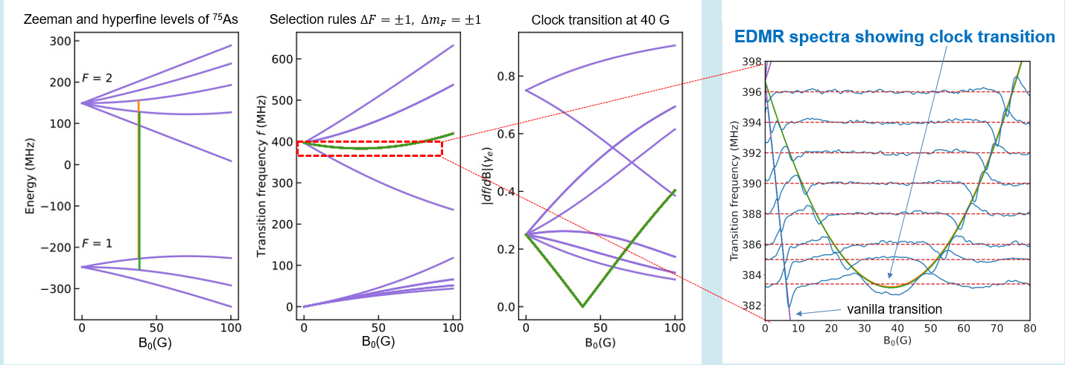
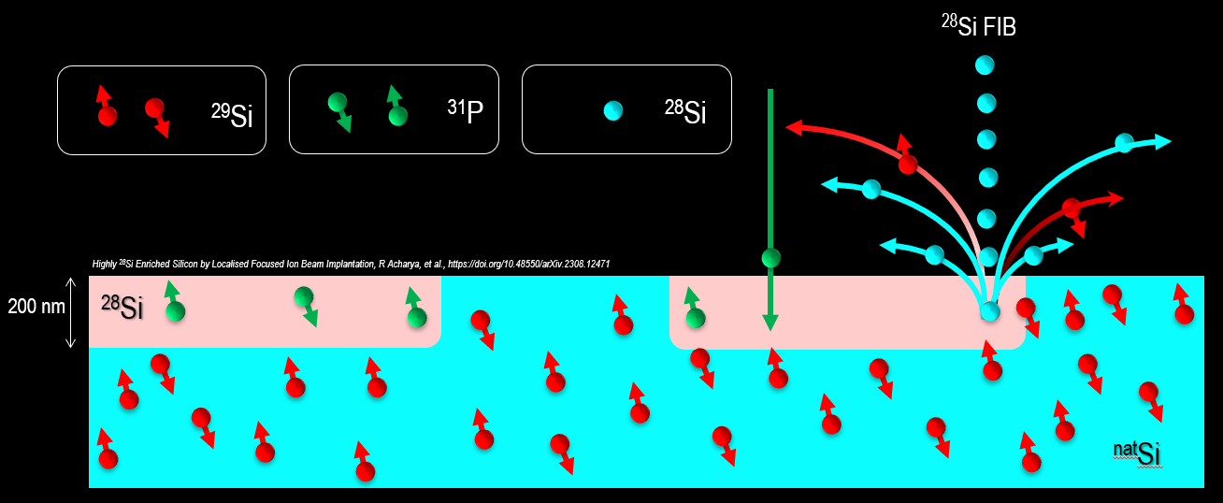
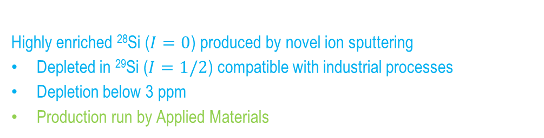
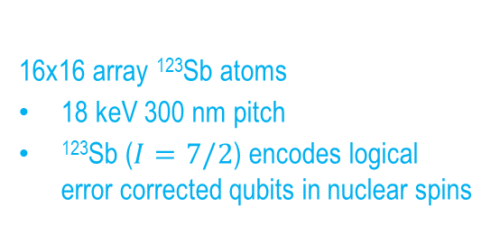
Prof David Jamieson: Donor spin quantum computer devices in enriched silicon
Donor qubits: Poisson ✓, deterministic ✓
¹²³Sb, ¹²³Sb₂
Isoelectronic qubits: Poisson ✓
⁷³Ge, ¹¹⁹Sn
Localised ²⁸Si enrichment ✓
< 3 ppm ²⁹Si in 20 µm squares
Isoelectronic Silicon nuclear qubit
²⁹Si available on demand
Deterministic single atom arrays
High fidelity implanted qubits
16x16 array ¹²³Sb atoms
18 keV 300 nm pitch
¹²³Sb ($I=7/2$) encodes logical error corrected qubits in nuclear spins
Single atom devices in highly enriched ²⁸Si
Electrically Detected Magnetic Resonance
Ion beam facilities
Highly enriched ²⁸Si ($I=0$) produced by novel ion sputtering
Depleted in ²⁹Si ($I=1/2$) compatible with industrial processes
Depletion below 3 ppm
Production run by Applied Materials
Clock Transitions in ⁷³As donors in enriched silicon
Insensitive to magnetic noise

Slide 5
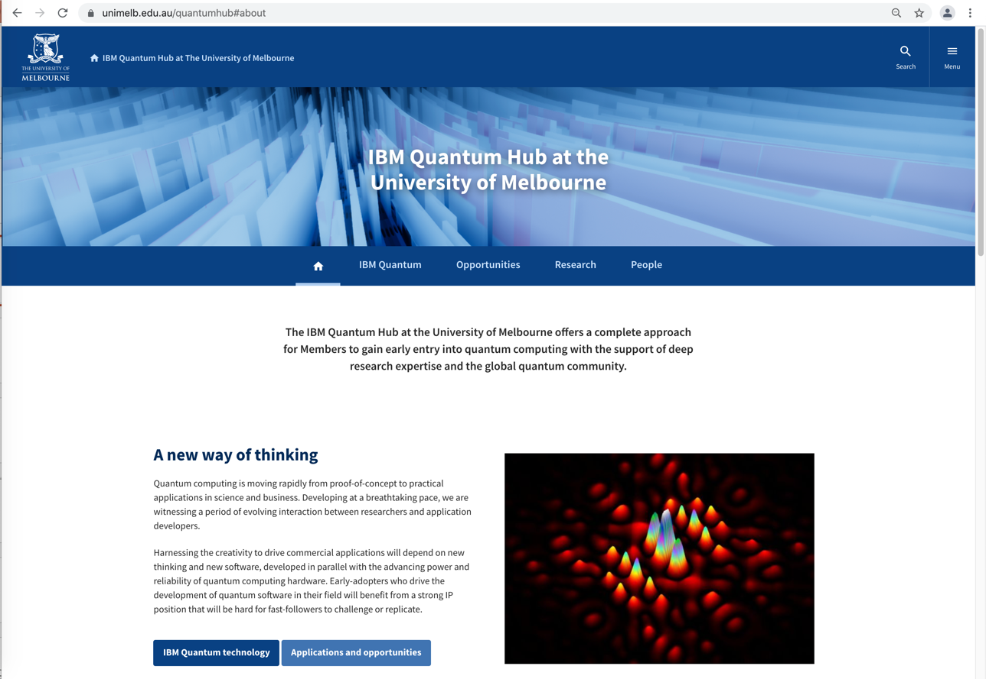
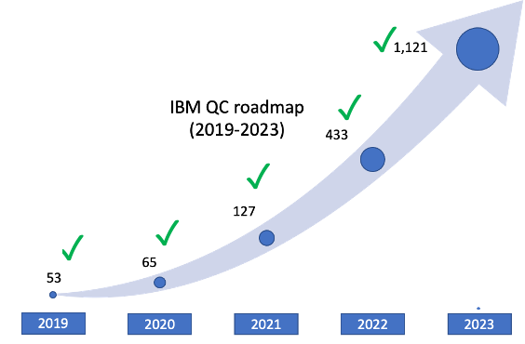
IBM Quantum Hub @ UoM (2018-present)
Multi-faculty initiative: research, teaching & industry engagement
University stakeholders: Faculty of Science, Faculty of Engineering & IT,
Faculty of Business and Economics
Rapid increase in # academics/students researching QC since 2018.
People:
Prof. Lloyd Hollenberg (Director, Physics)
Dr. Josh Combes (Maths/Physics)
Dr. Lucas Hackl (Maths/Physics)
A/Prof. Kim-Anh Le Cao (Maths)
Dr. Gary Mooney (IBMQ-admin, Physics)
Prof. Kate Miles-Smith (Maths)
A/Prof. Usman Muhammad (CSIRO/Physics)
Prof. Carsten Murawski (Finance)
Prof. Udaya Parampalli (Computer Science)
Dr. Thomas Quella (Maths)
A/Prof. Stephan Rachel (Physics)
Prof. Martin Sevior (Physics)
Dr. Nitin Yadav (Finance)
+ > 20 MSc and PhD students
Research:
Quantum information
Quantum device characterization
Quantum applications
Quantum Machine Learning
Education:
MULT20015, MULT90063, COMP90084
c.200 students/year
Engagement:
industry, defence
universities (Victorian & national)
outreach
Web: unimelb.edu.au/quantumhub

Slide 6
QHub research areas
Quantum Machine Learning: M .Usman, U. Parampalli, M. Sevior, P. Wang, M. West, J. Heredge, C. Nakhl, L. Hollenberg
Quantum simulation: H. Vallury, S. Zhang, M. Jones, A. Fiusco, M. Usman, L. Hollenberg
Optimisation: J. Villanueva, V. Katial, G. Mooney, K. Smith-Miles, L. Hollenberg
Quantum Error Correction: S. Gicev, B. Hall, Y. Kim, M. Usman, M. Sevior, L. Hollenberg
Benchmarking: G. Mooney, JF Kam, H. Kang, L. Hollenberg
Condensed matter: P. Frey, S. Rachel
Quantum omics: F. Creevey, K-A Le Cao, M. Sevior, L. Hollenberg
Quantum Noise: B. Harper, H. Kang, M. Usman, M. Sevior
See list of papers: unimelb.edu.au/quantumhub

Slide 7
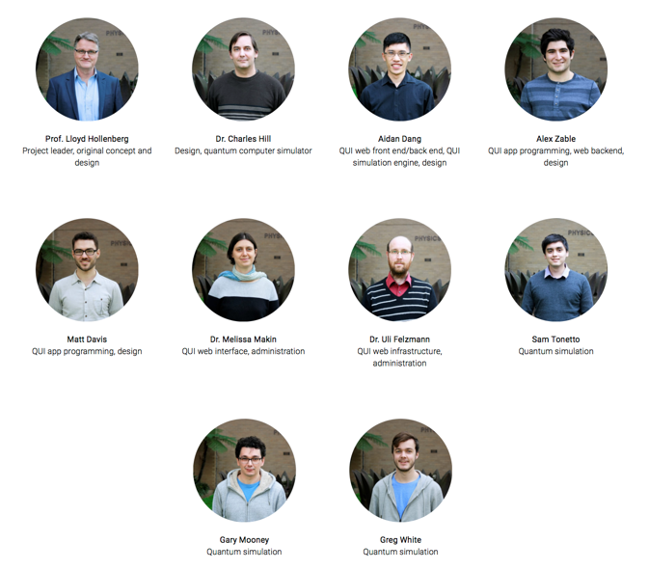
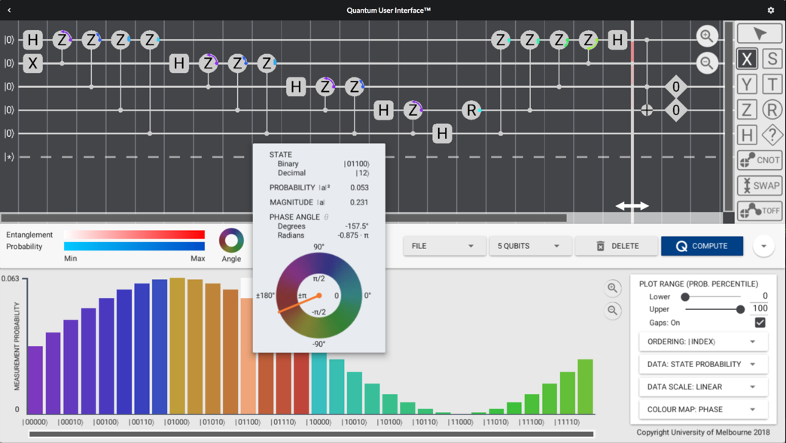
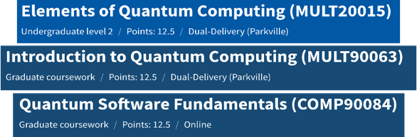
Quantum education – Quantum User Interface (2019)
UoM Curriculum in QC
try it at quispace.org!

Slide 8
University of Melbourne contributions to QTML
Hevish Cowlessur | A Hybrid Quantum Neural Network for Split Learning | Poster
Floyd Creevey | Genetic Algorithms for Quantum Circuit Compilation in Data Loading and Machine Learning Applications | Poster
Farhad Farokhi | Optimal Universal Quantum Encoding for Statistical Inference | Short Oral
Julian Greentree | Adaptive Quantum magnetometry using Myopic Entropy reduction | Short Oral
Bacui Li | Computable Model-Independent Bounds for Adversarial Quantum Machine Learning | Poster
Peiyong Wang | Let the Quantum Creep In: Designing Quantum Neural Network Models by Gradually Swapping Out Classical Components | Poster
Jamie Heredge | Non-Unitary Quantum Machine Learning | Short Oral
Jamie Heredge | Prospects of Privacy Advantage in Quantum Machine Learning | Short Oral
Chris Nakhl | Calibrating the role of entanglement in variational quantum circuits | Poster
Max West | Adversarial Robustness Guarantees for Quantum Classifiers | Short Oral

Slide 9


Lloyd Hollenberg (UoM), QTML 24/11/2024 – c.130 high-school students
Survey result: Overall experience = 8.6/10, Understanding = 8.3/10

Slide 10
University of Melbourne contributions to QTML
Hevish Cowlessur | A Hybrid Quantum Neural Network for Split Learning | Poster
Floyd Creevey | Genetic Algorithms for Quantum Circuit Compilation in Data Loading and Machine Learning Applications | Poster
Farhad Farokhi | Optimal Universal Quantum Encoding for Statistical Inference | Short Oral
Julian Greentree | Adaptive Quantum magnetometry using Myopic Entropy reduction | Short Oral
Bacui Li | Computable Model-Independent Bounds for Adversarial Quantum Machine Learning | Poster
Peiyong Wang | Let the Quantum Creep In: Designing Quantum Neural Network Models by Gradually Swapping Out Classical Components | Poster
Jamie Heredge | Non-Unitary Quantum Machine Learning | Short Oral
Jamie Heredge | Prospects of Privacy Advantage in Quantum Machine Learning | Short Oral
Chris Nakhl | Calibrating the role of entanglement in variational quantum circuits | Poster
Max West | Adversarial Robustness Guarantees for Quantum Classifiers | Short Oral

