Slide 1



Variational quantum algorithms:
adaptive and pulse-based approaches
Sophia Economou
QTML, Melbourne, Nov 2024

Slide 2
Outline
Adaptive quantum algorithms (ADAPT-VQA)
  Background & ADAPT-VQE
  Adaptive Gibbs state preparation
Control-VQE: optimizing at the pulse level

Slide 3
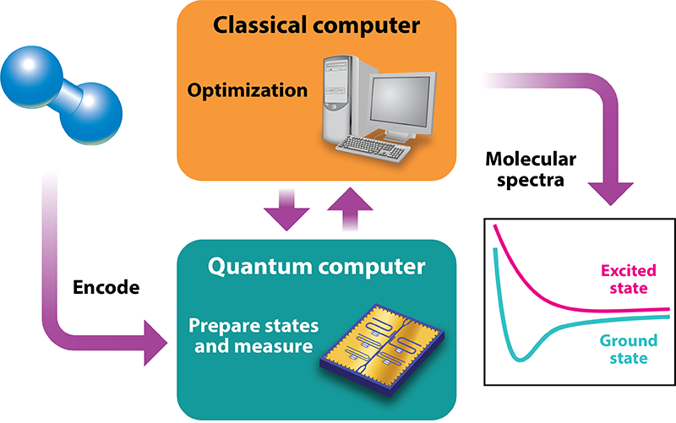
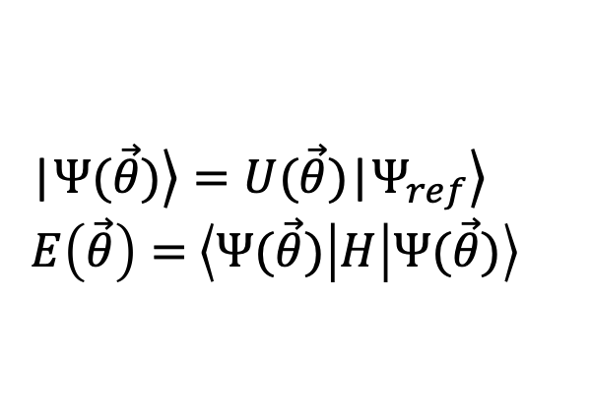
Variational Quantum Eigensolver (VQE)
Ansatz
|$\left.Ψ(\vec{θ})\right\rangle =U(\vec{θ})\text{|}\left.Ψ_{ref}\right\rangle$
$Ε\left(\vec{θ}\right)=$ $\left\langle Ψ(\vec{θ}) | H | Ψ(\vec{θ})\right\rangle$
Variationally change
Measured energy
Parametrized circuit
Reviews:
Cerezo et al, Nat. Rev. Phys. 3, 625 (2021)
Bharti et al, RMP 94, 015004 (2022)
Tilly et al, arXiv:2111.05176
Image from Physics 11, 14 (2018)

Slide 4
Hardware-efficient ansatz
Tailored to chosen platform
Inefficient—too much of the Hilbert space sampled
Not related to the problem →
Difficult to optimize (barren plateaus)
  McClean et al., Nat. Commun. 9, 4812 (2018)
  +lots of work from LANL
Kandala et al, Nature 549, 242 (2017)

Slide 5
Problem-aware ansätze
Instead of random circuits, use circuits that have knowledge of the problem
Incorporate: symmetries (particle number, spin, spatial symmetry, etc), locality
This can avoid issues with optimization, can lead to shorter circuits

Slide 6
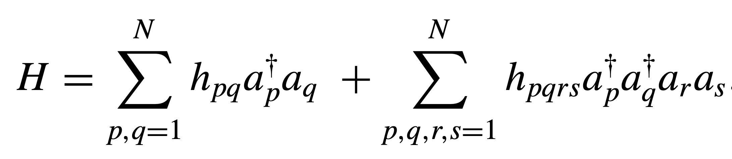
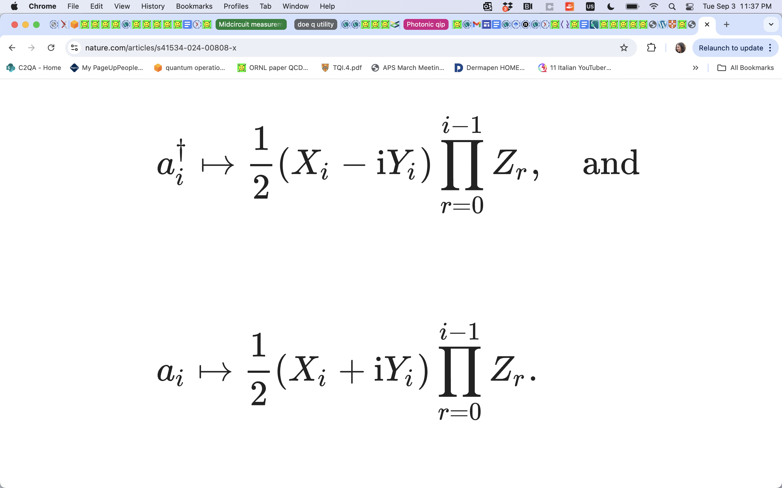
Fermionic Hamiltonian and mapping
Map (spin) orbitals to qubits: Jordan-Wigner mapping
Z strings O(N)

Slide 7
One of the first problem-aware ansätze: UCCSD
gates built from symmetry-adapted fermionic operators
Chemistry-inspired (UCCSD) ansatz
Incorporates symmetries
Generalizes classical simulations
Impractically long circuits, many CNOTs
Inconsistent under low-order Trotterization
Grimsley et al., JCTC 2020, 16, 1, 1-6
Peruzzo et al, Nature Comm. 5, 1 (2014)
O’Malley et al, PRX 6, 031007 (2016)
Xue et al, Nature 601, 343 (2022)

Slide 8
Constructing ansatz: desiderata
Quantum circuit that is:
Short
Expressive
Trainable

Slide 9
Outline
Adaptive quantum simulation (ADAPT-VQE)
  Molecules
  Periodic systems
Control-VQE: optimizing at the pulse level

Slide 10

Adaptive, problem-tailored VQE (ADAPT-VQE)
Start from a simple reference state
Quantum resources are precious: Only add as many operators as needed
Problem-tailor the ansatz: Use the QC to determine how to grow the ansatz further
$$U_{3}(θ_{3})$$
Grimsley, Economou, Barnes, Mayhall, Nature Communications 10, 3007 (2019)

Slide 11
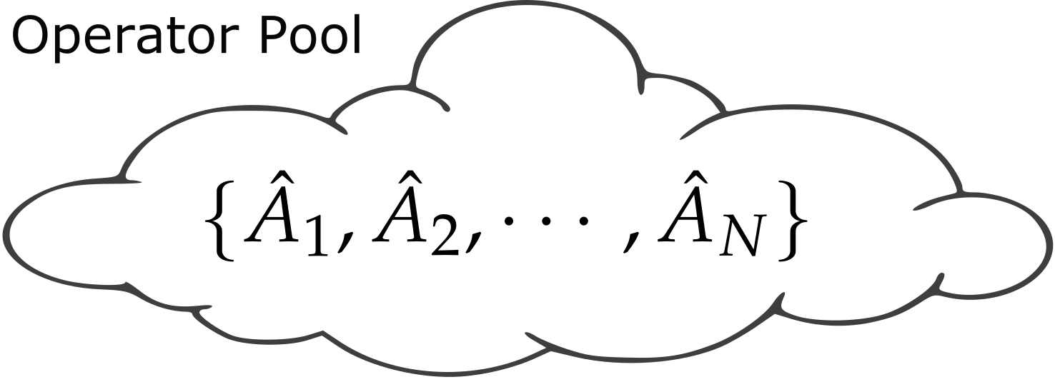
ADAPT-VQE ingredients: (i) operator pool
ADAPT-VQE uses a pool of operators, A_{m}
Applies unitaries one by one : U_{m} = exp(θ_{m}A_{m}) to a reference state
Grimsley, Economou, Barnes, Mayhall, Nature Communications 10, 3007 (2019)

Slide 12
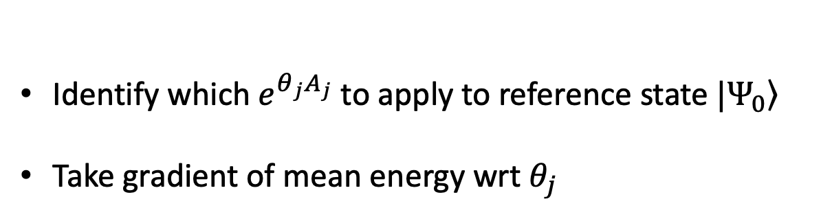
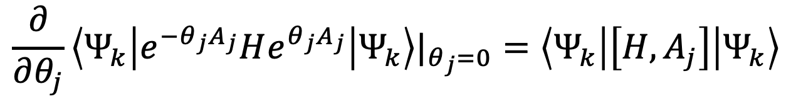

ADAPT-VQE ingredients: (ii) update criterion
Identify which$e^{θ_{j}A_{j}}$ to apply to reference state $\left.|Ψ_{0}\right\rangle$
Take gradient of mean energy wrt $θ_{j}$
$$\frac{∂}{∂θ_{j}}\left\langle Ψ_{k} | e^{−θ_{j}A_{j}}He^{θ_{j}A_{j}} | Ψ_{k}\right\rangle |_{θ_{j}=0}=\left\langle Ψ_{k} | \left[H,A_{j}\right] | Ψ_{k}\right\rangle$$
New operator → measure on hardware
$k$: ADAPT iteration step
Grimsley, Economou, Barnes, Mayhall, Nature Communications 10, 3007 (2019)

Slide 13
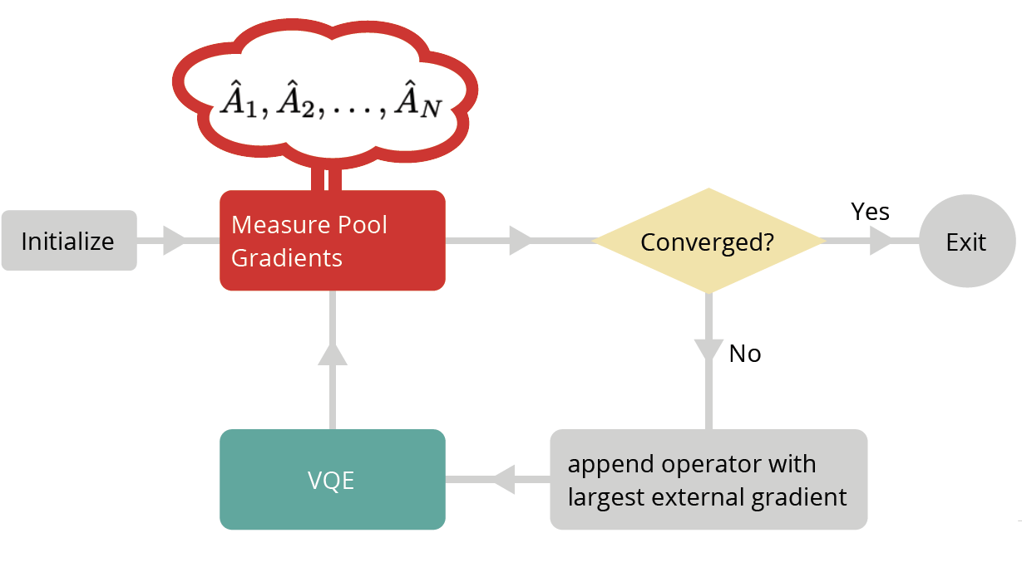
ADAPT-VQE overview
Inputs:
Hamiltonian
Initial state
Operator pool
Grimsley, Economou, Barnes, Mayhall, Nature Communications 10, 3007 (2019)

Slide 14
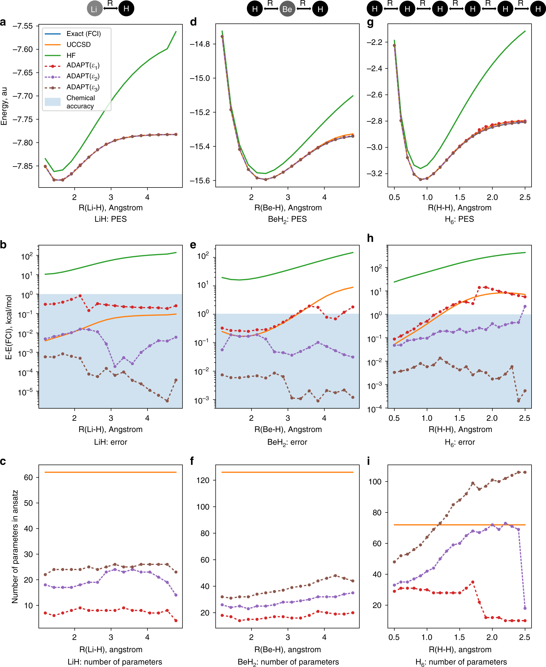
ADAPT-VQE with fermionic pool
energy
error
BeH₂
bond distance 2.39 Å
nr of
variational
parameters
Grimsley, Economou, Barnes, Mayhall,
Nature Communications 10, 3007 (2019)

Slide 15
ADAPT-VQE vs other ansätze
Problem-tailored vs problem-aware
  Example: ansatz at different points on dissociation curve of a given molecule
  UCCSD: exact same across curve
  ADAPT-VQE: changes across the curve, picks up operators as needed for strongly correlated regions

Slide 16
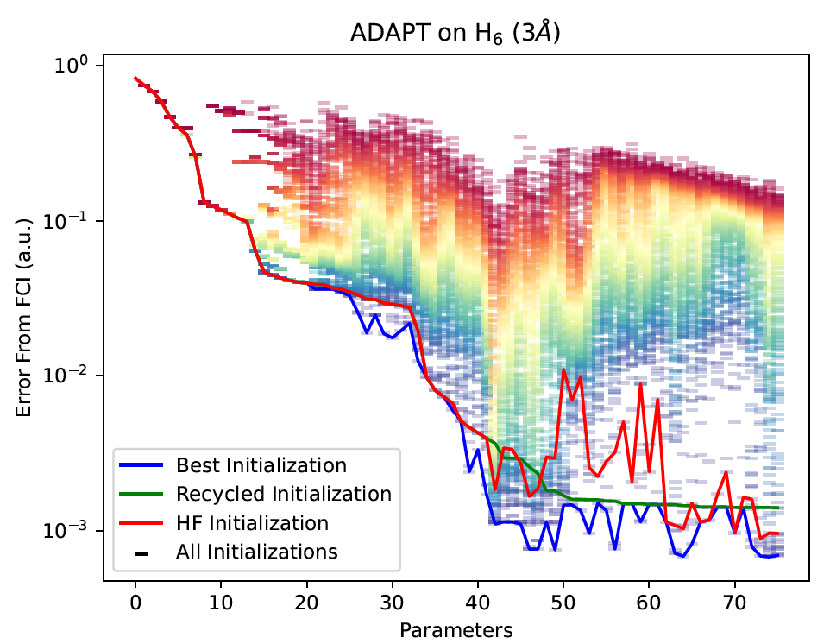
Trainability of ADAPT-VQE
ADAPT produces compact tailored ansätze
Shallow circuit → the landscape is generally too rugged
ADAPT avoids the issues associated with trainability
By construction resistant to barren plateaus
Grimsley et al, npj Quantum Information 9, 19 (2023)

Slide 17
ADAPT-VQE vs other ansätze
Problem-tailored vs problem-aware
  Example: ansatz at different points on dissociation curve of a given molecule
  UCCSD: exact same across curve
  ADAPT-VQE: changes across the curve, picks up operators as needed for strongly correlated regions
Expressivity potential vs expressive circuits
  Random circuits: very expressive, hard to optimize
  ADAPT-generated ansatz:
    bespoke to problem, each instance not random
    parameters warm-started

Slide 18
How should the operator pool be chosen?
An obvious choice is the fermionic pool
Preserves particle number
Can be spin-adapted (preserves Sz)
Criteria & desiderata
Problem constraints: symmetries, etc
Hardware constraints: connectivity, locality, etc
Small pool size
…
But:
Hardware inefficient
Grows with system size

Slide 19
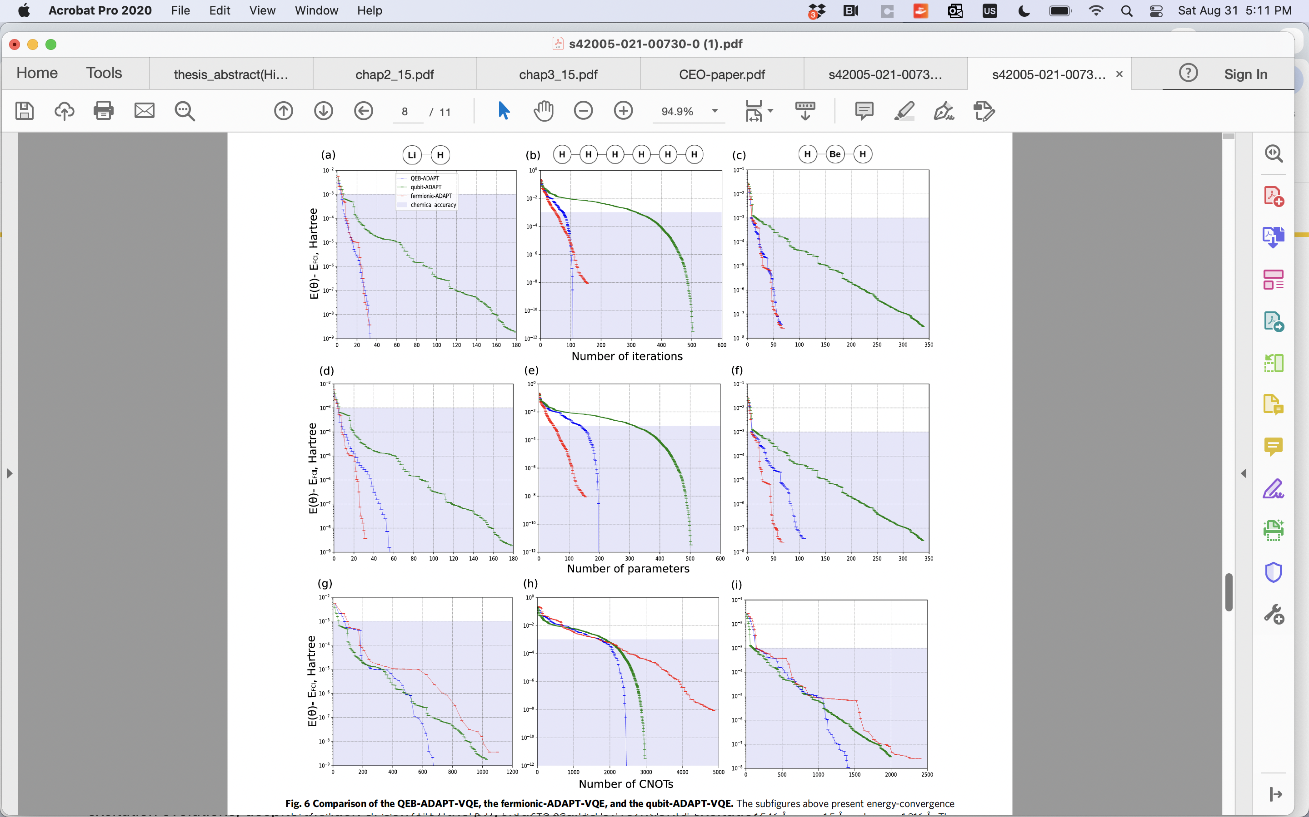
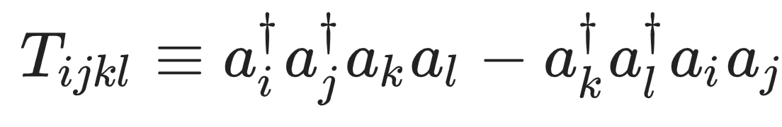
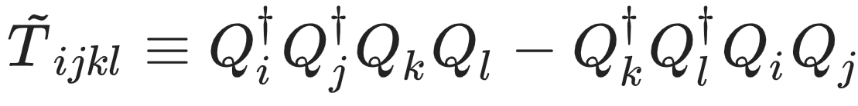
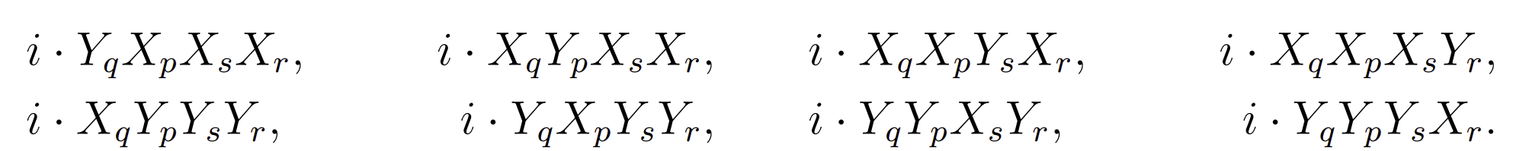
ADAPT-VQE: Pool Choices
The choice of operator pool impacts the circuit- and parameter-efficiency of the final ansatz. Popular pool types include:
Fermionic Pools: Operators directly correspond to fermionic excitations
Qubit Excitation (QE) Pools: Operators correspond to fermionic excitations up to anticommutation effects
Qubit Pools: Operators are individual Pauli strings
Yordanov et al, Commun Phys 4, 228 (2021)
Tang et al, PRX Quantum 2, 020310 (2021)

Slide 20
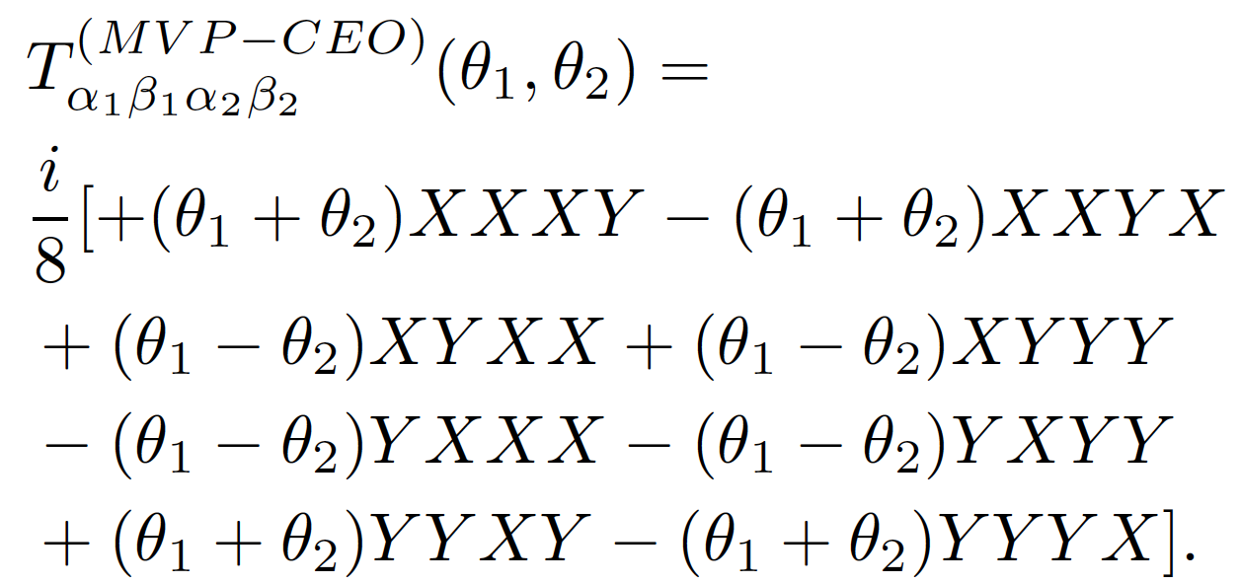
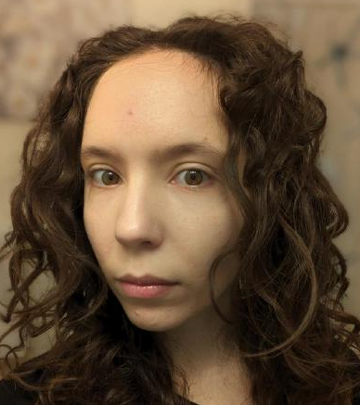
We can do even better by further incorporating symmetries:
Coupled-excitation operator pool
Couple certain excitations based on symmetry considerations
E.g., QE pool does not take α₁, β₁ → α₂, β₂ on the same footing as α₁, β₂ → α₂, β₁ (α: spin up; β: spin down)
If we couple such operators, we obtain a pool with operators of the form:
Ramôa et al, arXiv:2407.08696
See Mafalda’s talk at 4.15 pm

Slide 21

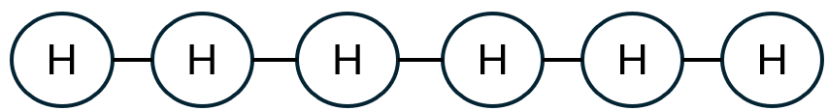
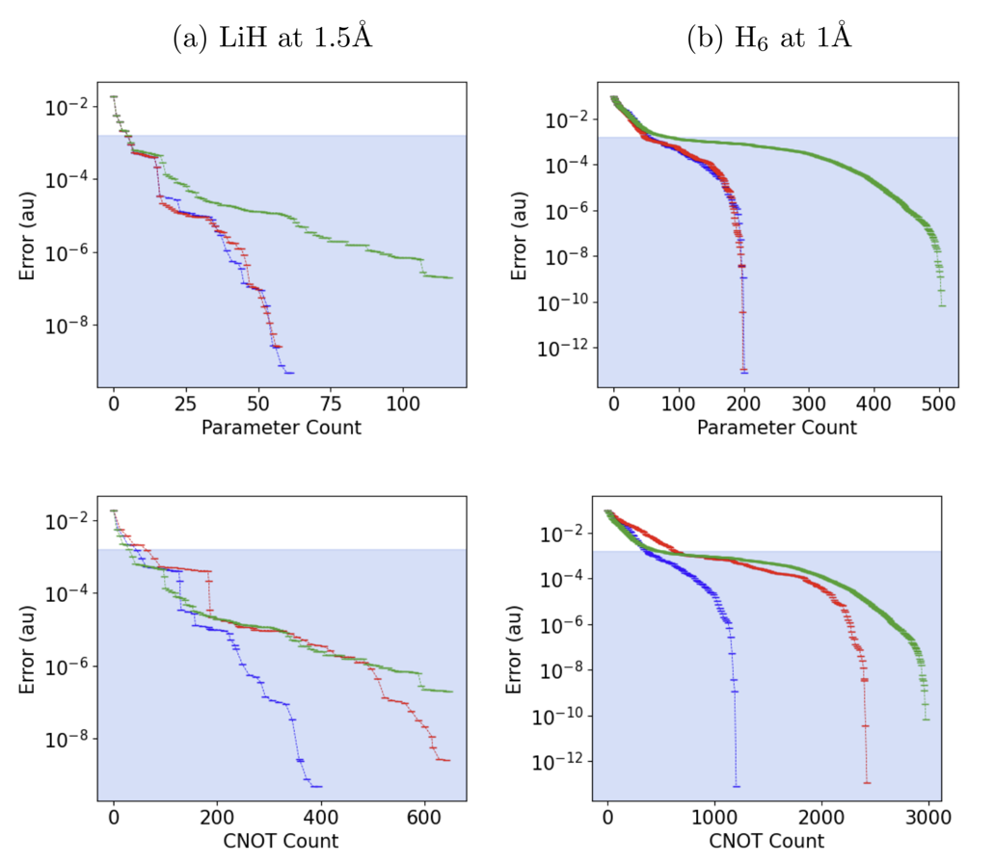
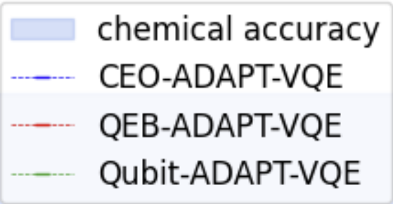
CEO pool, results & comparison to qubit and QE pools
energy
error
parameter
count
Ramôa et al, arXiv:2407.08696
CNOT count

Slide 22
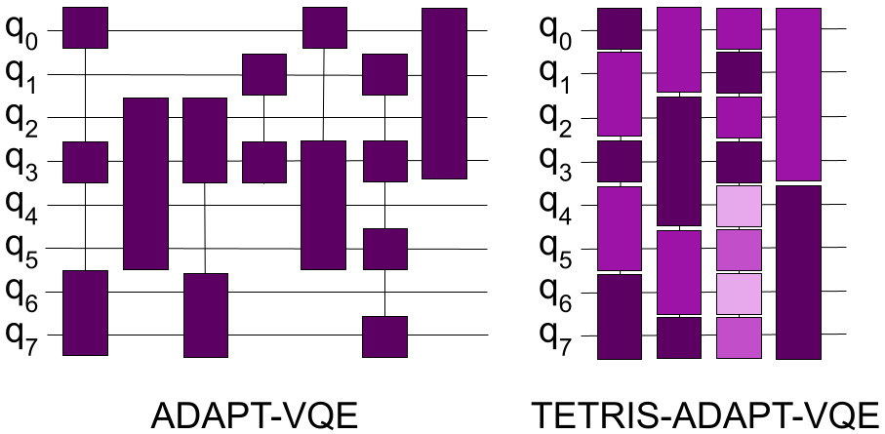
Is ADAPT-VQE the most efficient way to construct circuits?
Can we optimize further for circuit depth?

Slide 23
TETRIS-ADAPT-VQE: concept
Tiling Efficient Trial circuits with Rotations Implemented Simultaneously
Instead of one-at-a-time, add multiple operators at each step
Anastasiou, et al Phys. Rev. Research 6, 013254 (2024)

Slide 24
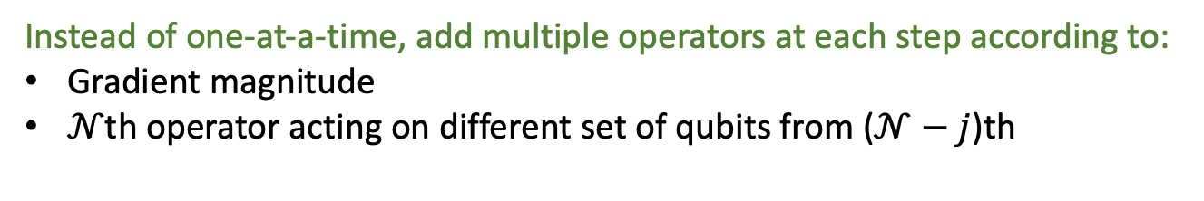
TETRIS-ADAPT-VQE: concept
Tiling Efficient Trial circuits with Rotations Implemented Simultaneously
Instead of one-at-a-time, add multiple operators at each step according to:
Gradient magnitude
$𝒩$th operator acting on different set of qubits from ($𝒩−j$)th
Anastasiou, et al Phys. Rev. Research 6, 013254 (2024)

Slide 25
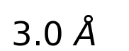
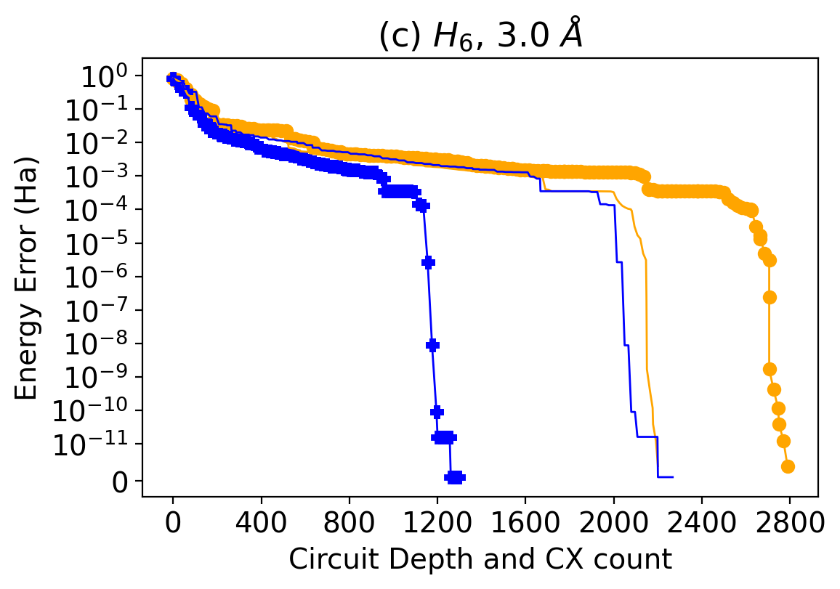
TETRIS-ADAPT-VQE: results
H
H
H
H
H
H
Blue: TETRIS-ADAPT
Orange: standard ADAPT
Anastasiou, et al Phys. Rev. Research 6, 013254 (2024)

Slide 26
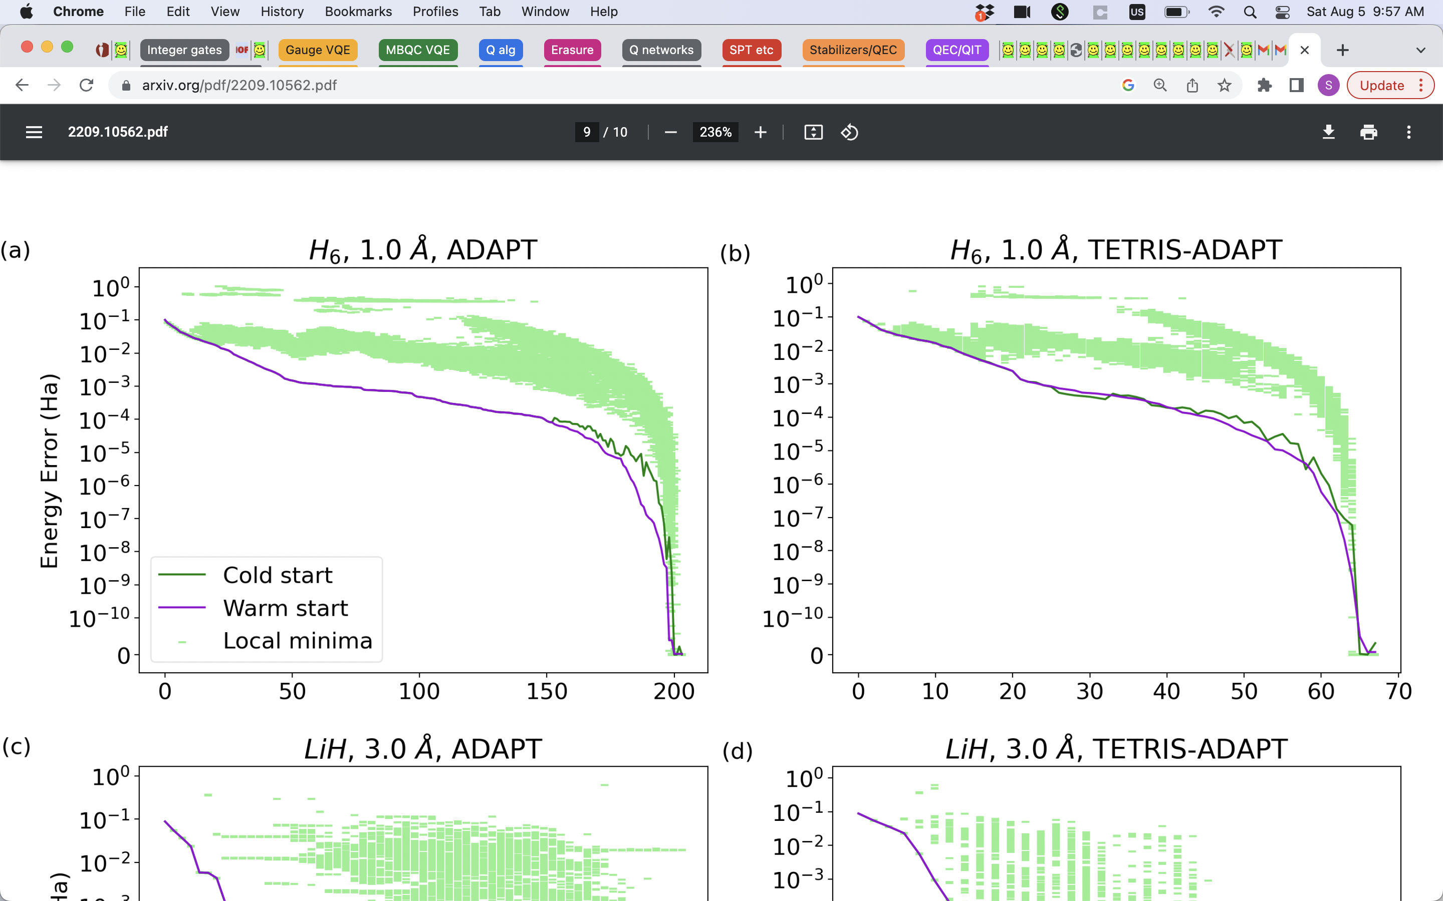
Trainability of TETRIS-ADAPT-VQE
ADAPT
strategy
ADAPT Iteration
Anastasiou, et al Phys. Rev. Research 6, 013254 (2024)

Slide 27
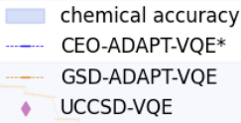
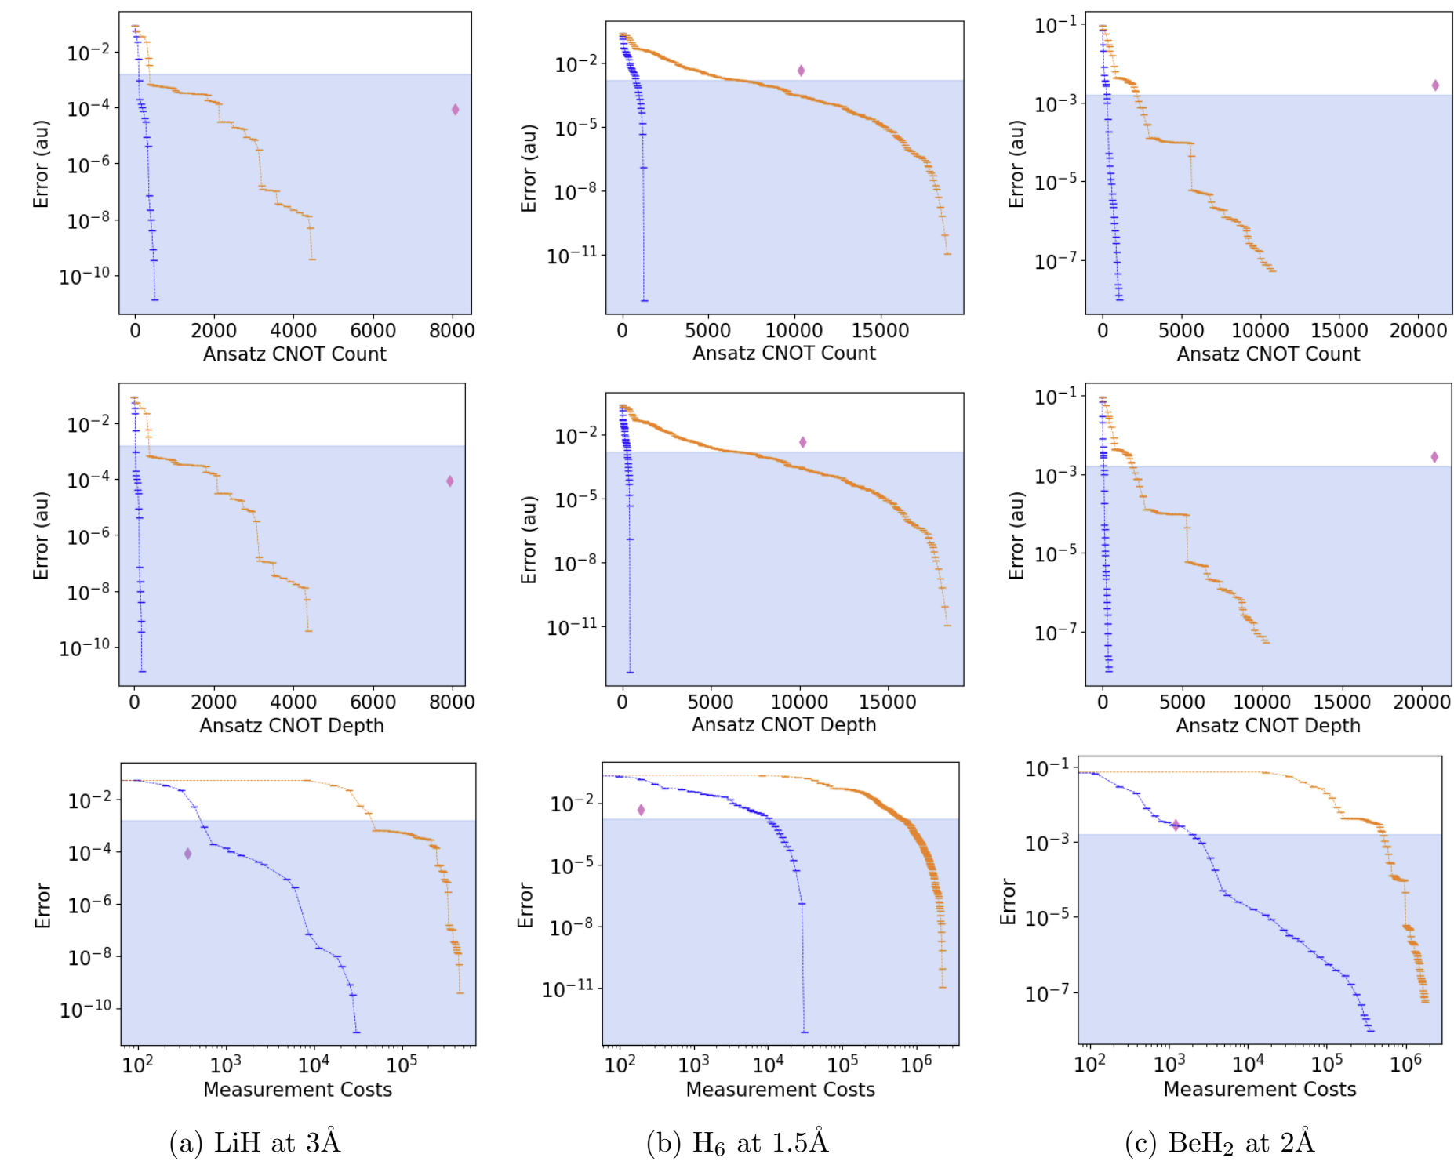
Putting it all together: CEO-ADAPT-VQE*
2019 vs 2024 ADAPT-VQE
New (CEO) pool
TETRIS strategy
Recycling Hessian
Grouping commuting operators
Compared to UCCSD:
Order(s) of magnitude improvement in CNOT count/depth
Comparable nr of measurements

Slide 28
Outline
Adaptive quantum algorithms (ADAPT-VQA)
  Background & ADAPT-VQE
  Adaptive Gibbs state preparation
Control-VQE: optimizing at the pulse level

Slide 29
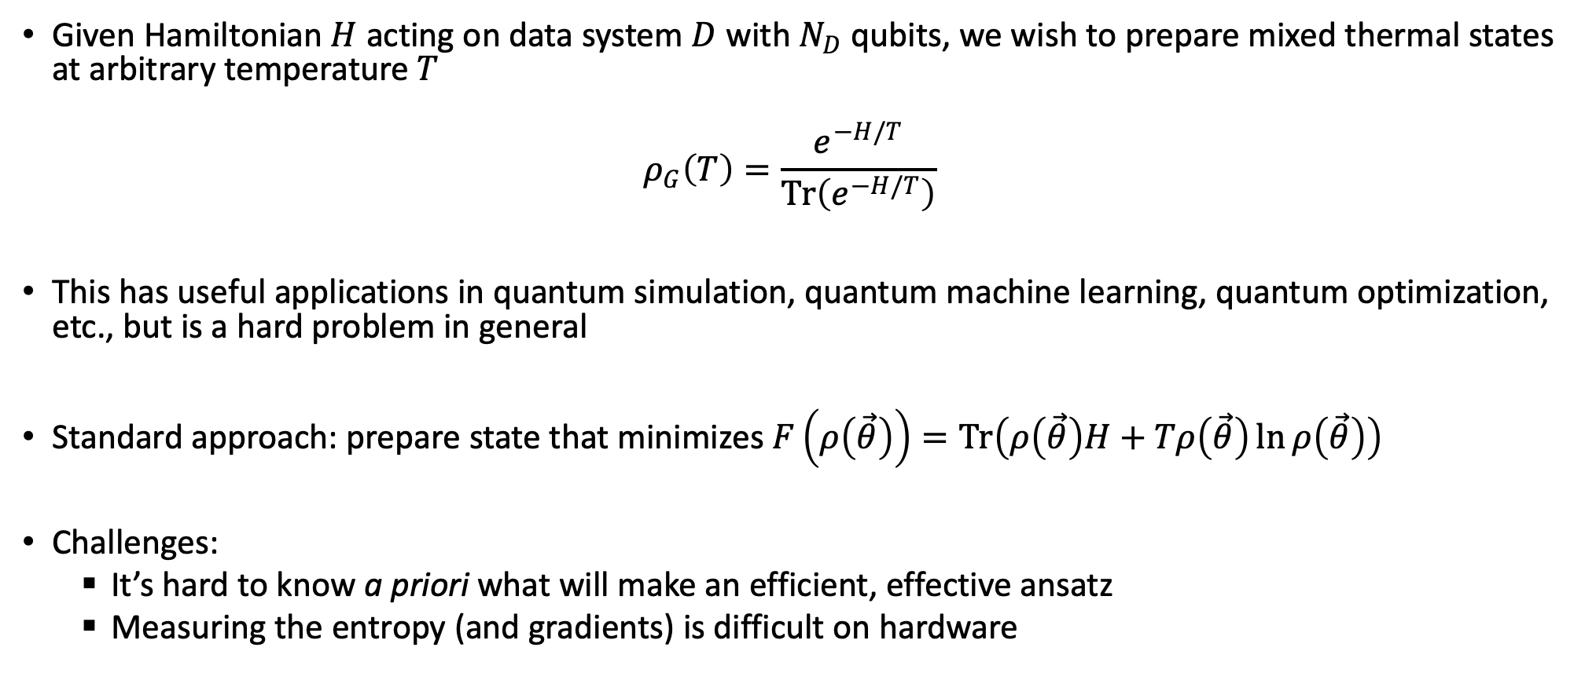
Gibbs state preparation
Given Hamiltonian $H$ acting on data system $D$ with $N_{D}$ qubits, we wish to prepare mixed thermal states at arbitrary temperature $T$
$$ρ_{G}\left(T\right)=\frac{e^{−H/T}}{\operatorname{Tr}\left(e^{−H/T}\right)}$$
This has useful applications in quantum simulation, quantum machine learning, quantum optimization, etc., but is a hard problem in general
Standard approach: prepare state that minimizes $F\left(ρ\left(\vec{θ}\right)\right)=Tr\left(ρ\left(\vec{θ}\right)H+Tρ\left(\vec{θ}\right)\ln{ρ\left(\vec{θ}\right)}\right)$
Challenges:
  It’s hard to know a priori what will make an efficient, effective ansatz
  Measuring the entropy (and gradients) is difficult on hardware
Wu and Hsieh. PRL 123, 220502 (2019)
Chowdhury, Low, and Wiebe. arXiv:2002:00055 (2020)
Wang, Li, and Wang. PRA 16, 054035 (2021)

Slide 30

Gibbs-ADAPT-VQE
Our approach:
  New objective function that is easier to measure: $C\left(ρ\left(\vec{θ}\right)\right)=−\operatorname{Tr}\left(ρ_{G}\left(T\right)ρ\left(\vec{θ}\right)\right)+\frac{1}{2}\operatorname{Tr}\left(ρ{\left(\vec{θ}\right)}^{2}\right)$
  ADAPT-VQE approach to grow the ansatz
Warren et al, arXiv: 2203.12757

Slide 31
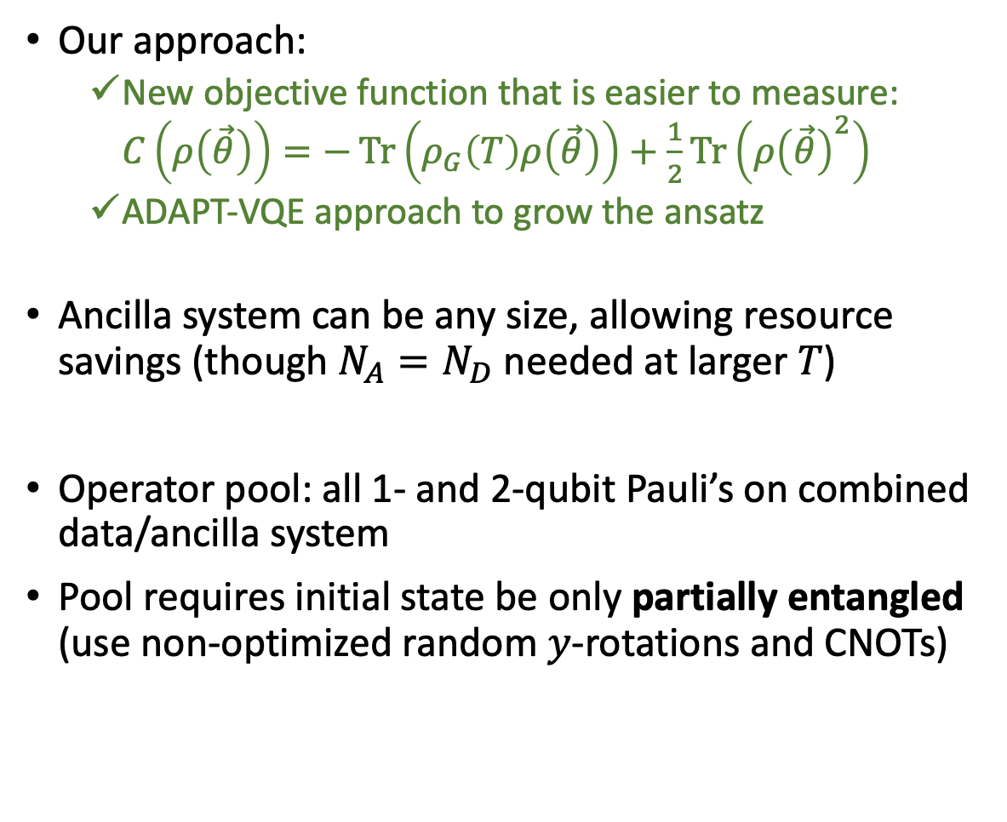
Gibbs-ADAPT-VQE
Our approach:
  New objective function that is easier to measure: $C\left(ρ\left(\vec{θ}\right)\right)=−\operatorname{Tr}\left(ρ_{G}\left(T\right)ρ\left(\vec{θ}\right)\right)+\frac{1}{2}\operatorname{Tr}\left(ρ{\left(\vec{θ}\right)}^{2}\right)$
  ADAPT-VQE approach to grow the ansatz
Ancilla system can be any size, allowing resource savings (though $N_{A}=N_{D}$ needed at larger $T$)
Operator pool: all 1- and 2-qubit Pauli’s on combined data/ancilla system
Pool requires initial state be only partially entangled (use non-optimized random $y$-rotations and CNOTs)
Warren et al, arXiv: 2203.12757

Slide 32
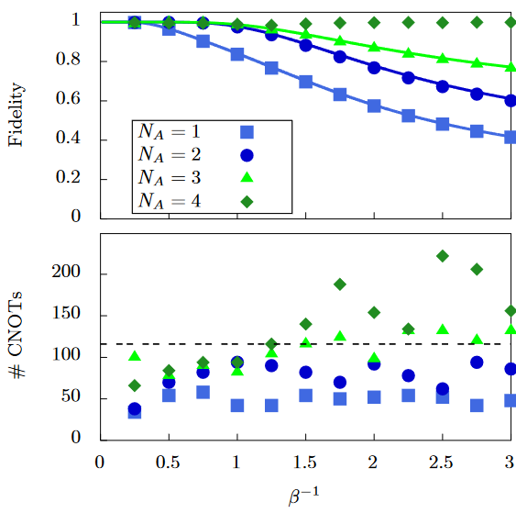
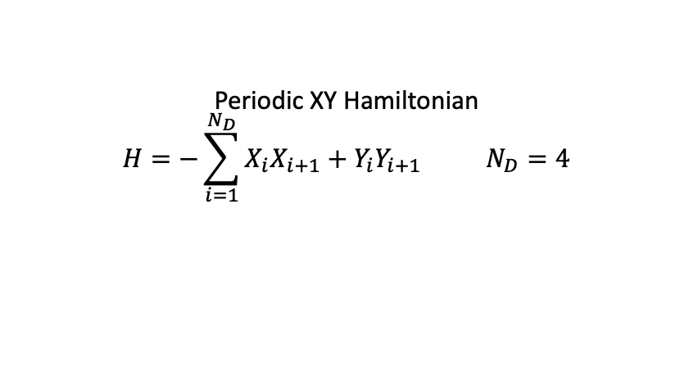
Gibbs-ADAPT-VQE
Our approach:
  New objective function that is easier to measure: $C\left(ρ\left(\vec{θ}\right)\right)=−\operatorname{Tr}\left(ρ_{G}\left(T\right)ρ\left(\vec{θ}\right)\right)+\frac{1}{2}\operatorname{Tr}\left(ρ{\left(\vec{θ}\right)}^{2}\right)$
  ADAPT-VQE approach to grow the ansatz
Ancilla system can be any size, allowing resource savings (though $N_{A}=N_{D}$ needed at larger $T$)
Operator pool: all 1- and 2-qubit Pauli’s on combined data/ancilla system
Pool requires initial state be only partially entangled (use non-optimized random $y$-rotations and CNOTs)
Periodic XY Hamiltonian
$$H=−\sum_{i=1}^{N_{D}}{X_{i}X_{i+1}+Y_{i}Y_{i+1}} N_{D}=4$$
Warren et al, arXiv: 2203.12757

Slide 33
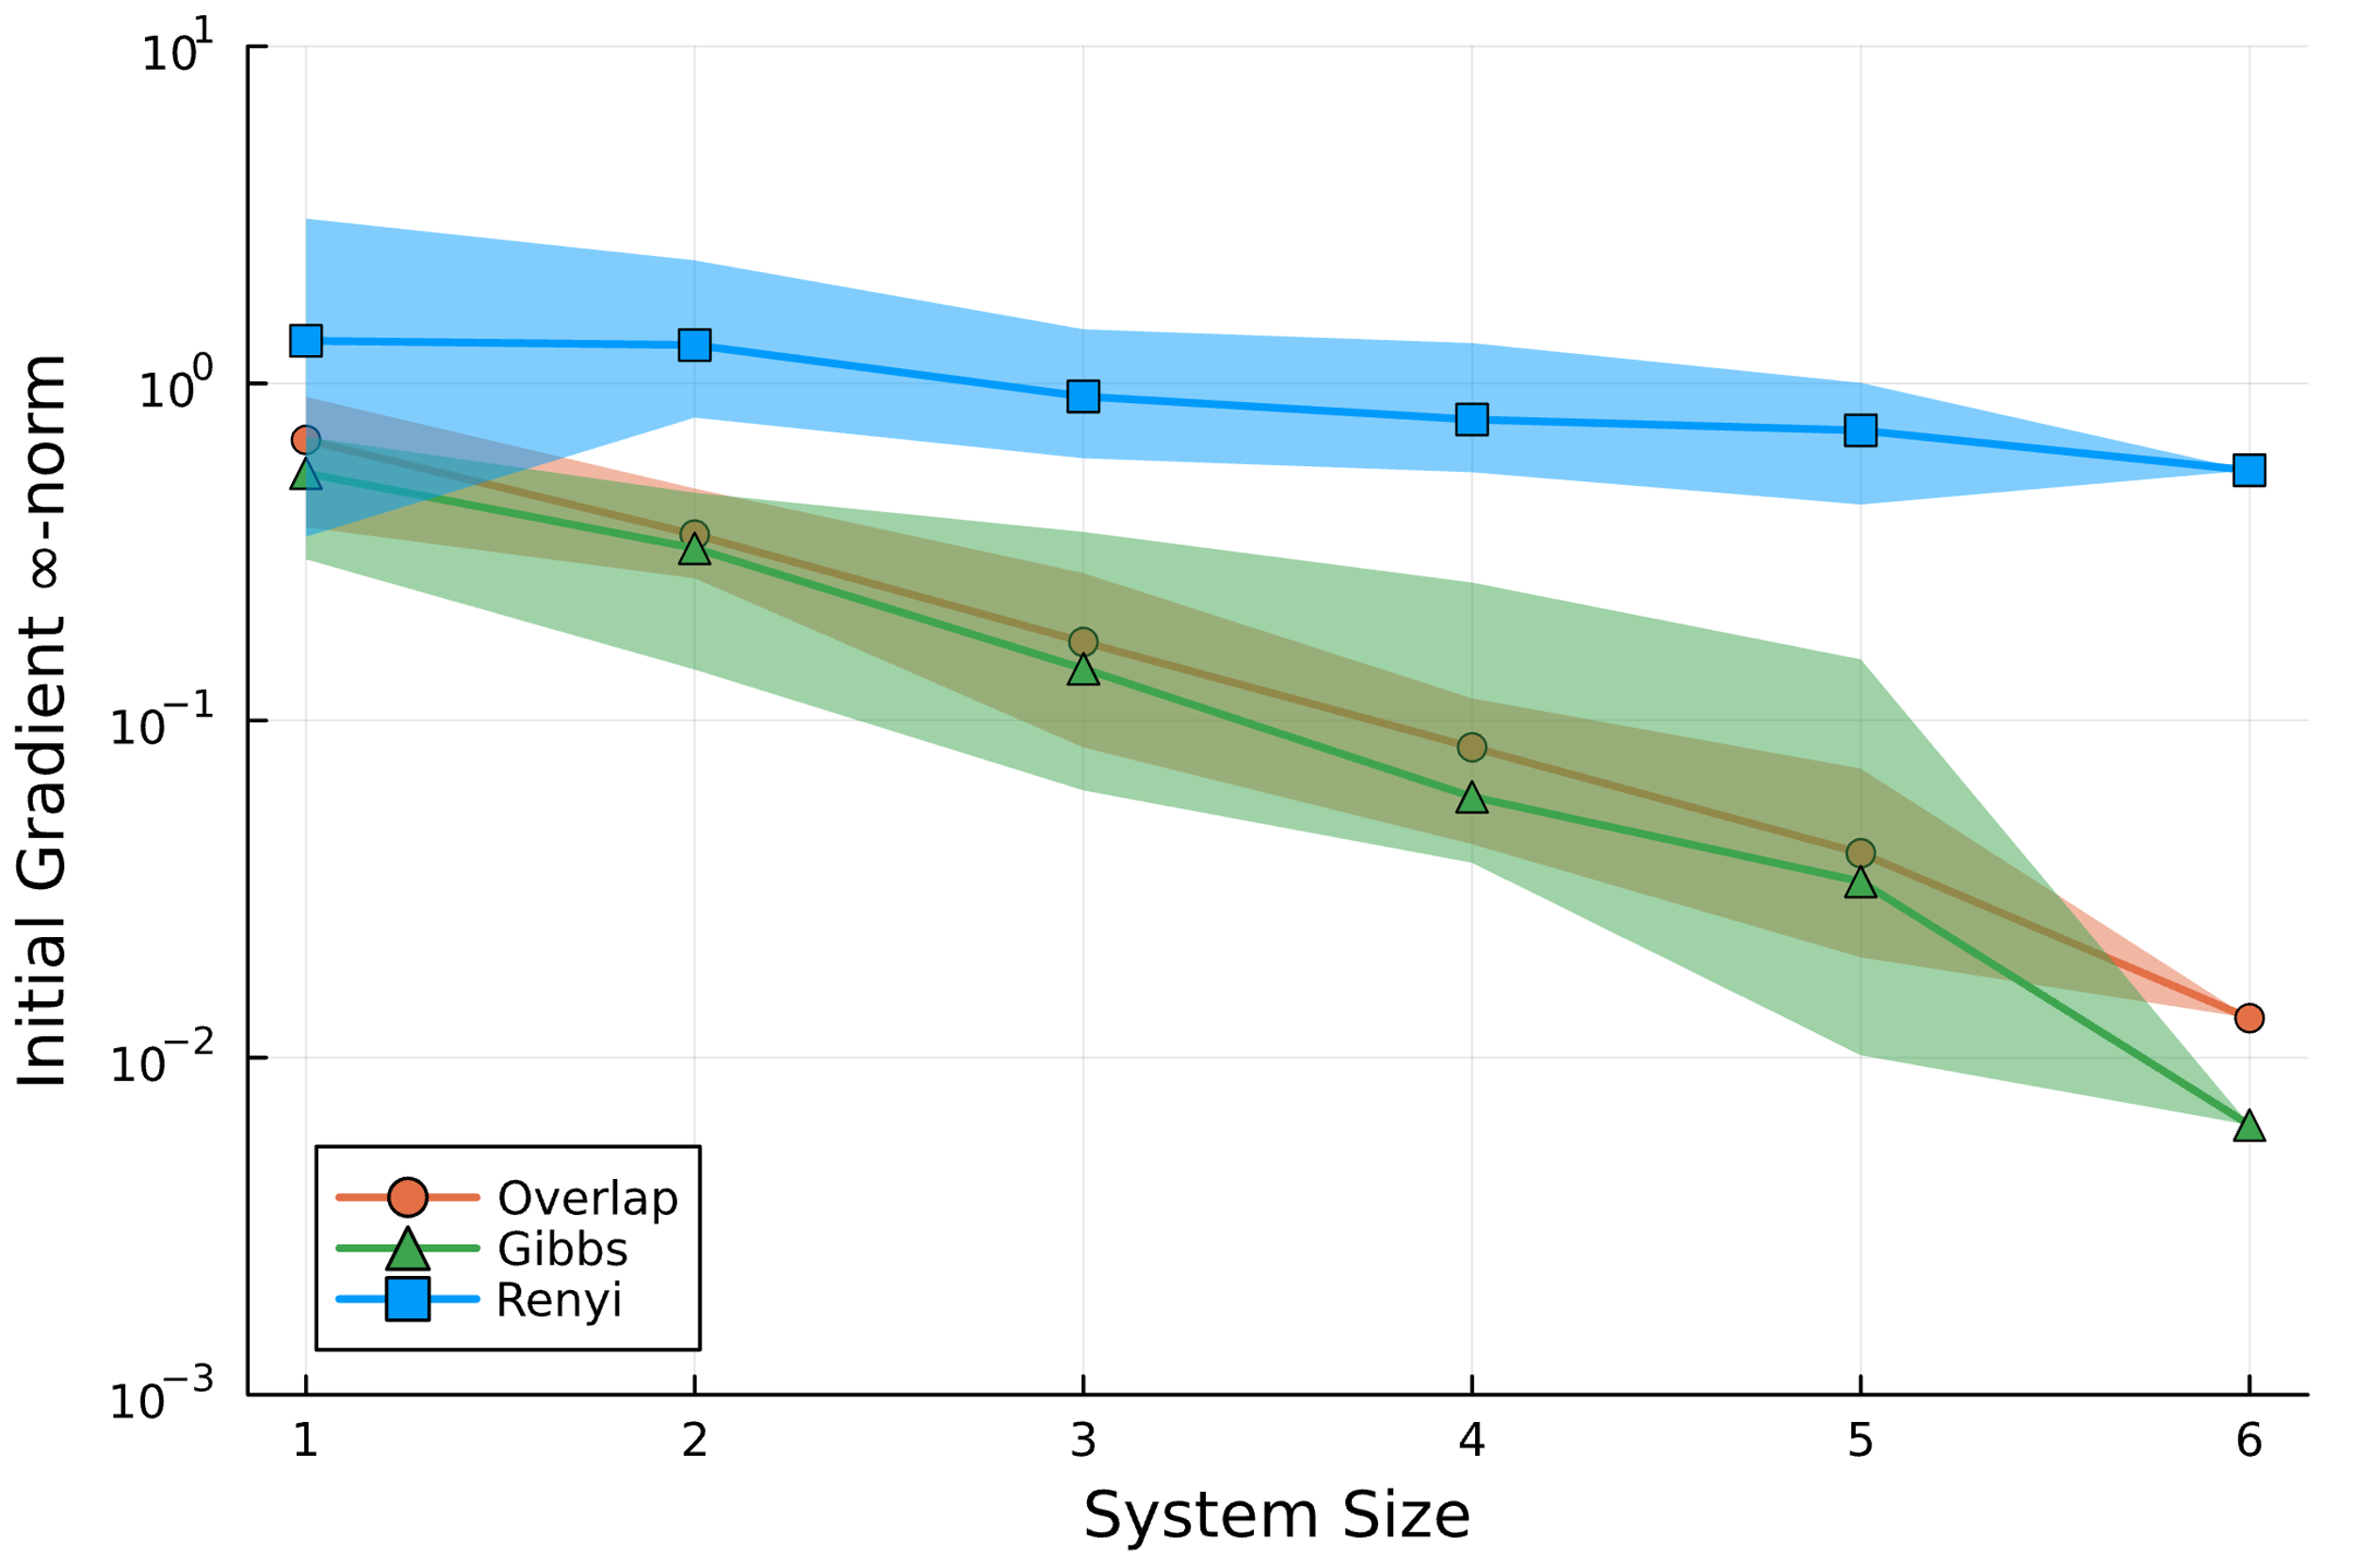

Avoiding barren plateaus in Gibbs-ADAPT-VQE
$$L\left(σ,ρ\right)=\log\left(Tr\left(σ^{2}ρ^{−1}\right)\right)$$
Use Renyi divergence-based loss function:
  Unbounded → gradients remain large far from solution Kieferová et al, arXiv:2106.09567
Gibbs-ADAPT-VQE simulations for
different loss functions
Sherbert et al, arXiv:2408.00218

Slide 34
Still no quantum advantage
What could work out in the near term?

Slide 35
Outline
Adaptive quantum algorithms (ADAPT-VQA)
  Background & ADAPT-VQE
  Adaptive Gibbs state preparation
Control-VQE: optimizing at the pulse level

Slide 36
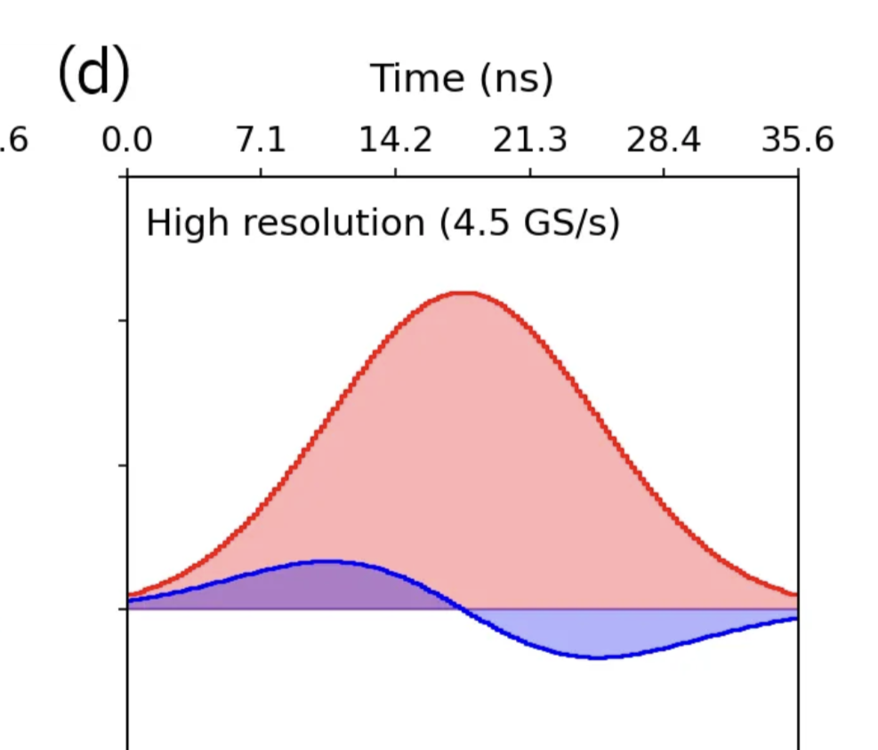
Optimizing at the pulse level
All gates are made of electromagnetic pulses
Using gates is a digitized approach
Example: pulses implementing
IBM single-qubit gates

Slide 37
Optimizing at the pulse level
All gates are made of electromagnetic pulses
Using gates is a digitized approach
Pulse-level optimization:
Throw out the gates, parameterize pulse directly
Measure <H>
Classical optimization → update pulse parameters
Repeat until convergence
Example: pulses implementing
IBM single-qubit gates
Meitei et al, npj Quantum Information 7, 155 (2021)

Slide 38
Pulse-based parameterization (“ctrl-VQE”)
Gate-based parameterization is a special case of pulse parameterization
Lots of freedom in which terms to parameterize, and how to parameterize them
Meitei et al, npj Quantum Information 7, 155 (2021)

Slide 39
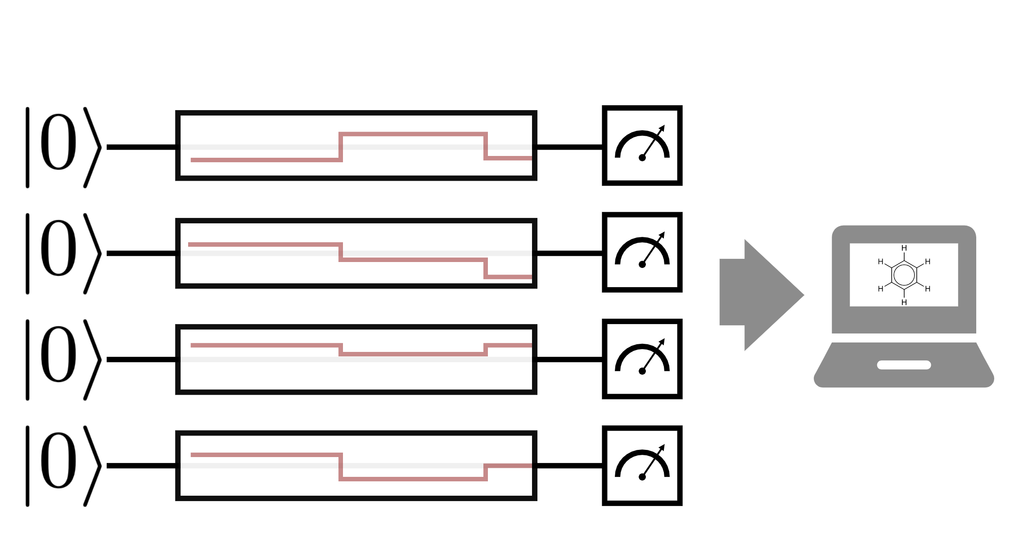
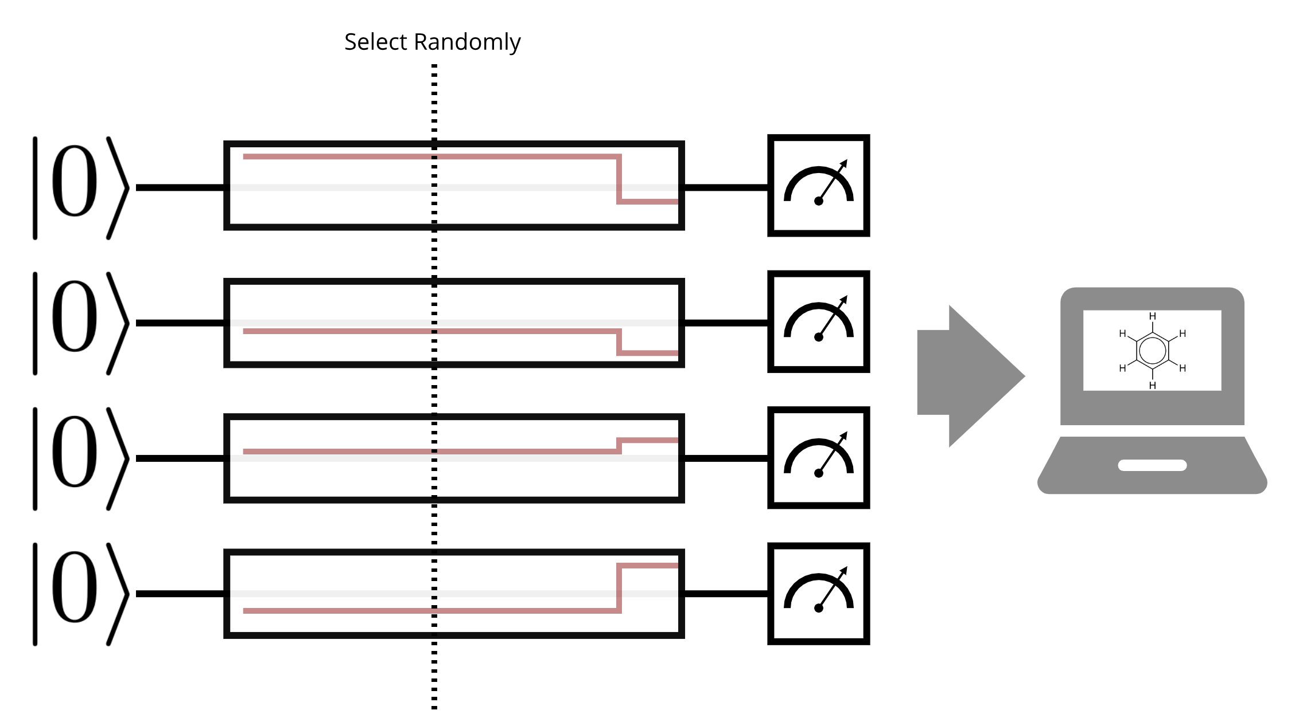
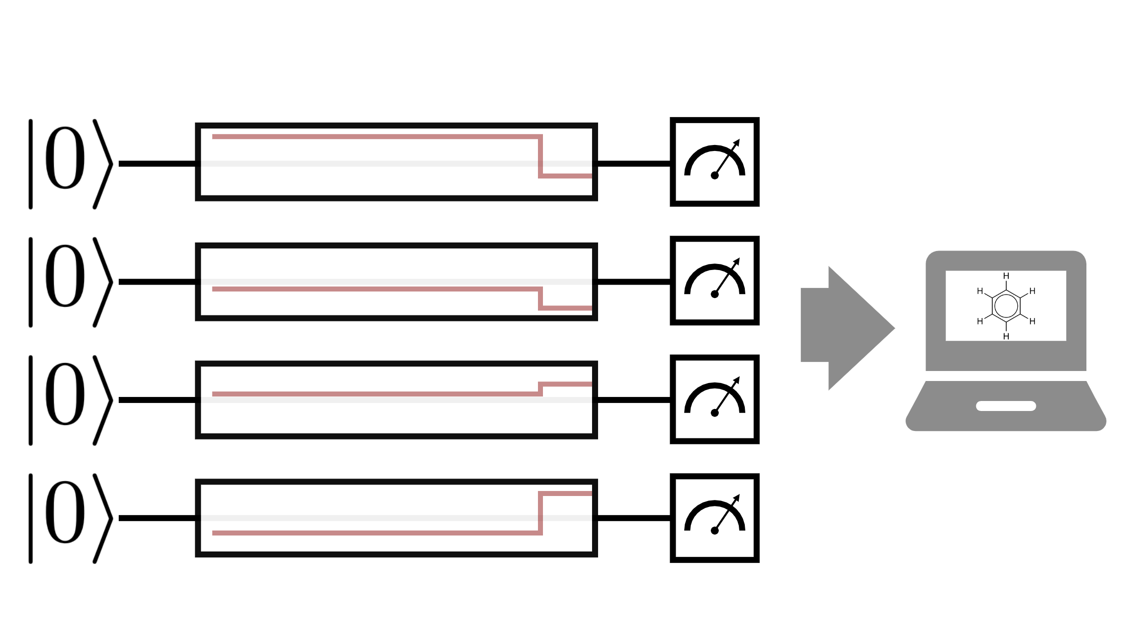
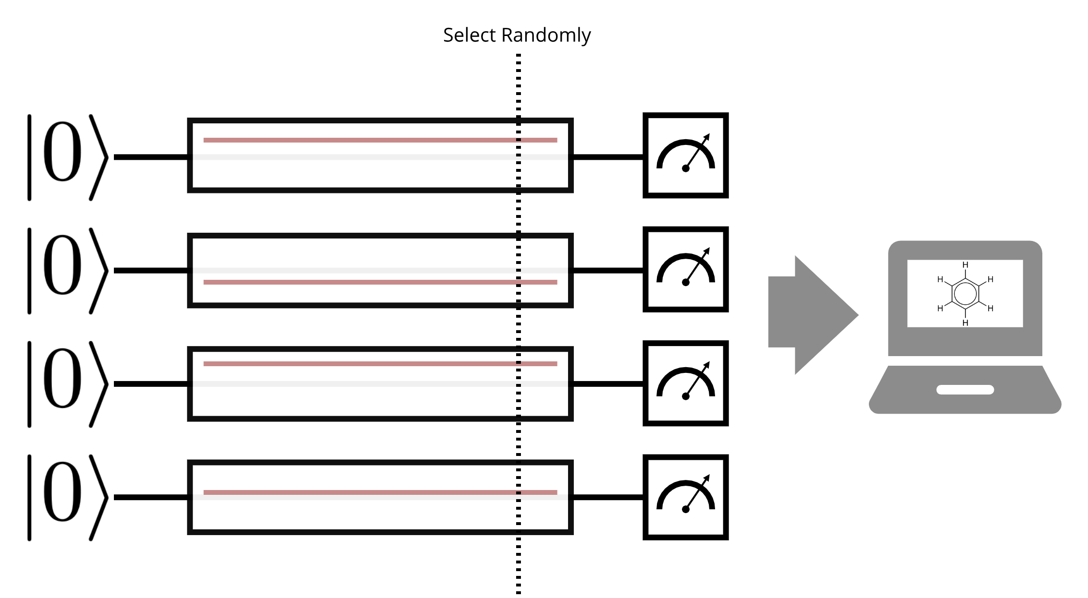
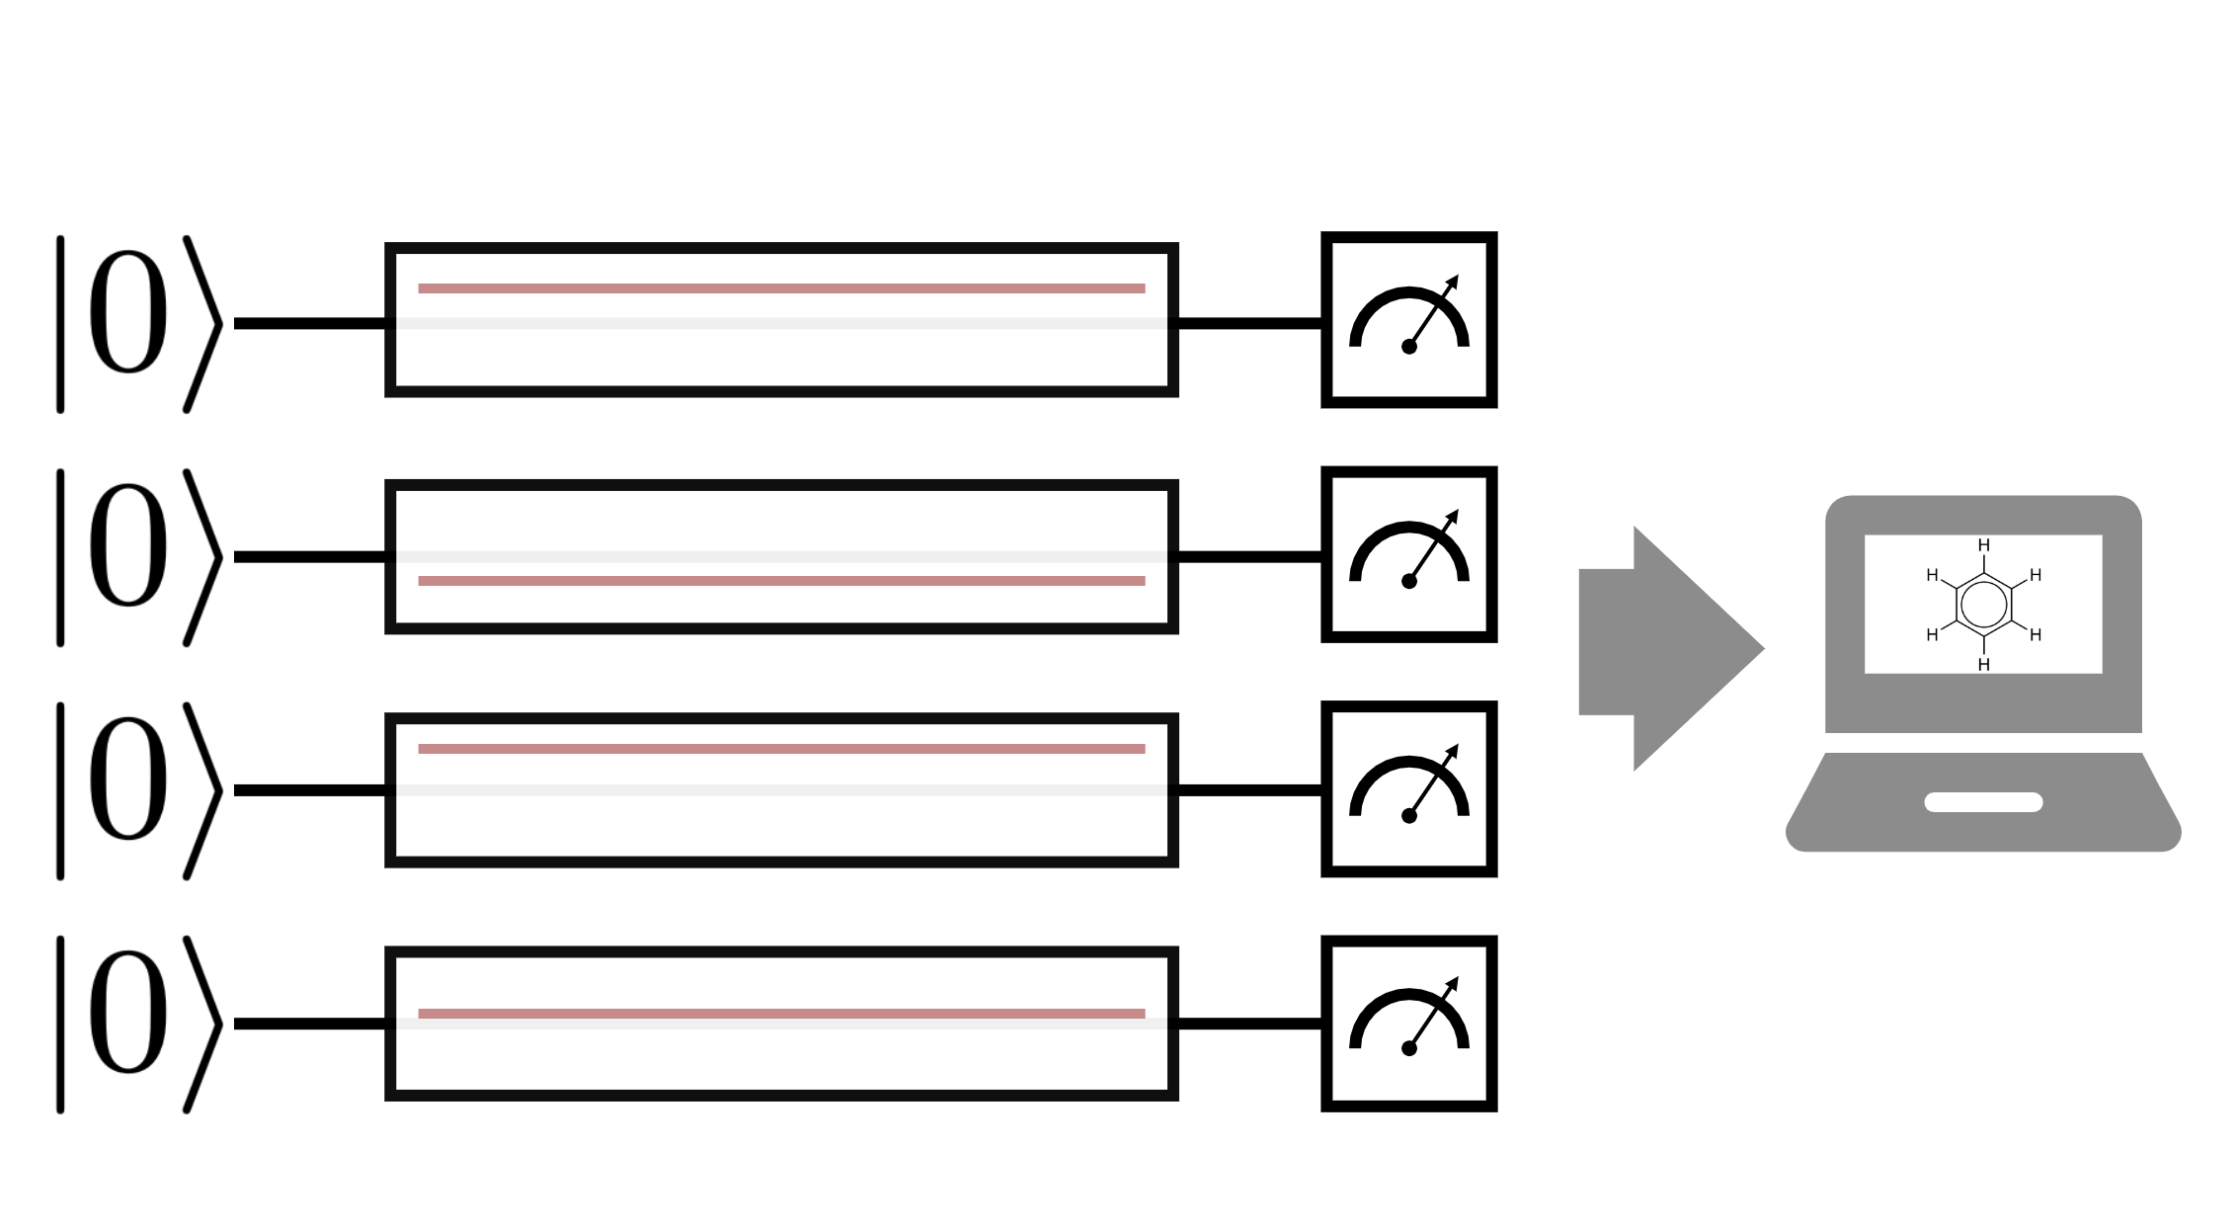

Slide 40
Numerical results
Dissociation curve for H2
(Indistinguishable from FCI)
Number of segments required for convergence
Orders of magnitude improvement:
E.g., for LiH: 80,000ns (gate-based UCCSD) vs. 50ns (ctrl-VQE)
Meitei et al, npj Quantum Information 7, 155 (2021)

Slide 41
Ctrl-VQE: minimal evolution time
Minimal evolution time (MET): the min time required to transition between two particular quantum states (also referred to as quantum speed limit (QSL))
Below a certain evolution time there is no solution
Shortening the total pulse time leads to ‘bang-bang’ control (Pontryagin principle)
Simulations for H2 at bond distance 1.5 A
Asthana, Liu, et al,
Phys. Rev. Applied 19, 064071 (2023)

Slide 42
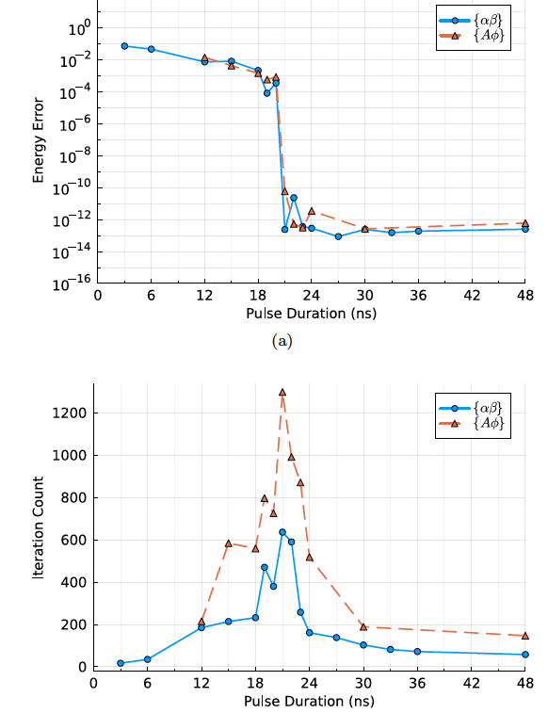
Ctrl-VQE: parameterization and optimizability
Sherbert, Amer, et al, arXiv:2405.15166

Slide 43
Summary
ADAPT-VQE
Algorithmic improvements since 2019
  TETRIS-ADAPT-VQE (2022)
  Efficient measurement of gradients (2023)
  CEO pool (2024)
  Hessian recycling (2024)
Adaptive Gibbs state preparation
Ctrl-VQE

Slide 44
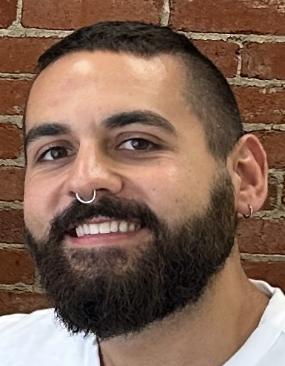

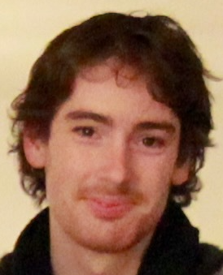
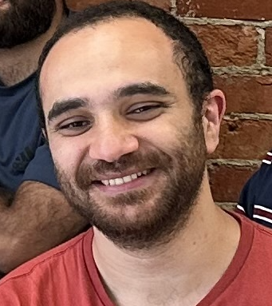

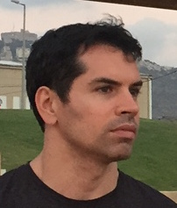
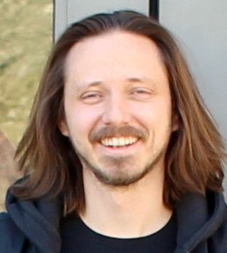
Acknowledgements
Student/postdocs:
Mafalda Ramoa
Peter Anastasiou
Karunya Shirali
Kyle Sherbert
Hisham Amer
Jim Furches
Senior collaborators (VT):
Edwin Barnes
Virginia Tech
Nick Mayhall
Virginia Tech

Slide 45

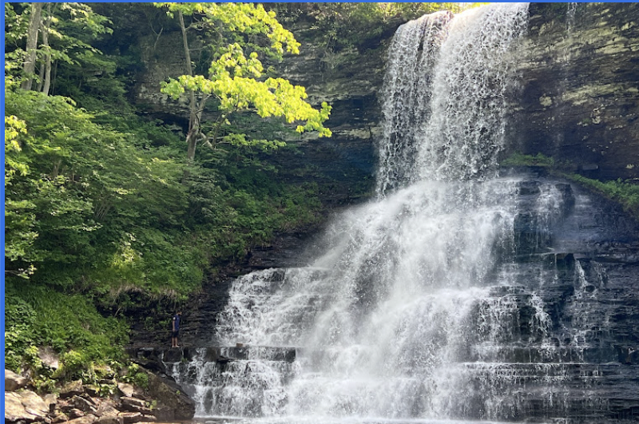
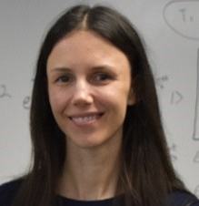
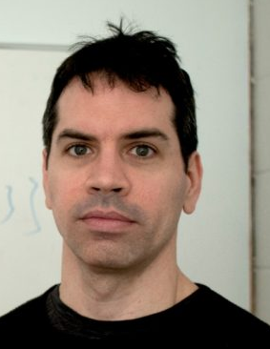
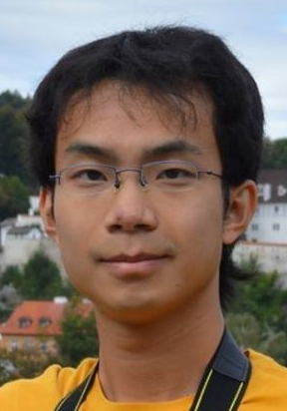
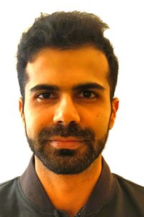
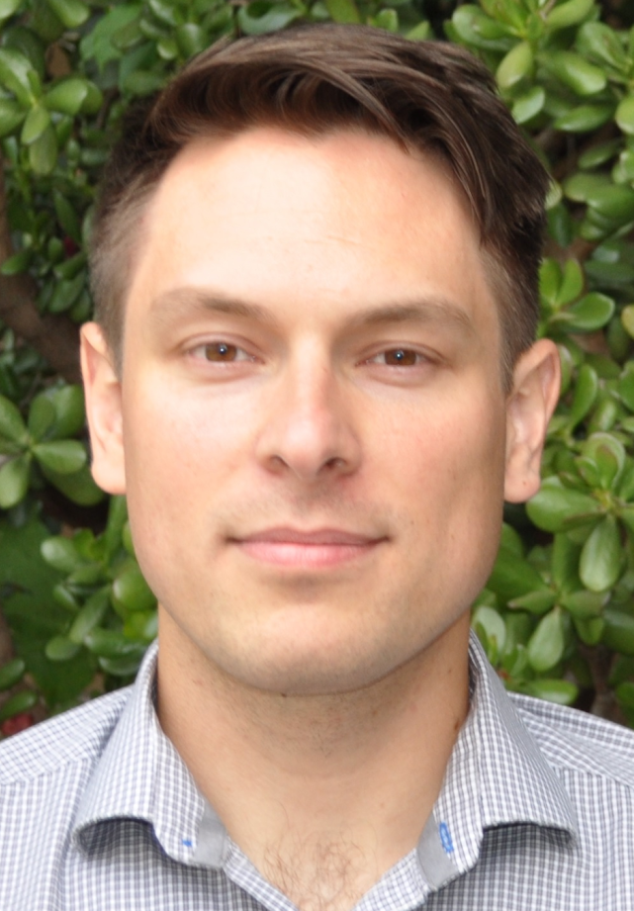









Postdoc positions open
Sophia Economou
Physics
VTQ Director
Ed
Barnes
Physics
Charles Cao
Physics
Arpit
Dua
Physics
Seva Ivanov
Physics
Sumeet Khatri
CS
Atul
Mantri
CS
Nick
Mayhall
Chemistry
Gretchen
Matthews
Math
Kyungwha Park
Physics
Vito Scarola
Physics
Linbo
Shao
ECE
Jamie
Sikora
CS
Tianci
Zhou
Physics

Slide 47
ADAPT-VQE: measurement ‘overhead’
What is the additional cost of this step?
Let’s focus first on the qubit pool (XXXY, etc)

Slide 48



Measuring gradients in ADAPT
Number of terms goes as $O(N4)$
Size of Pauli pool also goes as $O(N4)$
How can we decrease the number of state preparations?
Commuting observables can be measured simultaneously
Which grouping heuristic should we use?
Grouping Hamiltonian terms not ideal
Anastasiou et al, arXiv:2306.03227 (2023)

Slide 49

Measuring gradients in ADAPT—a better approach
For $A, B, C$Pauli strings:
If $[B,C]=0$, then $[ [A,B] , [A,C] ] = 0$
By extension, the commutators of the elements of any mutually commuting set of Pauli strings with any one Pauli string commute
Anastasiou et al, arXiv:2306.03227 (2023)

Slide 50




Measuring gradients in ADAPT—a better approach
What does this mean for operators of the form
${iY}_{i}X_{j}X_{k}X_{l}$ ?
$H$ terma
$O(N3)$commutators can be measured simultaneously!
We can group the commutators of any Hamiltonian term with all qubit operators into $2N$ groups
Measuring term-by-term of the Hamiltonian means all observables in any given group have the same weight – lower shot-noise
Measuring the pool gradient is only $\sim N$ times as expensive as a naïve VQE iteration
QE and CEO pools contain same commuting terms → approach carries over
Anastasiou et al, arXiv:2306.03227 (2023)

Slide 51

Ctrl-VQE: minimal evolution time
A (possibly surprising) finding:
Leakage to excited states outside qubit space speeds up evolution
Probability to reach exact solution
Simulations for H2 at bond distance 1.5 A
Asthana, Liu, et al,
Phys. Rev. Applied 19, 064071 (2023)

