Slide 1
New Approaches for Training Quantum Models
Nathan Wiebe, Burak Cathli, Sophia Simon
Trigger Warning: There may be memes (but not as many as Marco’s talk)

Slide 2
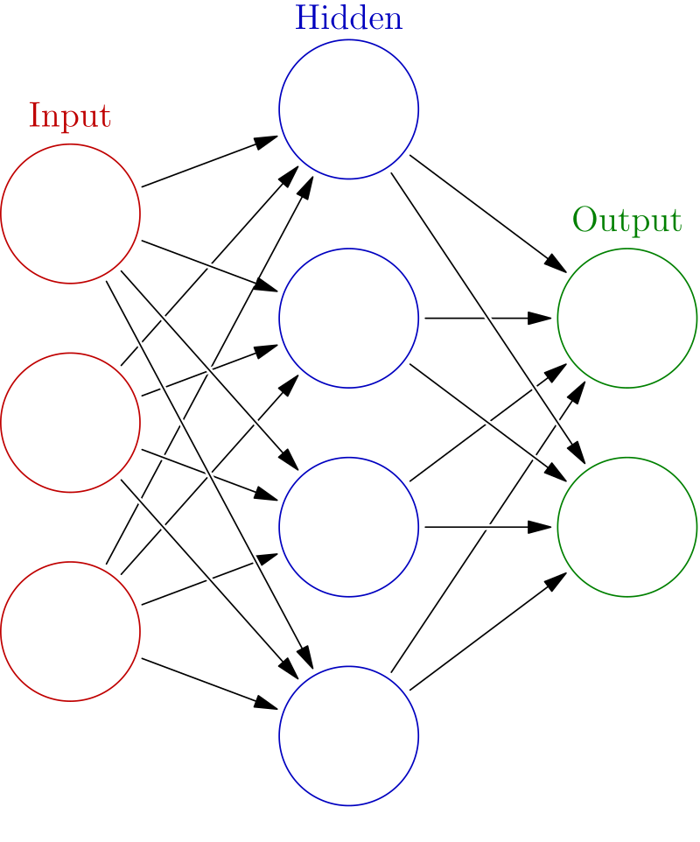
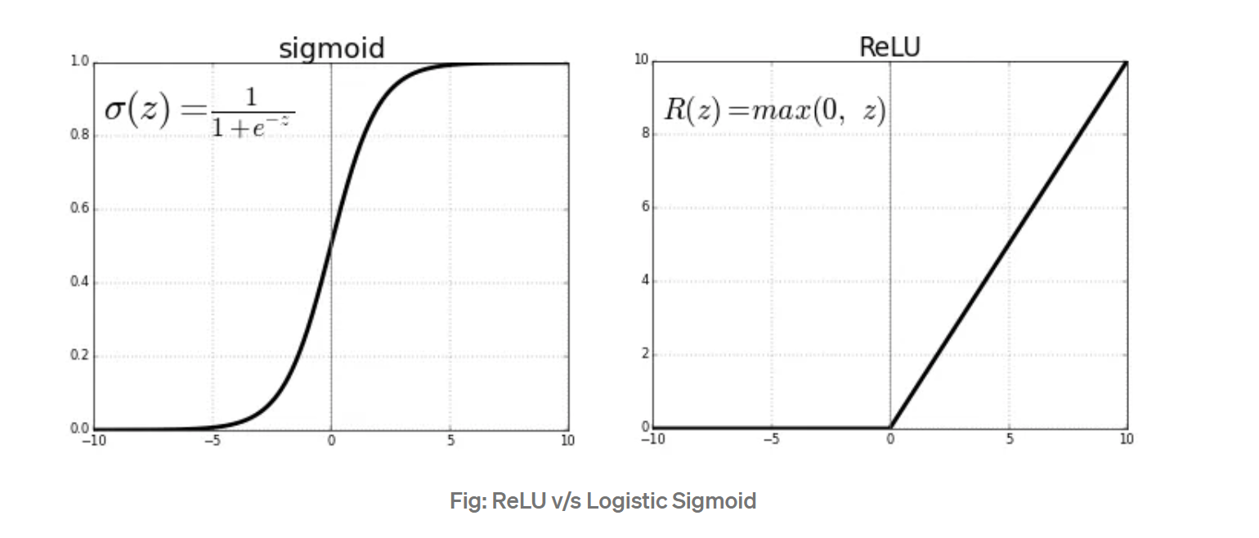
Neural network
An (artificial) neural network is a graphical model for data.
It consists of hidden (latent) and visible variables.
Each edge in the graph has a weight $w_{ij}$.
Each node has an activation. The activation of a subsequent layer is $x_{i}=f(\sum_{j}{w_{ij}x_{j}).}$
Kolmogorov: f cannot be linear if you want to learn an arbitrary function.
Goal is to learn w matrix by gradient ascent on some objective function.

Slide 3
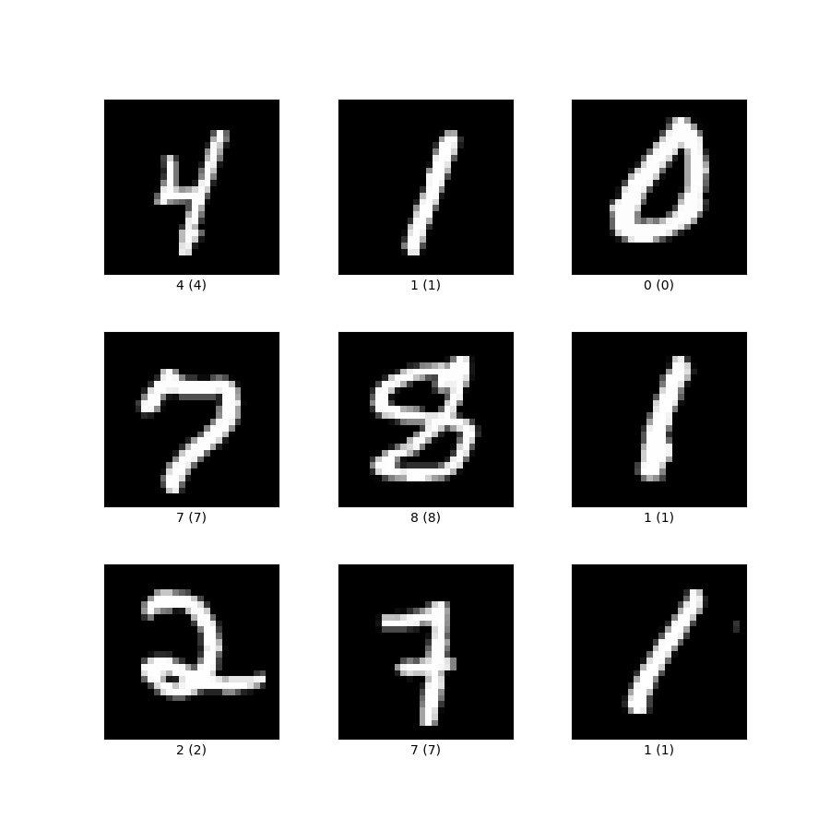
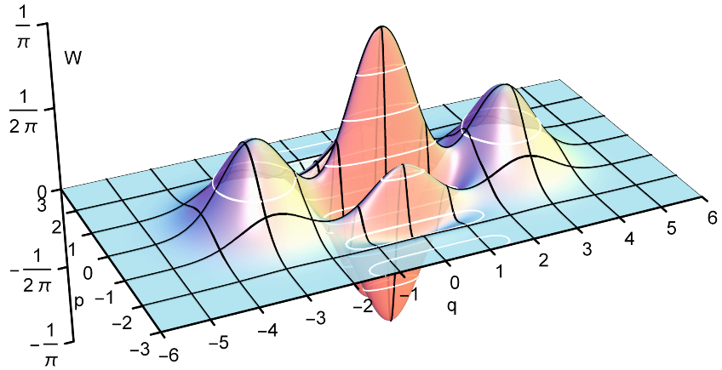
The dream of QML
$$Tr\left(ρ_{out}M_{objective}\right)$$
$$f_{encoding}(w)$$
Relevant Data About Input
We want to maximize the information about the relevant data in the input distributions and the output data.
$$U_{NN}(θ)$$
Classical Data
Quantum Data
Hilbert Space of Quantum Computer

Slide 4
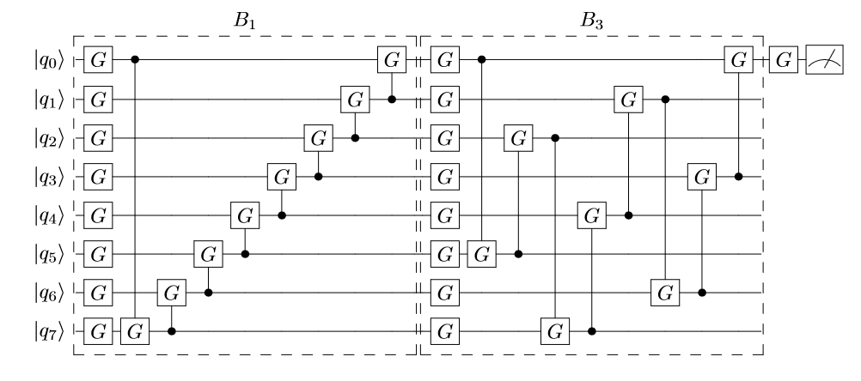
What does a quantum neural network look like?
Class label (0,1) out
$$ρ_{1}vs ρ_{0}$$
$$ρ_{1}=\frac{1}{D}\sum_{j}{\left|φ_{j}\right\rangle \left\langle φ_{j}\right|}$$
$$ρ_{0}=\frac{1}{D′}\sum_{j}{\left|ψ_{j}\right\rangle \left\langle ψ_{j}\right|}$$
$$G=R_{z}\left(θ\right)R_{x}\left(φ\right)R_{z}(ψ)$$
$M_{objective}=\left|1\right\rangle \left\langle 1\right|⊗1 ,$ if training label is 1
$M_{objective}=\left|0\right\rangle \left\langle 0\right|⊗1 ,$ if training label is 0
In order to find the best parameters for each G we use gradient
Descent $Tr\left(ρ_{out}M_{objective}\right)$
Training data
vector
$$\left|ψ_{14}\right\rangle$$
$$\left|φ_{32}\right\rangle$$
$$\left|ψ_{17}\right\rangle$$
$$\left|φ_{39}\right\rangle$$
Class label
0
1
0
1

Slide 5
Mea Culpa: I may have talked some trash about variational QML / VQE
Fig 3. My conclusion about near term applications of QML.
Fig 1. My usual attitude towards students who want to do variational stuff with me.
Fig 2. Its really not scalable. Number of gates needed for precision estimates for VQE ${10}^{20}$ gates. Let alone train… Also LLM scale applications unlikely and unclear prospects for exponential advantage.

Slide 6
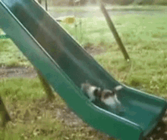
A major problem
(This cat should be named Sisypus)
We usually focus on the gradient.
We do not usually talk about how many gradient steps are needed.
Can we turn this on its head by abandoning explicit gradient calculations?
In this work we will do exactly this.
We will remove explicit gradient calculation from variational methods.
We provide bounds on the number of steps needed under certain strong assumptions.
May need many gradient steps to reach your goal.

Slide 7
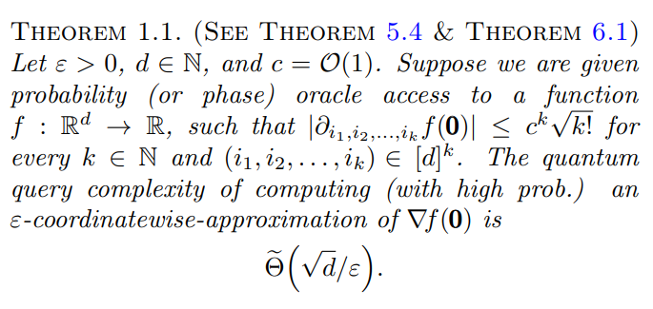
What is the cost of gradient computation?
Gilyen, Arunalacham, Wiebe (2019):
Evaluating the gradient within exponentially small error will take exponentially many queries to the objective fcn.
This means vanishing gradient is far worse in quantum than classical.

Slide 8
Problems with QML
Barren Plateaus
Exponentially small gradients are typical for QML models.
Assuming that we simply need to compute the sign of the gradient, the lower bound is $Ω\left(2^{n}\sqrt{d}\right),$ where d is the number of parameters.
Number of gradient steps
The above is just the cost of doing a gradient evaluation.
We need to evaluate the model as well.
Typical cost is on the order of $O\left({N_{steps}2}^{n}\sqrt{d}\right)=O\left({L2}^{2n}\sqrt{d}/λ\right)$

Slide 9
The bottleneck
Core idea: Perform the entire optimization on a quantum computer.
This saves us from either sampling or using phase estimation.
Intuition same as that used to exponentially improve HHL.
Classical
Quantum
Bottleneck is moving the information in and out of the quantum computer
$$O\left(\frac{1}{ε}\right)$$

Slide 10
Approach
Let us assume that we have a model that computes an objective function $F(θ)$ for $θ∈R^{d}.$
Goal is to minimize $\left\langle ψ\left(θ\right)\left|\hat{F}\right|ψ\left(θ\right)\right\rangle .$
$$θ_{1}$$
$$θ_{4}$$
Need to pick their masses, treat momentum classically or quantumly.
$$F(θ)$$
$$θ_{3}$$
$$θ_{2}$$
We store the parameters as positions of fake particles.
Optimize their values using quantum simulation.

Slide 11
Cost of Simulations
Trotter-Suzuki Simulations
$Cost∼\frac{{\left(α_{comm}t\right)}^{1+\frac{1}{2k}}}{ε^{\frac{1}{2k}}}$
LCU Simulations
$Cost∼\frac{\left(\sum_{j}{{|α}_{j}|}t\right)\log\left(\frac{1}{ε}\right)}{\log{\log\left(\frac{1}{ε}\right)}}$
Qubitization Simulations
$Cost∼\left(\sum_{j}{{|α}_{j}|}t\right)+\frac{\log\left(\frac{1}{ε}\right)}{\log{\log\left(\frac{1}{ε}\right)}}$
$$α_{comm}={\max_{\vec{i},N}\left|\left[H_{i_{1}},\left[H_{i_{2}},⋯\left[{H_{i_{N−1}},H}_{i_{N}}\right]\right]⋯\right]\right|}^{1/N}$$
Pro: Cost scales with commutator of terms Works for time-dependent H
Pro: Very flexible
Works for time-dep H
Con: empirically more costly
Many ancillae needed
Pro: Optimal scaling.
Con: Many ancillae needed Does not work for time-dep H
Con: Not optimal scaling with t or error.
Low Chuang (2016)
Berry, Motlagh, Wiebe (2024)
Wiebe, Childs et al (2012)
Wiebe, Low (2018)
Kieferova, Berry et al (2018)
Su, Wiebe, Childs et al (2019)

Slide 12
Approach 1: Liouville Mechanics /Koopman von Neumann
Let p be the phase space density for the system of nuclei.
The equation of motion reads
Here L is the Liouvillian:
The formal solution to the equation is:
The dynamics is unitary, but $ρ(t)$ is not a quantum state vector.
Insert new wave function that is square root of
$∂_{t}\left|ψ_{KvN}\left(t\right)\right\rangle =−iL\left|ψ_{KvN}\left(t\right)\right\rangle$

Slide 13
The Hamiltonian
s is a variable that describes a bath, $p_{s}$is its conjugate momentum (commutes here), Q is a mass for the bath.
Microcanonical distribution for $H_{N}$is the gives a thermal distribution over x.
$V\left(x\right)=⟨ψ\left(x\right)\left|\hat{F}\right|ψ\left(x\right)⟩$
$$V(x)$$
Thermal Distribution

Slide 14
Approach to thermalization
We borrow ideas from quantum thermodynamics to bound the time needed to approach the microcanonical distribution over x.
We assume that the global state is pure.
x
Bath
$$p,s,p_{s}$$
Uniform distribution
Energy Window = $Δ$
x
System
p
Microcanonical distribution

Slide 15
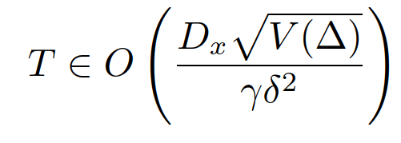
Query Complexity
Using this block-encoding strategy for the gradient we can use qubitization to simulate the Liouvillian.
Under Eigenstate thermalization hypothesis, time required to reach microcanonical dist is [Short Popescu Winter Linden, 2006]
$γ$ is the spectral gap of the Liouvillian operator
$δ$ is the error in the equilibrium dist.

Slide 16
How do you compute gradients
Assume F is unitary.
Amplitude AA: eigenvalues $e^{±i\sin^{−1}\left(\sqrt{Pr⁡(0)}\right)}$
Using Quantum Signal Processing transform this to $e^{iPr(0|x)}$.
Gradient can be approximated via $e^{iPr\left(0 | x+δ\right)/2δ}e^{−iPr(0|x−δ)/2δ}$
We then can use a logarithmic block-encoding to estimate gradient .
H
H
$$\operatorname{Pr}\left(0|x\right)=\frac{1+Re\left(⟨ψ\left(x\right)\left|\hat{F}\right|ψ\left(x\right)⟩)\right)}{2}$$
F

Slide 17
Total cost
Using Qubitization to simulate this the number of queries to the block-encoded gradient operator is
This shows that we can find the minimum provided that the variance is small and the Liouvillian is gapped.

Slide 18
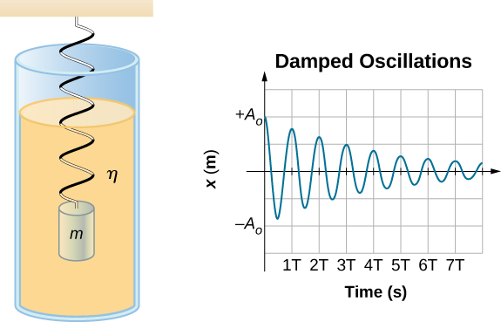
Dissipative Strategy
Same idea but add dissipative Hamiltonian.
$H\left(t\right)=\left(\frac{m\dot{x^{2}}}{2m}+V(x) \right)e^{γt}$
Repeat same analysis for a time dependent Hamiltonian.
Find convergence like gradient descent if locally quadratic.
$O\left(λT log\left(\left|x−x_{0}\right|/ε\right)\right)$ queries to the Hamiltonian

Slide 19
Approach 2: Local Approach
We consider dissipation through a time-dependent H
We want to find the time required to reach the minimum for a strongly convex function using a truncated dyson series sim.

Slide 20
Approach 3: Local Approach with bit oracle
If objective function is given by a bit oracle then we can fast forward the evolution.
This allows us to take advantage of an interaction picture transformation for the time-dependent simulation.
This achieves an enormous difference in the query complexity.
This is exponentially cheaper than a single gradient evaluation.
(Caveat: scaling assumes discretization error negligible)

Slide 21
Conclusion
For a long time I was terrified about the complexity of variational algorithms.
Gradient calculation is fundamentally a bottleneck.
We can sidestep this cost and do whole evolution on QC.
We solve problem using thermal state preparation methods and frictional forces.
Out of the box approaches can deal with some of the problems facing QML.
Variational algorithms are not necessarily dead, but we still need a killer application.

Slide 22
Linear Combinations of Unitaries
Goal: Show $e^{−iHt}$ can be simulated by adding unitary matrices together.
$e^{−iHt}=1−iHt−\frac{H^{2}t^{2}}{2}+⋯$
Linear Combinations of unitaries gives a way to implement a sum of unitary matrices.
Eg: Pauli operators are unitary and easy to implement.
The sum of unitary matrices in not necessarily unitary.
The idea is to block-encode the sum in a larger unitary.
$$U+V+⋯$$ | ?
? | ?
$$\left|ψ\right\rangle ↦\left[\begin{matrix}|ψ⟩ \\ 0\end{matrix}\right]$$
$$U_{U+V+ ⋯}≔$$

Slide 23
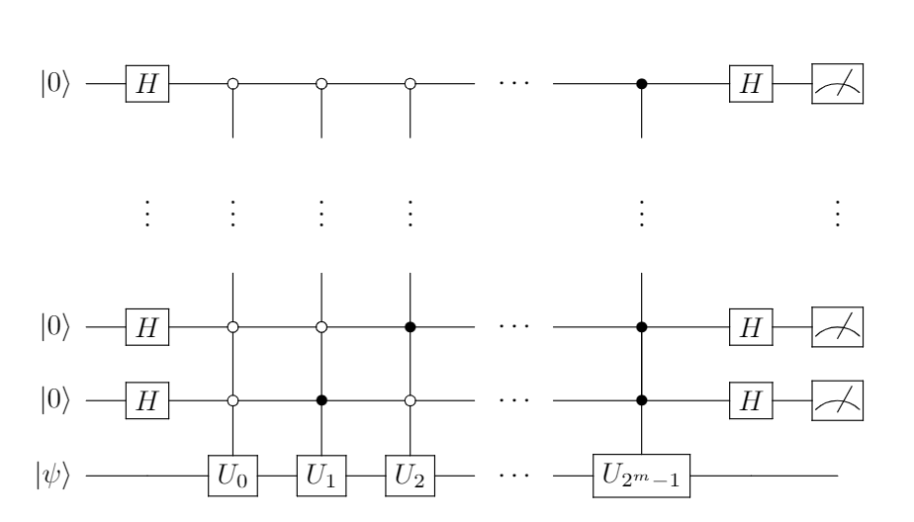
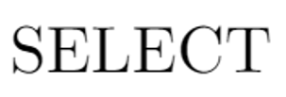
Specific Example: Adding Unitary Matrices
If you measure $0⋯00$ then
$$\left| ψ\right\rangle →\frac{\left(U_{0}+U_{1}+⋯+U_{2^{m}−1}\right)\left|ψ\right\rangle }{|\left(U_{0}+U_{1}+⋯+U_{2^{m}−1}\right)\left|ψ\right\rangle |}$$
If sum of unitaries is approximately unitary,
probability of success can be boosted to 1 using amplitude amplification.
If $B=\sum_{j}{α_{j}}U_{j}$, $U_{prep}\left|0\right\rangle =\sum_{j}{\sqrt{α_{j}}\left|j\right\rangle }, U_{select}\left|j\right\rangle \left|ψ\right\rangle =\left|j\right\rangle U_{j}|ψ⟩$ then
$$U_{B}={\left(U_{prep}⊗1\right)}^{−1}U_{select}\left(U_{prep}⊗1\right)$$

Slide 24
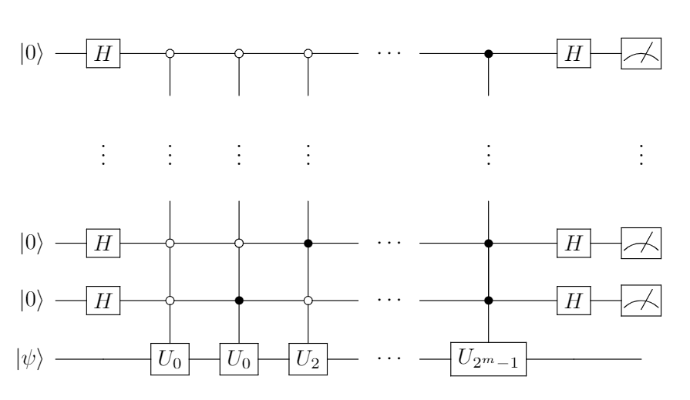
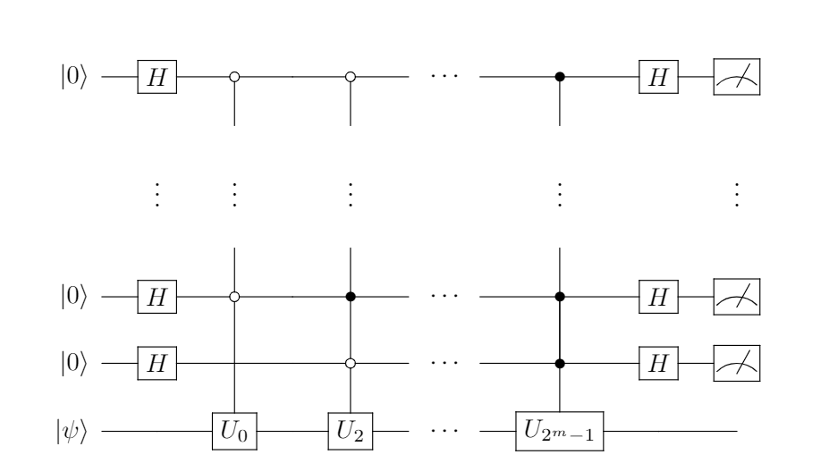
LCU as a Monte Carlo Analogue
Imagine $U_{0} = U_{1}$
$$\left| ψ\right\rangle →\frac{\left({2U}_{0}+U_{2}+⋯+U_{2^{m}−1}\right)\left|ψ\right\rangle }{|\left({2U}_{0}+U_{2}+⋯+U_{2^{m}−1}\right)\left|ψ\right\rangle |}$$
You can imagine this as drawing a unitary uniformly.
Select then looks up the value of j on the CDF and applies it to the state in superposition.
Like Monte-Carlo, cost does not depend on dimension if CDF lookup is efficient.
Simulation cost scales with sum of amplitudes.
Cumulative
Amplitude Sum
j

Slide 25
Truncated Dyson Series
We can really do pretty much anything with LCU, so why not simulate a time-dependent Hamiltonian?
$H\left(t\right)=\sum_{j}{a_{j}\left(t\right)U_{j}}$.
For simplicity, assume j=1, $H(t)$is unitary, differentiable and $SELECT\left|t\right\rangle \left|ψ\right\rangle =|t⟩H\left(t\right)|ψ⟩$
$U_{sim}\left(t\right)=1−i\int_{0}^{t}{H\left(t^{′}\right)dt^{′}} −\int_{0}^{t}{\int_{0}^{t^{′}}{H\left(t^{′}\right)H\left(t^{′′}\right)dt^{′′}dt^{′}} }+⋯$
If we truncate at order K, the error is $O(t^{K}/K!)$.
Number of bits needed scale logarithmically with derivatives.
Queries needed are independent of derivatives.

Slide 26
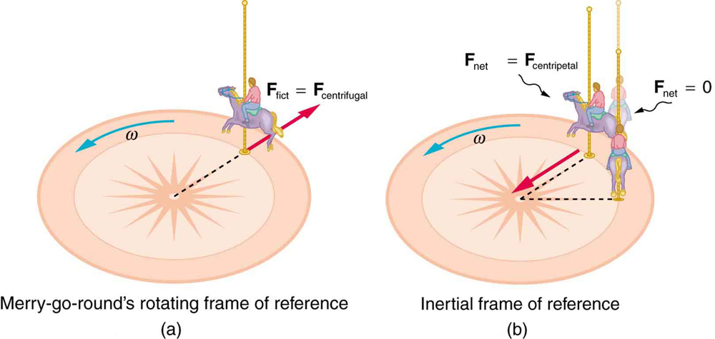
Interaction Picture Simulation
This actually can give a great way to simulate a time-independent Hamiltonian by transforming to an interaction frame.
$H = a_{big}U_{0}+a_{small}U_{1}$
$\left|ψ\left(t\right)\right\rangle ≔e^{−ia_{big}U_{0}t}|ψ_{I}\left(t\right)⟩$.
Evaluating the Schrodinger equation leads to the following DE:
$∂_{t}\left|ψ_{I}\left(t\right)\right\rangle =−ia_{small}\left(e^{ia_{big}U_{0}t}U_{1}e^{−ia_{big}U_{0}t}\right)|ψ_{I}\left(t\right)⟩$.
Cost becomes independent (up to additive logarithms) of $a_{big}‼‼‼!$

Slide 27
Qubitization
Goal: Build a simple walk operator that is equivalent to $e^{−iHt}$
The oracles used in LCU can also be used to build a quantum walk.
For simplicity, assume SELECT is unitary and Hermitian.
The idea is to repeat the exact same reasoning as was used in Grover.
$|1⟩$
$$W=$$

Slide 28
Reflection Operations
Let $E_{k}$ be an eigenvalue of $H=\sum_{j}{α_{j}U_{j}}, λ=\sum_{j}{{|α}_{j}|}$
$$\left(SELECT −\frac{E_{k}}{λ}\right)\left|α\right\rangle |E_{k}⟩$$
$$\left|α\right\rangle |E_{k}⟩$$
$|1⟩$

Slide 29
Reflection Operations
Let $E_{k}$ be an eigenvalue of $H=\sum_{j}{α_{j}U_{j}}, λ=\sum_{j}{{|α}_{j}|}$
$$\left(SELECT −\frac{E_{k}}{λ}\right)\left|α\right\rangle |E_{k}⟩$$
$$\left|α\right\rangle |E_{k}⟩$$
$|1⟩$
Eigenvalues are arccos of phase!
Can be fixed using quantum
Signal processing.

