Slide 1





Graybox Quantum System Identification and Control
8th International Conference on
Quantum Techniques in Machine Learning
University of Melbourne | Melbourne, Australia | 25-29 November 2024
Dr. Akram Youssry
Quantum Photonics Laboratory and Centre for Quantum Computation and Communication Technology
RMIT University | Melbourne, Australia

Slide 2
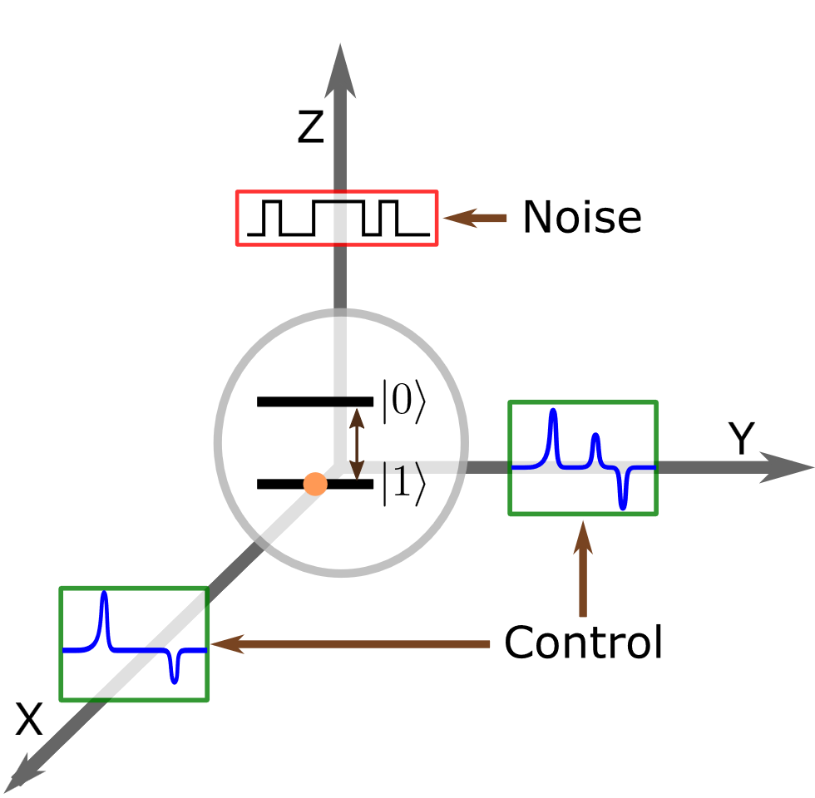
Quantum Control
Find optimal pulses to implement a desired gate G
Optimize a cost function that captures the system dynamics

Slide 3







Quantum Control Methods
Model-Free
Direct Optimization [1-2]
Reinforcement Learning [2-3]
Model-Based
Whitebox
Graybox
Blackbox
Data-Driven
[1] N. Khaneja, et al., J. Magn. Reson. 172, 296 (2005).
[2] X. dong Yang, et al. Physical Review A 102, 062605 (2020).
[2] V. Sivak et al., Physical Review X 12, 011059(2022)
[3] L. Giannelli et al., Physics Letters A 434, 128054(2022).
Notes:
Data-Driven means based on measurements as opposed to expert-based such as DD and CPMG
Model-free: no equation oibrained for I/O or dynamics, just find the solution
Robot in environment and trying to navigate
Direct optimization: calculate fidelity in the fly experimentally then its gradient
RL: use an NN to find actions to maximize a reward
Model-Based: get an equation relating I/O and/or dynamics
Control is two stages: model identification then put in aqn optimization loop replacing the experiment

Slide 4
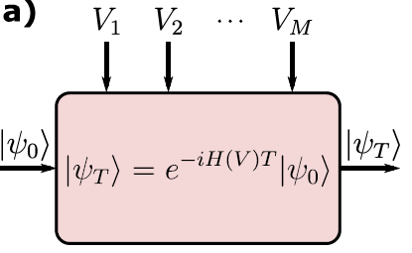
Identification - Whitebox
Curve-fitting / Parameter estimation
Full Physics picture
Device​
A Youssry et al., npj Quantum Information 10 (9) 2024.
Notes:
Two sets of laws
Fit the first
Hamiltonian uncertainities

Slide 5
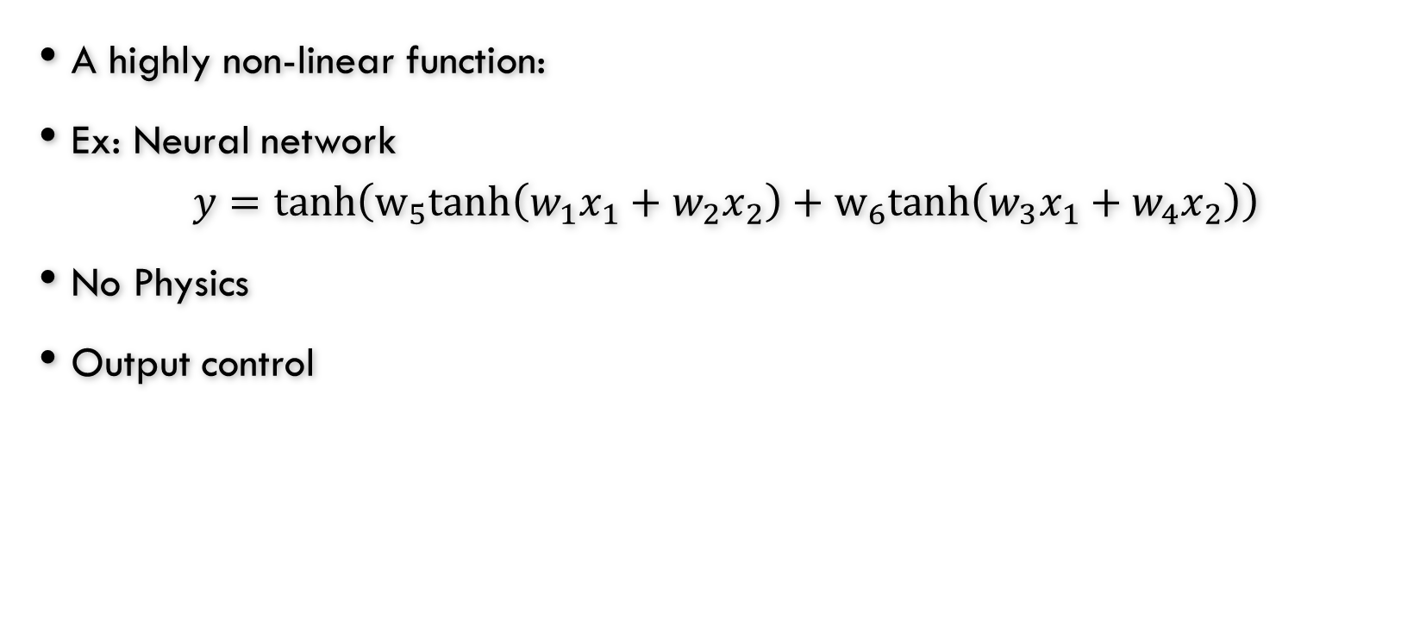
Identification - Blackbox
A highly non-linear function:
Ex: Neural network
$$y=\tanh\left(w_{5}tanh\left(w_{1}x_{1}+w_{2}x_{2}\right)+w_{6}tanh\left(w_{3}x_{1}+w_{4}x_{2}\right)\right)$$
No Physics
Output control
Device​

Slide 6
Identification - Graybox
Best of the two worlds!
How much Black vs White?
Device​
A Youssry et al., npj Quantum Information 10 (9) 2024.
Notes:
-- set of equations that do not changes
-- set of equations we don’t care about
-- This approach has been developed a long time ago in classical control engineering, we were first to apply in quantum back in 2018 with the advance of auto-differentiation methods such tensorflow

Slide 7




Graybox Research Timeline
2018:
Photonic system (time-independent unitary evolution) [1]
2019:
Characterization of open quantum systems [2]
2020:
Noise Detection with a spectator [3]
2022:
Control of qubit in an unknown non-Markovian quantum bath [5]
2024:
Experimental implementation for a photonic system [6]
2024:
Quantum control in strongly-coupled Non-Markovian Noise [7]
2020:
Geometric Gate Synthesis [4]
[1] A Youssry, RJ Chapman, A Peruzzo, C Ferrie, M Tomamichel, Quantum Science and Technology, 5 (2).
[2] A Youssry, GA Paz-Silva, C Ferrie, npj Quantum Information 6 (1).
[3] A. Youssry, GA Paz-Silva, and C Ferrie, New Journal of Physics 25 (7), 073004
[4] E. Perrier, D. Tao, and C. Ferrie, NewJournal of Physics 22, 103056 (2020).
[4] A Youssry, HI Nurdin, Quantum Science and Technology, 8 (1).
[5] A Youssry, Y. Yang, R. J. Chapman, B. Haylock, F. Lenzini, M. Lobino, and A. Peruzzo, npj Quantum Information 10 (9) 2024.
[6] A Auza, A Youssry, GA Paz-Silva, A Peruzzo arXiv:2404.19251

Slide 8
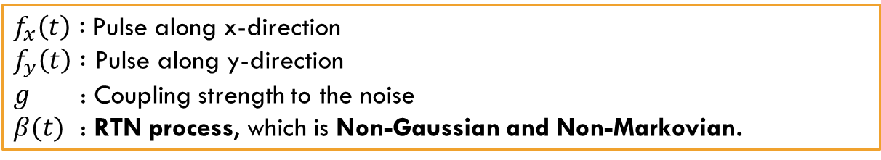
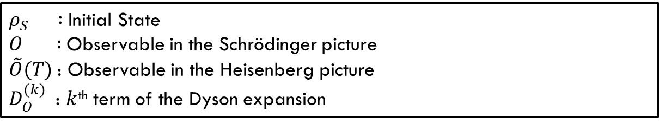

Quantum Control in the presence of strongly coupled non-markovian noise
A Auza, A Youssry, GA Paz-Silva, A Peruzzo arXiv:2404.19251
$$H\left(t\right)=f_{x}\left(t\right)σ_{x}+f_{y}\left(t\right)σ_{y}+gβ\left(t\right)σ_{z}$$
$f_{x}\left(t\right) :$Pulse along x-direction
$f_{y}\left(t\right) :$ Pulse along y-direction
$g$ : Coupling strength to the noise
$β(t)$ : RTN process, which is Non-Gaussian and Non-Markovian.
$$𝔼{\left\{O(T)\right\}}_{ρ}=Tr\left[\sum_{k=0}^{N}{\frac{𝒟_{O}^{\left(k\right)}\left(T\right)}{k!}ρ\tilde{O}(T)}\right]$$
$ρ_{S} :$Initial State
$O :$Observable in the Schrödinger picture
$\tilde{O}(T)$: Observable in the Heisenberg picture
$D_{O}^{(k)}$: $k$^{th} term of the Dyson expansion

Slide 9
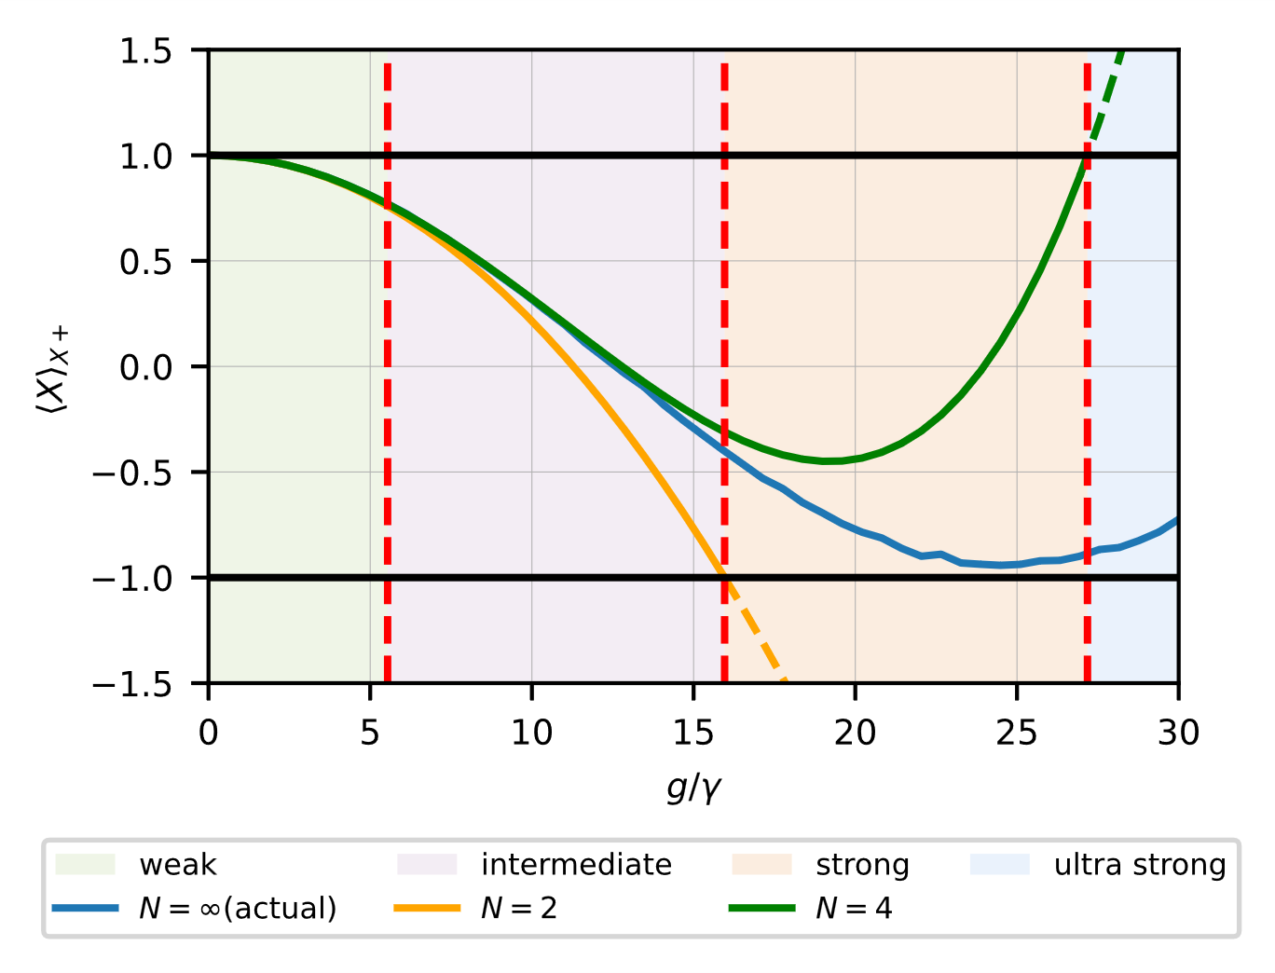
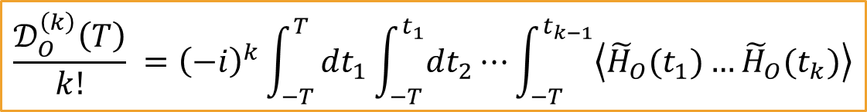
Quantum Control in the presence of strongly coupled non-markovian noise
A Auza, A Youssry, GA Paz-Silva, A Peruzzo arXiv:2404.19251
$$\frac{𝒟_{O}^{\left(k\right)}\left(T\right)}{k!} ={\left(−i\right)}^{k}\int_{−T}^{T}{dt_{1}\int_{−T}^{t_{1}}{dt_{2}⋯}\int_{−T}^{t_{k−1}}{\left\langle {\tilde{H}}_{O}(t_{1})…{\tilde{H}}_{O}(t_{k})\right\rangle }}$$
If noise is known (unlikely)
  calculation is intractable
If noise is unknown
  Estimated experimentally (even more difficult)
We limit the expansion to second order
  Dynamical Decoupling, Filter functions, quantum noise spectroscopy, etc.
This fails for strongly-coupled noise ☹

Slide 10
Quantum Control in the presence of strongly coupled non-markovian noise
A Auza, A Youssry, GA Paz-Silva, A Peruzzo arXiv:2404.19251
$$𝔼{\left\{O(T)\right\}}_{ρ}=tr\left(V_{O}(T)U_{ctrl}\left(T\right)ρ\left(0\right){U_{ctrl}\left(T\right)}^{†}O\right)$$
Step 1
Step 2:
Step 3:
Step 4:
Create Dataset: { (control pulses, observables) }
Train the GB model: minimize prediction error over training dataset
Test the GB model: Predict measurements given new voltages
Use GB to find optimal controls
Test experimentally the obtained controls

Slide 11
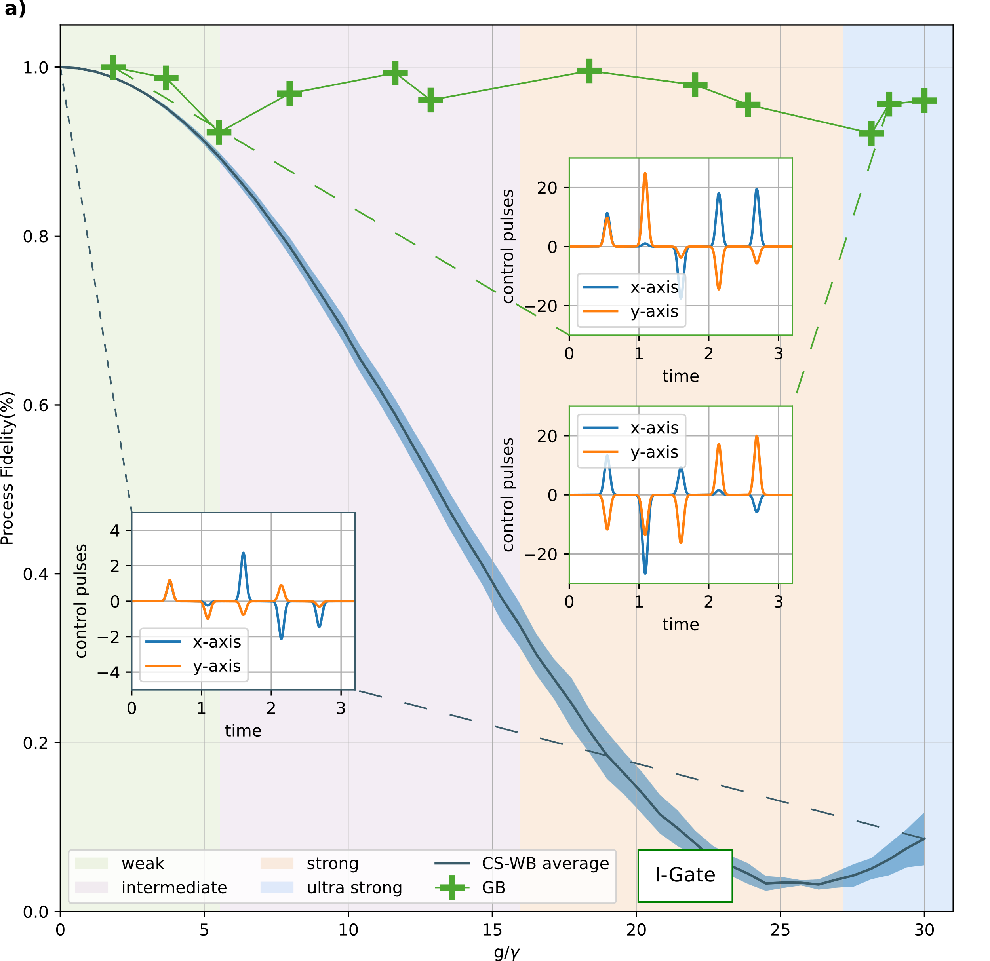
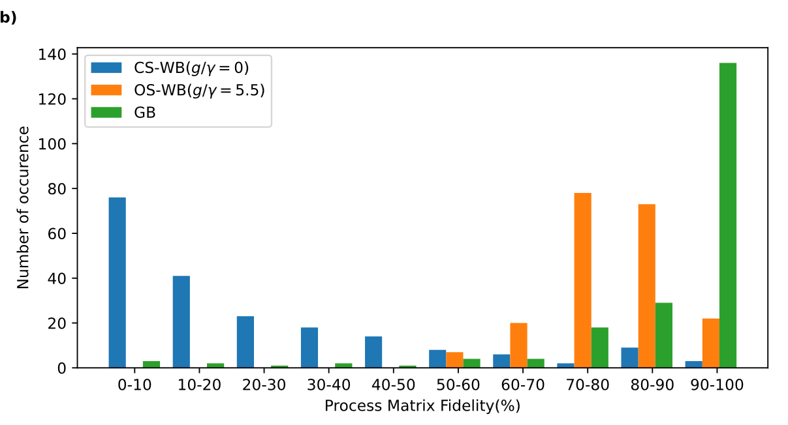
Quantum Control in the presence of strongly coupled non-markovian noise
A Auza, A Youssry, GA Paz-Silva, A Peruzzo arXiv:2404.19251

Slide 12
Experimental Graybox for a photonic circuit
A Youssry et al., npj Quantum Information 10 (9) 2024.

Slide 13
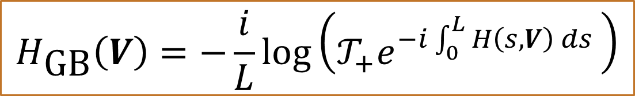

Experimental Graybox for a photonic circuit
A Youssry et al., npj Quantum Information 10 (9) 2024.
$$\vec{z}$$
$$H\left(V\right)→H\left(z, V\right):\left[H\left(z_{1},V\right), H\left(z_{2},V\right)\right]≠0$$
$$U\left(V\right)=𝒯_{+}e^{−i\int_{0}^{L}{H\left(s, V\right) ds} }≡e^{−i H_{GB}\left(V\right)L}$$
$$H_{\text{GB}}\left(V\right)=−\frac{i}{L}log\left(𝒯_{+}e^{−i\int_{0}^{L}{H\left(s, V\right) ds} }\right)$$

Slide 14


Summary
Identification:
  Whitebox: Full Physics
  Blackbox: No Physics
  Graybox: Selectable Physics
Control an extremely noisy device using Graybox
Learn unknown physics of a device using Graybox
Challenges:
  Dataset collection (experiment versus simulations)
  Computational efficiency
Next: Graybox for qudits [Poster 251 by Yule Mattiaccio]
A Auza, A Youssry, GA Paz-Silva, A Peruzzo arXiv:2404.19251
A Youssry et al., npj Quantum Information 10 (9) 2024.

Slide 15
Acknowledgements
Thanks to my colleagues and collaborators: Arinta Auza, Gerardo Paz-Silva Yang Yang, Robert J. Chapman, Ben Haylock, Francesco Lenzini, Mirko Lobino, Alberto Peruzzo, Hendra Nurdin, Yule Mayevsky-Mattiaccio, Ritik Sareen, Chris Ferrie, Marco Tomamichel.

Slide 16
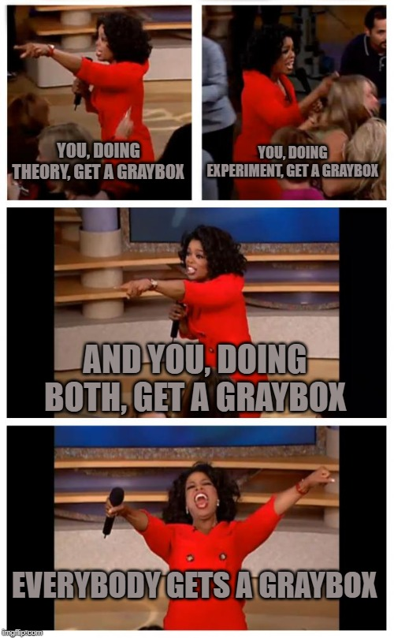
Take Home Message

Slide 17

Thanks
☺ ☺ ☺

