Slide 1
Exact spectral gaps of random one-dimensional quantum circuits
By Andrew Deneris
In collaboration with P. Bermejo, P. Braccia, L. Cincio, M. Cerezo
November 25th 2024
arXiv:2408.11201
LA-UR-24-32357
Notes:
Things to do:
Define eta
Pick how to express the commutant and the space that A acts on
Read through paper and make sure you understand everything

Slide 2
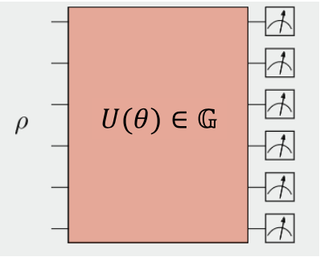
Random quantum circuits
Random quantum circuits such as $U$ sampled from a group $𝔾$ have many applications to:
Quantum Chaos
Entanglement Transitions
Variational Quantum Algorithms
Error Mitigation…
However they are difficult to implement in a quantum circuit and could be prohibitively expensive.
We focus on a more realistic architecture.
$$U∈𝔾$$
Notes:
Their study has allowed researchers to find experiments
capable of achieving a quantum advantage by offering
classically hard-to-simulate sampling experiments, providing insights into quantum chaos and entanglement
transitions, as well as improving the study
of the trainability of variational quantum algorithms and error mitigation techniques

Slide 3
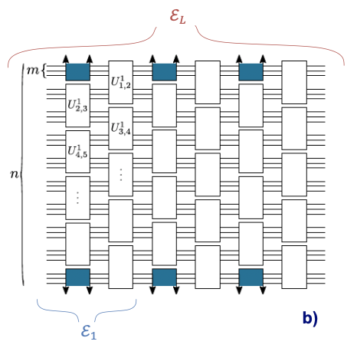
Random quantum circuits
Locally random unitaries, $U_{j, j′}^{l}$ sampled i.i.d. from a group $G$ acting on alternating groups of $m$ qudits of dimension $d$ (e.g. $d=2$ for qubits) in a brick-like fashion.
We let $η=\frac{n}{m}∈ℕ$.
Colored gates are removed (added) for open (closed) boundary conditions.
$$U=\prod_{l}{\prod_{j,j′}{U_{j,j^{′}}^{l}}}$$
True random quantum circuit
Structure used in this work
Notes:
Their study has allowed researchers to find experiments
capable of achieving a quantum advantage by offering
classically hard-to-simulate sampling experiments, providing insights into quantum chaos and entanglement
transitions, as well as improving the study
of the trainability of variational quantum algorithms and error mitigation techniques

Slide 4
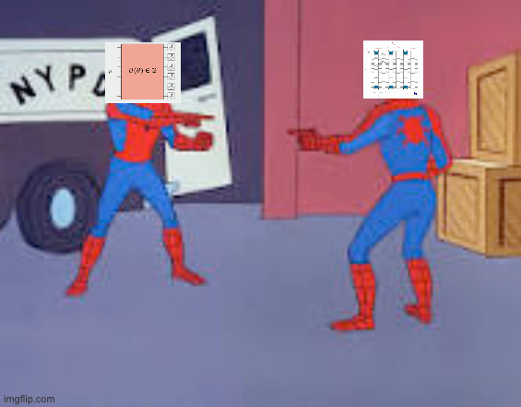
Random quantum circuits
We consider the cases when $G=𝕌\left(d^{2m}\right), 𝕆(d^{2m})$ and $𝕊ℙ\left(\frac{d^{2m}}{2}\right)$.
The brick-like circuit forms a distribution of unitaries: $ℇ_{L}$.
As $L→∞$, $ℇ_{L}$ converges to some group $𝔾⊆𝕌(d^{n})$.
We ask the question: at what $L$does the distribution $ℇ_{L}$ form an $ε$-approximate 2-design over the group $𝔾$?
True random quantum circuit
Structure used in this work

Slide 5
Moment operators
The 2nd moment operators of $𝔾$ and $ℇ_{L}$ are $d^{4n} ×{ d}^{4n}$ matrices defined as:
We can decompose $𝒯_{ℇ_{L}}^{(2)}$ into a product of local moments, which can be analytically studied via Weingarten calculus.
$$\int_{ℰ_{L}}{dU}U^{⨂2} ⨂{{ (U}^{∗})}^{⨂{2}}→\prod_{l}{\prod_{j,j^{′}}{\int_{G}{dU_{j,j^{′}}^{l}}{\left(U_{j,j^{′}}^{l}\right)}^{⊗2}}}⊗{\left({U_{j,j^{′}}^{l}}^{∗}\right)}^{⊗2}$$
Which implies that
$$𝒯_{ℰ_{L}}^{(2)}→\prod_{l}{\prod_{j,j^{′}}{𝒯_{G}^{(2)}}}$$
$𝒯_{𝔾}^{(2)}=\int_{𝔾}{dμ} U^{⨂2} ⨂{{ (U}^{∗})}^{⨂2}$ and $𝒯_{ℇ_{L}}^{(2)}=\int_{ℰ_{L}}{dU} U^{⨂2} ⨂{{ (U}^{∗})}^{⨂2}$.
Notes:
Unitaries of $ℇ_{L}$ might not form a group or dU might not be the haar measure

Slide 6
Spectral gaps
The spectral gap is given by:
Here we equivalently define it as the absolute value of the largest non-one eigenvalue of $𝒯_{ℇ_{L}}^{(2)}$.
If the spectral gap is less than a given $ε$, then we can say that $ℇ_{L}$ forms an $ε$-approximate 2-design over $𝔾$.
${\left|𝒯_{ℇ_{L}}^{(2)}− 𝒯_{𝔾}^{(2)}\right|}_{∞}$.

Slide 7
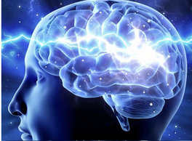
Dealing with local moment operators
While the circuit $U$ is not Haar random, each local gate is, so we can use Weingarten calculus to evaluate each $𝒯_{G}^{(2)}$
$$𝒯_{ℰ_{L}}^{(2)}→\prod_{l}{\prod_{j,j^{′}}{𝒯_{G}^{(2)}}}$$
And the question now becomes how to study this product:
Theoretically: finding bounds via statistical mechanics tools.
Numerically: Monte Carlo, tensor networks.
Our approach: exact computation!
Braccia, Paolo, et al. "Computing exact moments of local random quantum circuits via tensor networks." arXiv:2403.01706 (2024).
Notes:
Unitaries of $ℇ_{L}$ might not form a group or dU might not be the haar measure

Slide 8
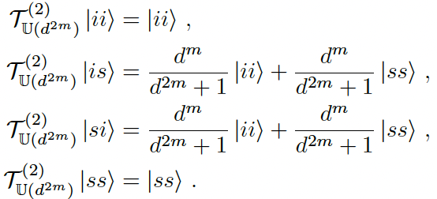
Theoretical results (open boundaries)
Local Group: $G=𝕌(d^{2m})$
Global Group: $𝔾=𝕌(d^{n})$
2nd order moment operator projects into the 2nd order commutant of the group:
Due to the brick-like structure we act on a set spanned by the basis .
Then based off the definition of the moment operator we have:
Notes:
Should that be ii and ss?

Slide 9
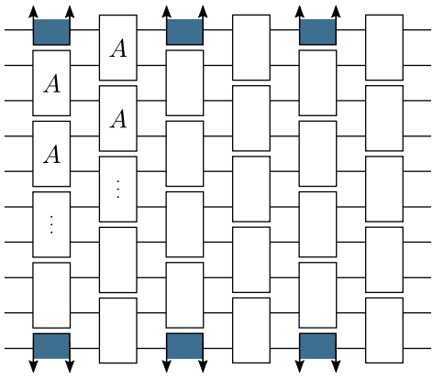
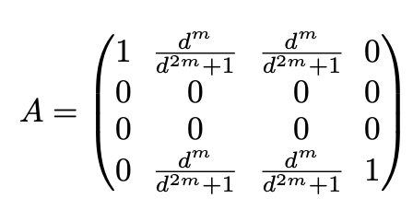
Theoretical results (open boundaries)
Local moment operator given by $A$ in the basis of the commutant.
We can focus on the 2nd moment operator over a single layer of the circuit since $𝒯_{ℇ_{L}}^{(2)}={\left(𝒯_{ℇ_{1}}^{(2)}\right)}^{L}$.
Following standard procedures we substitute $A$ in for every local unitary of $ℇ_{1}$.
This gives us a matrix of size $2^{η} ×{ 2}^{η}$.
Notes:
Derive A, explain basis, relate to Paolo’s talk and mention how we take extra steps

Slide 10
What we’ve done so far
We have the local moment operator, $A$.
We can then substitute this in for every local unitary to form $𝒯_{ℰ_{L}}^{(2)}$.
$$𝒯_{ℰ_{L}}^{(2)}→\prod_{l}{\prod_{j,j^{′}}{A}}$$

Slide 11
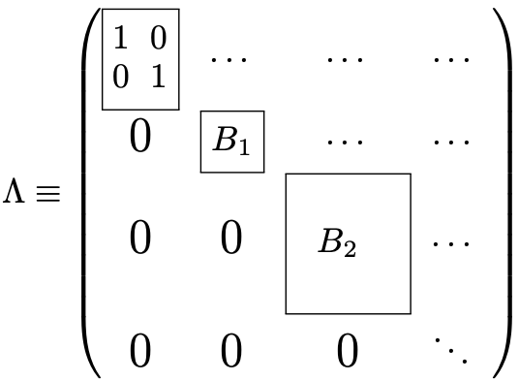
Dimensionality reductions
We then find that the operator projects into a basis of size $2^{\frac{η}{2}}$ and can be represented by $Λ$.
Notes:
We start with a matrix of size $2^{4n} ×2^{4n}$ then get to $2^{η} ×2^{η}$

Slide 12
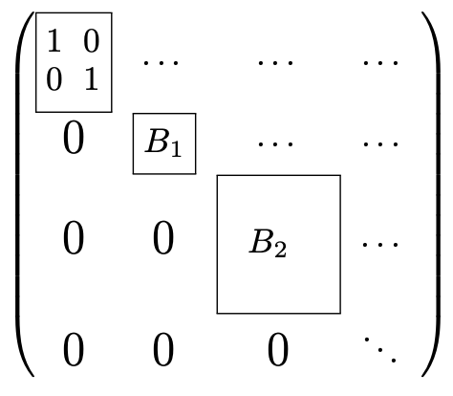
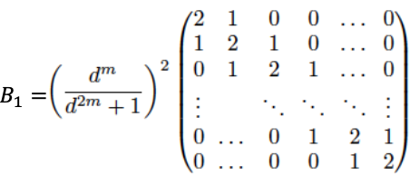
Dimensionality reductions
The block triangular form of $Λ$ tells us that its eigenvalues are exactly those of the diagonal blocks.
We prove that the spectral gap (the largest non-one eigenvalue of $𝒯_{ℇ_{L}}^{(2)}$) is simply the largest eigenvalue of $B_{1}$.
tridiagonal Toeplitz!!
Notes:
High light “tridiagonal Toeplitz”

Slide 13
Theoretical results (open boundaries)
Due to the tridiagonal Toeplitz structure, the eigenvalues of $B_{1}$ have exact formulas with the largest given by:
Theorem 1: The spectral gap of the distribution, $ℇ_{L}$, is exactly ${\left(λ_{max}^{(n)}\right)}^{L}$ and thus the circuit formed by $ℇ_{L}$ will become an 𝜀-approximate 2-design of $𝕌(2^{η})$ when the number of layers is
$λ_{max}^{(n)}={\left(\frac{d^{m}}{d^{2m}+1}\right)}^{2}\left[2+2 cos\left(\frac{2π}{η}\right)\right]$.
$L≥\frac{[n log\left(d\right)+log\left(\frac{1}{ε}\right)]}{\left[2\log\left(\frac{d^{2m}+1}{d^{m}}\right)−2 log⁡\left(2+2 cos⁡\left(\frac{2mπ}{n}\right)\right)\right]}$.
Notes:
Maybe mention how the number m changes things: sets of m = log(n) is favorable, in general as m increases the scaling gets better

Slide 14
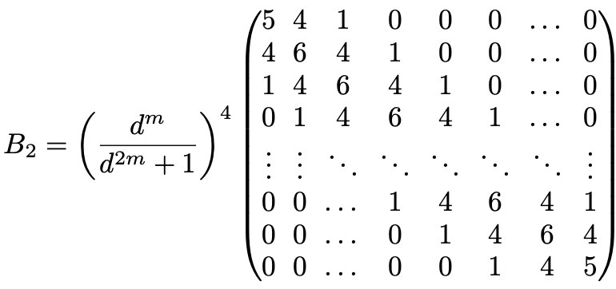
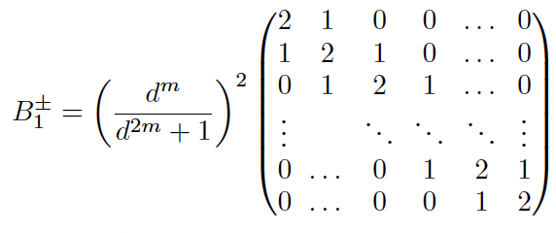
Theoretical results (closed boundaries)
Following a similar process, we find that with closed boundary conditions the matrix of importance is now $B_{2}={B_{1}}^{2}$.

Slide 15
Theoretical results (closed boundaries)
We can now square our equation for open boundaries to get the following formula for closed boundaries:
Theorem 2 [informal]: The number of layers required for the circuit to become an 𝜀-approximate 2-design of $𝕌(2^{η})$ is now halved:
$λ_{max}^{(n)}={\left(\frac{d^{m}}{d^{2m}+1}\right)}^{4}{\left[2+2 cos\left(\frac{2π}{η}\right)\right]}^{2}$.
$L≥\frac{[n log\left(d\right)+log\left(\frac{1}{ε}\right)]}{\left[4\log\left(\frac{d^{2m}+1}{d^{m}}\right)−4 log⁡\left(2+2 cos⁡\left(\frac{2mπ}{n}\right)\right)\right]}$.

Slide 16
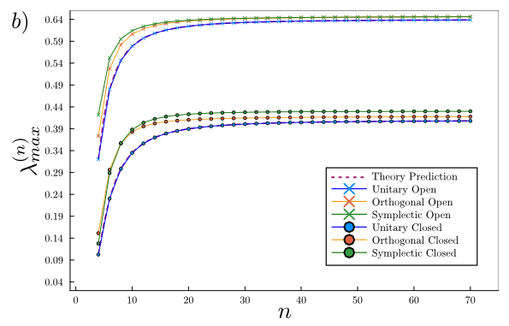
Numerical results
$G= 𝕆\left(4\right), 𝕊ℙ(2)$.
Commutant’s of dimension 3.
Size of $𝒯_{ℇ_{L}}^{(2)}$ becomes larger.
Structure of the matrix breaks down.
Analytical solution becomes more complicated.
We opt to numerically compute the largest non-one eigenvalue of $𝒯_{ℇ_{L}}^{(2)}$ using DMRG.
Spectral gaps for $d=2$ & $m=1$ up to $n=70$ qubits.

Slide 17
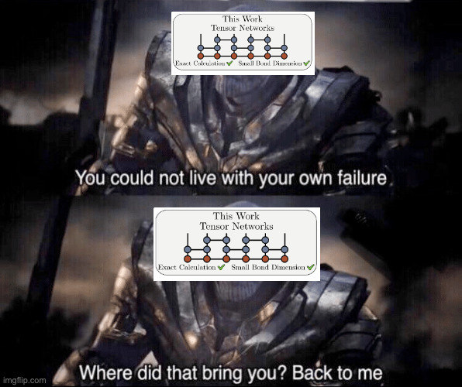
Paolo’s method
Paolo’s method

Slide 18
Conclusion
We recall how to find the matrix representation of the 2nd moment operator of a brick-like circuit.
We provide an exact characterization of the spectral gaps of the circuit when the local group is $G= 𝕌(d^{2m})$.
Bounds based on the one-dimensional spectral gap can be tightened.
We also give a procedure to numerically compute the spectral gap when the local group is $G= 𝕆\left(4\right)$, $𝕊ℙ(2)\text{.}$
We hope that this framework can be extended to higher order designs, other groups and different architectures.

Slide 19
Thanks!
Pablo Bermejo
Paolo Braccia
Lukasz Cincio
Marco Cerezo
We would also like to acknowledge LDRD which funded this work!
Notes:
Mention Summer school, learning memes lol

Slide 20
Questions?
Notes:
Possible question: Huang gets log depth through pseudorandomness whereas we get linear?
Our work can be combined with the results of Huang to get exact formulas and possibly tighter bounds
Our work can be extended to other architectures and groups where the form of the spectral gap is not known
Possible question: What does being an approximate design imply?

